Slide 1

ON TARGET INSTALLS

Slide 2
THE AIM DIFFERENCE
RISK MANAGEMENT
Our single focus is INSTALLATIONS – allowing AIM’s project teams to take complete ownership of our scope and communicate job site conditions – up and down the channel. AIM provides value added solutions for OEM Manufacturers, Factory Reps, Dealers and Operations – As the single point of contract for their installation needs
SCALE
National installation network with 40+ years of experience managing specialty projects in the foodservice industry. Our dedicated teams of project managers and field support technicians, utilize project management software, as well NetSuite (ERP / WMS) to finish projects on time and on budget, we are an EOS operating company.
SOLUTION PROVIDER
Single point of contact coordinating installations for multi-unit chains, new construction projects, and remodels. Specializing in Refrigeration, Ventilation, and unique jobs.

Slide 3
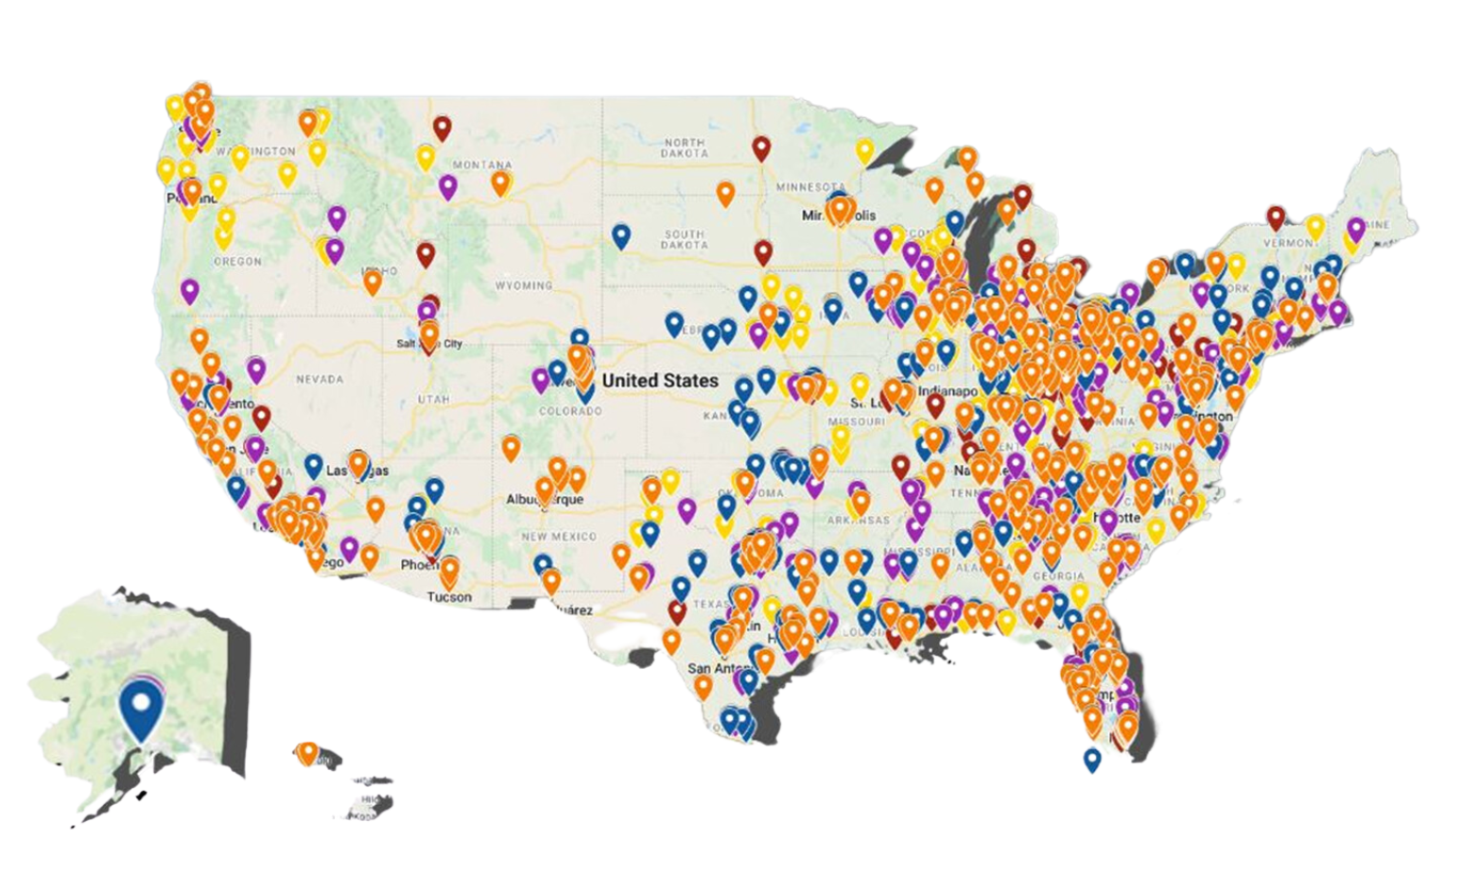
NATIONAL INSTALLATION NETWORK

Slide 4






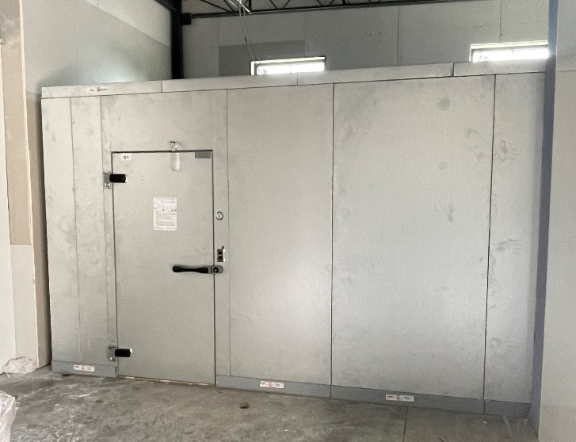
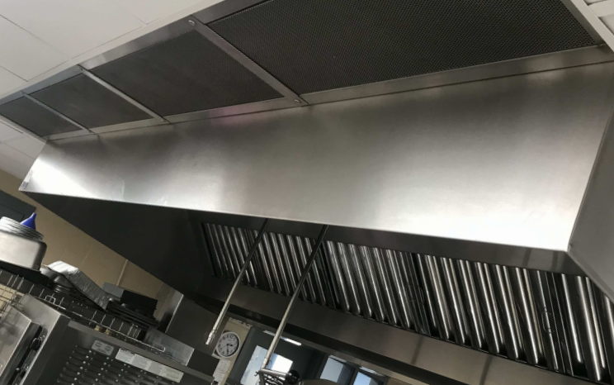
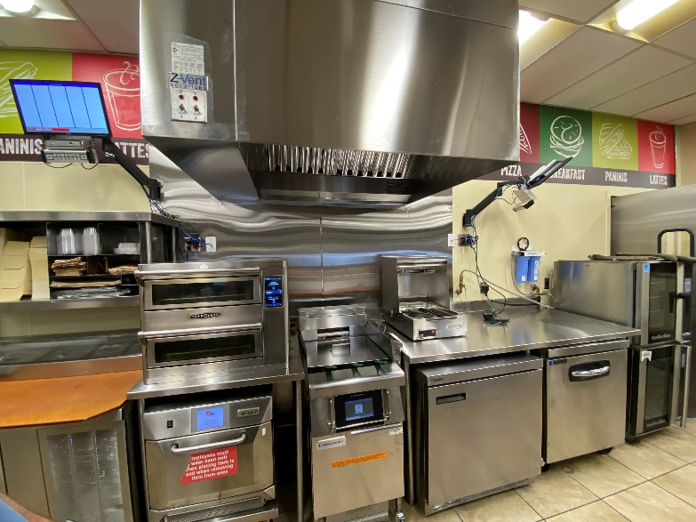
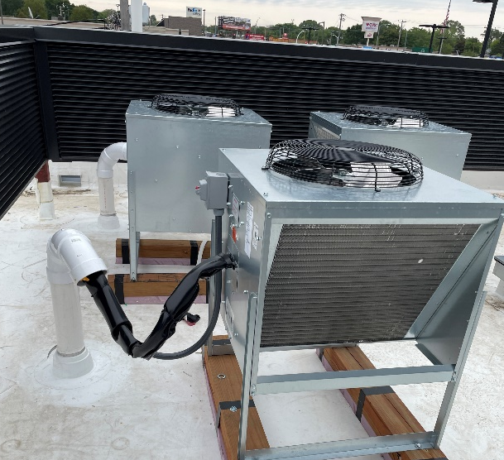
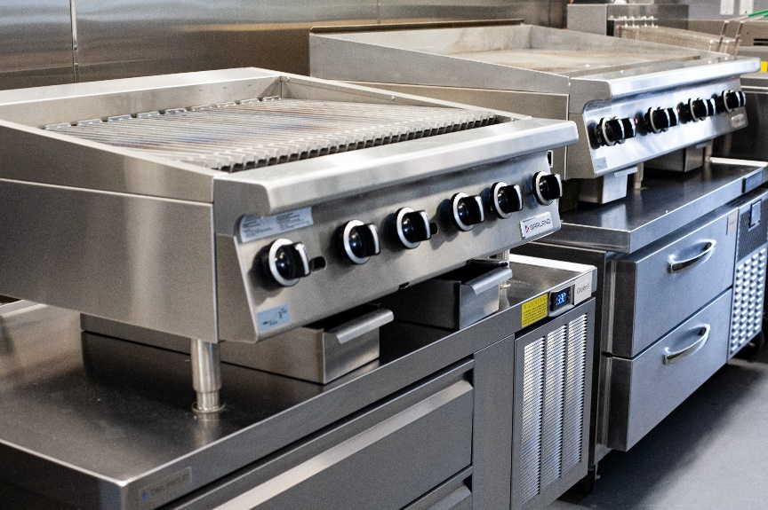
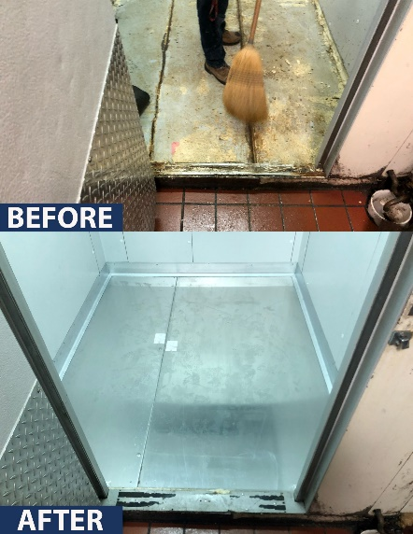
INSTALLATION SERVICES
Refrigeration
Ventilation
Retail
Warewashing
Cooking
Automation

Slide 5
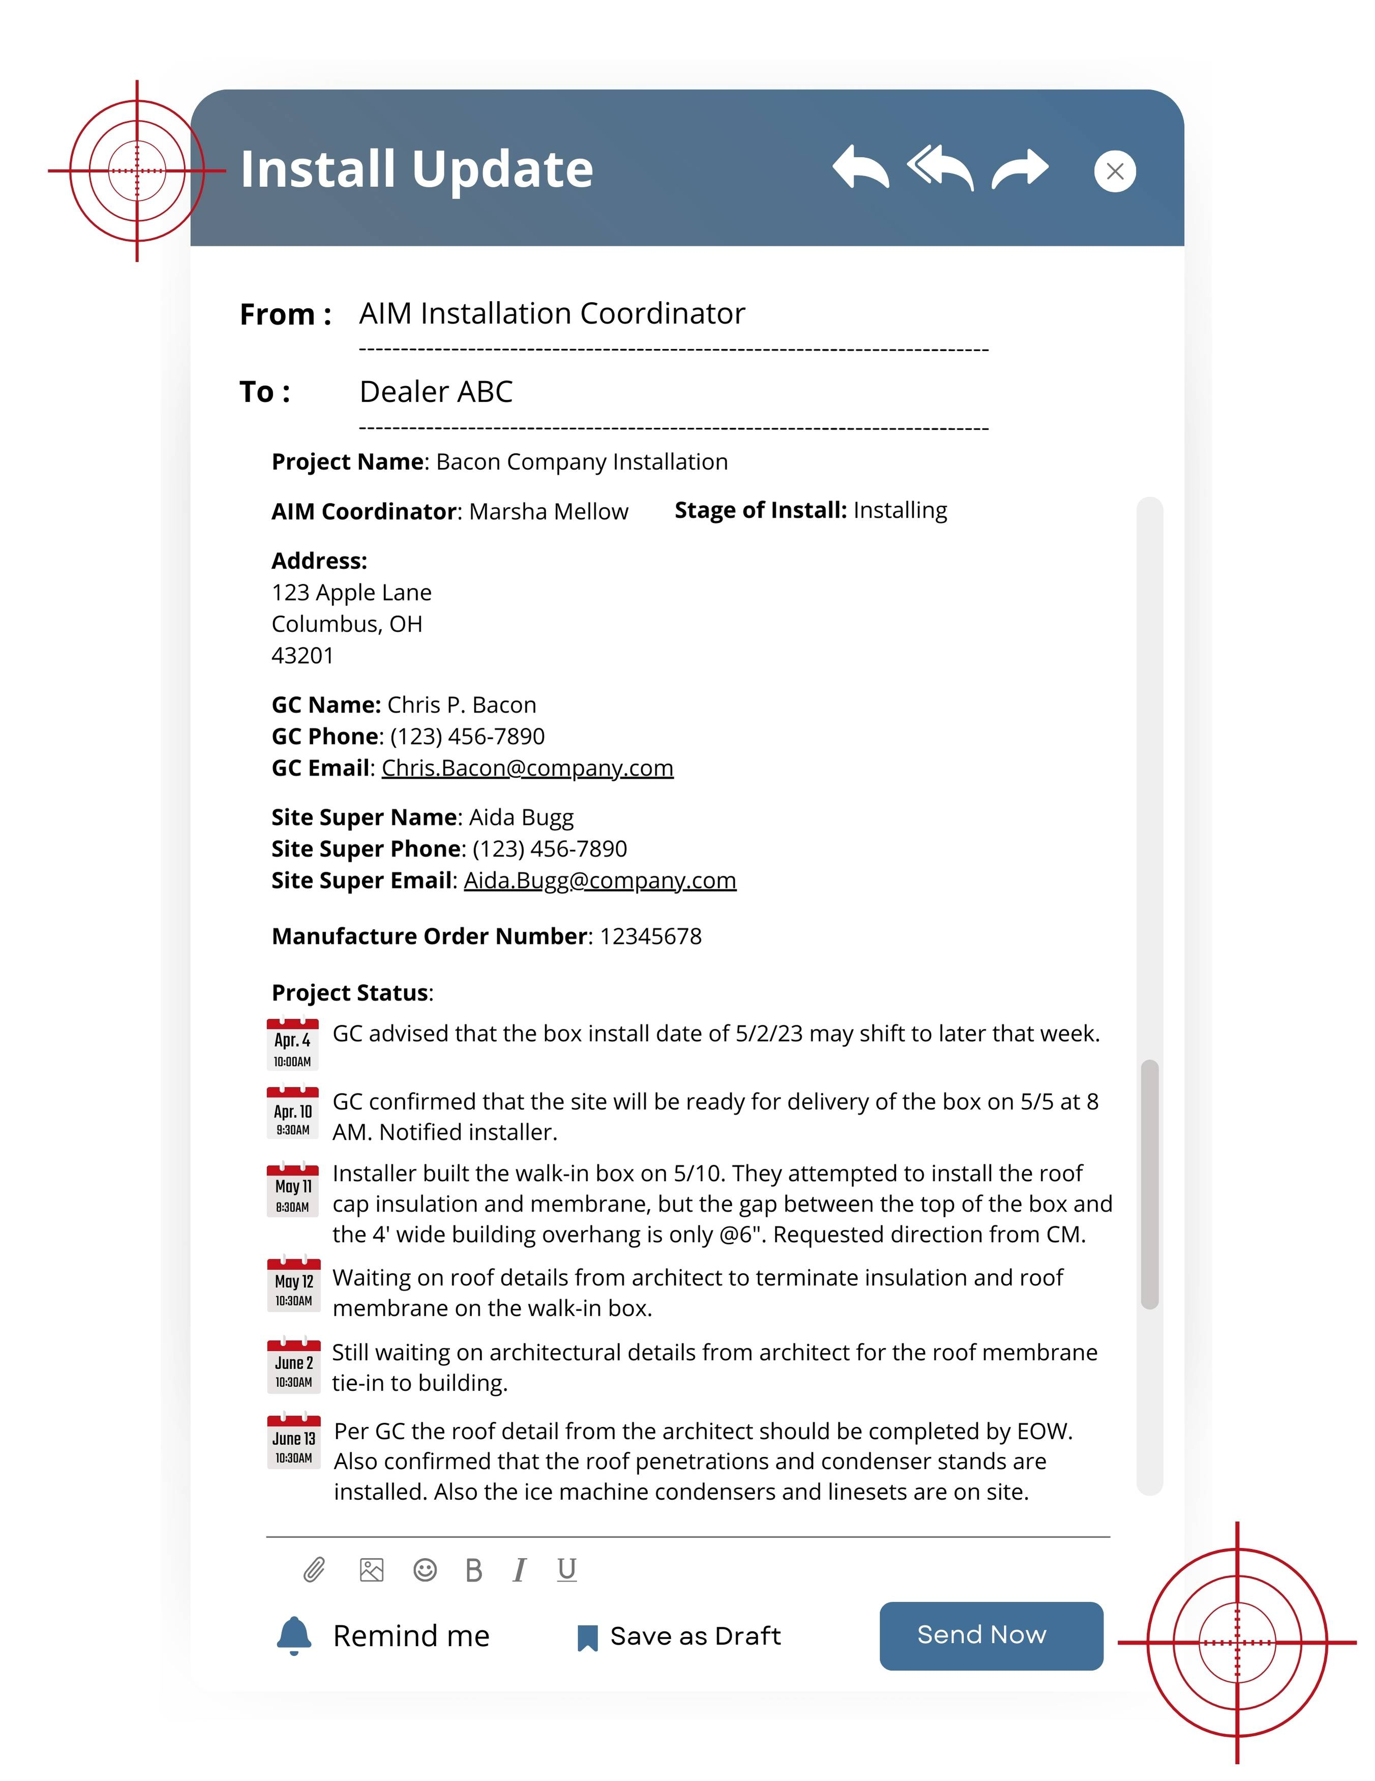
PROJECT UPDATES
OUR PROVEN PROCESS
PROJECT ASSESSMENT
Site survey
Quote for scope of work
EQUIPMENT INSTALLATION
All local permitting completed upfront
Meeting equipment on-site
Project communication with the manufacturer, GC, and dealer
PROJECT COMPLETION
Equipment is set in place and hooked up
Start up
Adjustments

Slide 6
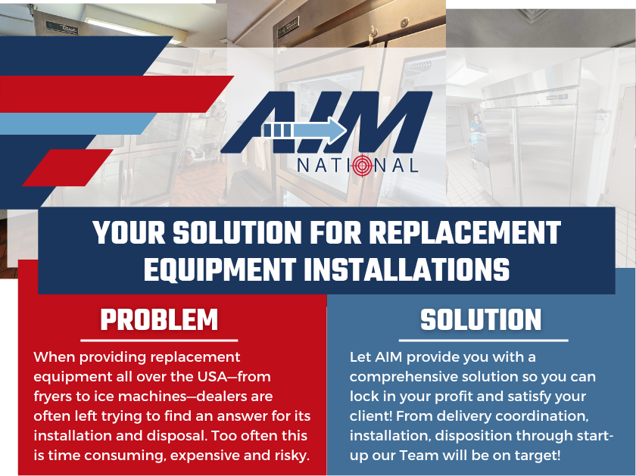
Single Piece Replacement Equipment Installs
Seamless Coordination – We handle delivery logistics to ensure timely arrival
Expert Installation – Skilled technicians install equipment efficiently
Old Equipment Removal – We manage proper disposal, so you don’t have to!
Nationwide Coverage – Reliable service across the U.S.
Fast Turnaround – Minimize downtime and keep operations running smoothly

Slide 7
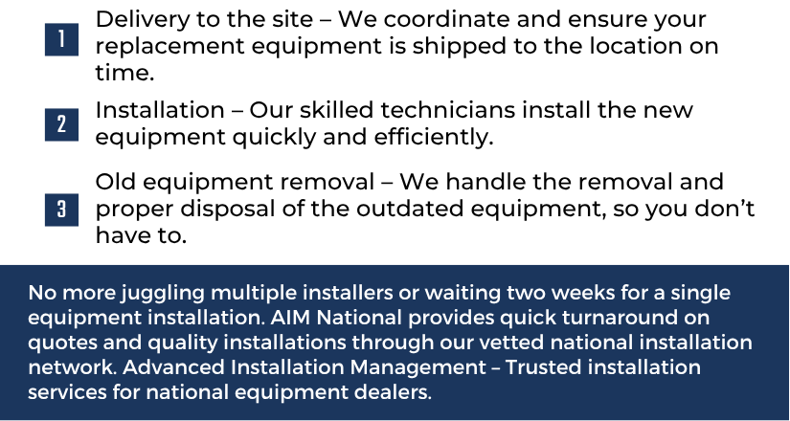
Single Piece Replacement Equipment Installs

Slide 8
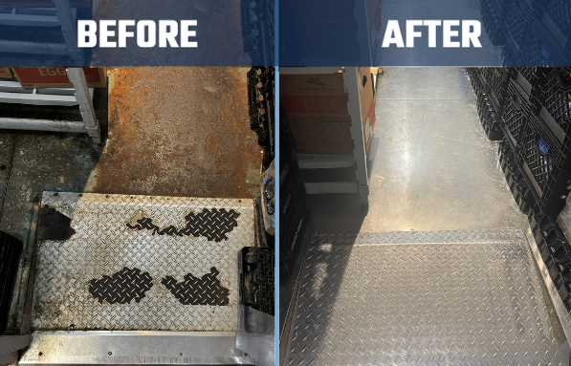


Walk-in Refurbish Program
Have a rusted or delaminated floor?
Restore Instead of Replacing– Upgrade your walk-in cooler or freezer without the cost of a full replacement
Cost-Effective Solution– Extend the life of your equipment while keeping operations running smoothly
What Can Be Refurbished??
DOORS
FLOORS
REFRIGERATION
AIM’s Refurbish Program helps you invest in your business’s future without breaking the bank. It’s the perfect balance of affordability and functionality, ensuring your walk-in cooler or freezer meets your needs for years to come.

Slide 9
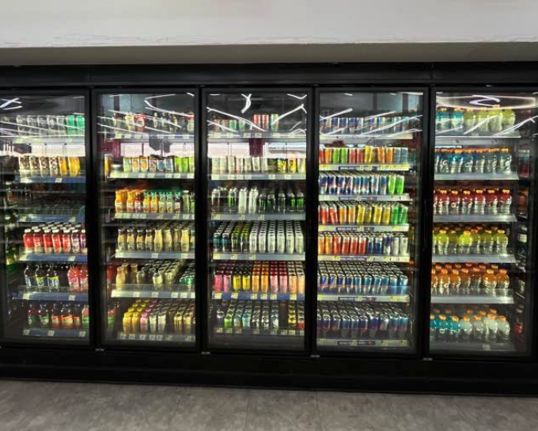
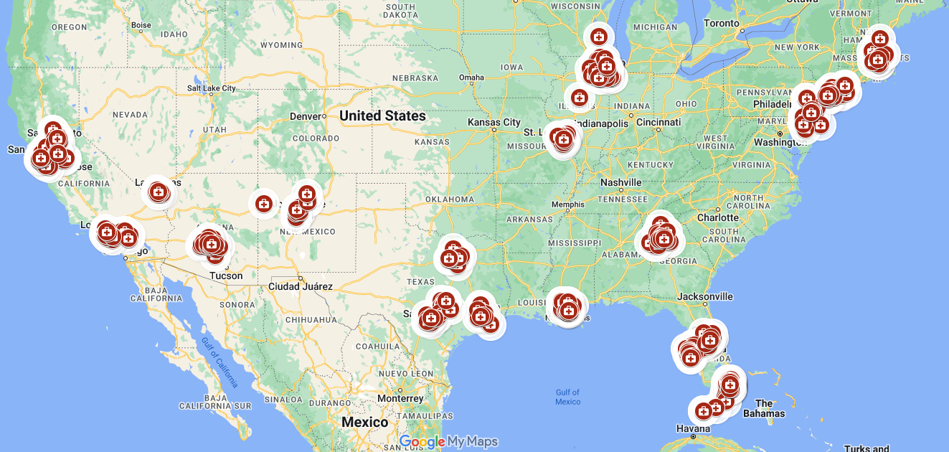
Nationwide Drugstore Chain Refurbishment Project
Project Overview
685 Locations– Large-scale commercial cooler refurbishment across the U.S.
Cooler Door & Electrical Upgrades – Replacing existing components for enhanced durability and performance
Efficient Installations– Each location required 14-16 doors, completed in just three hours per store!

Slide 10
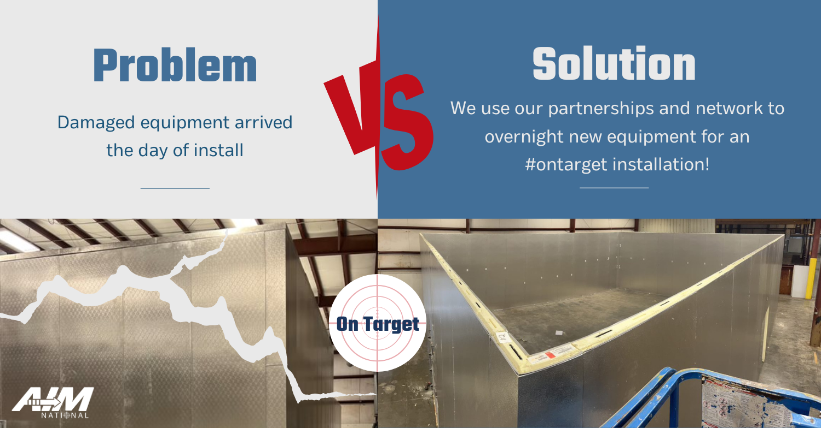
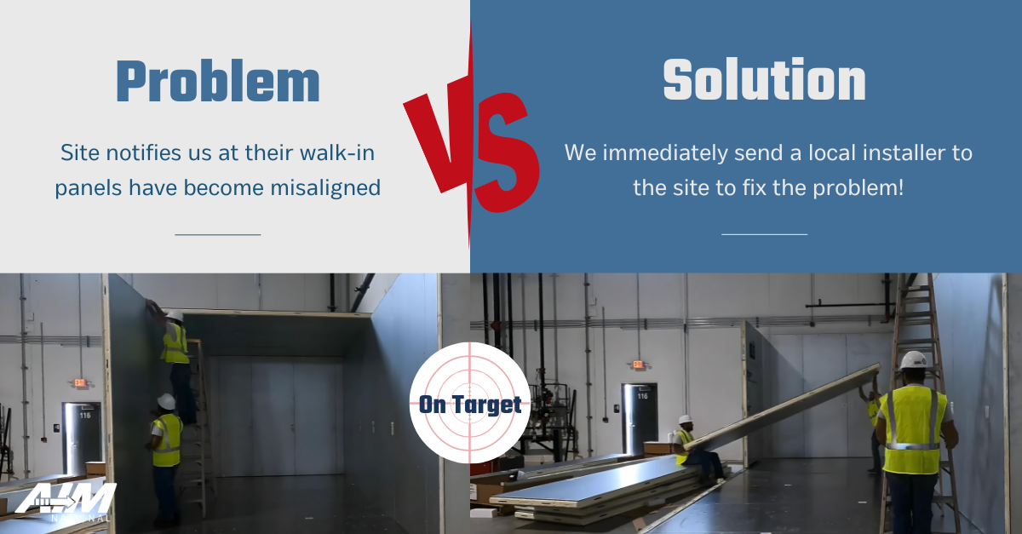
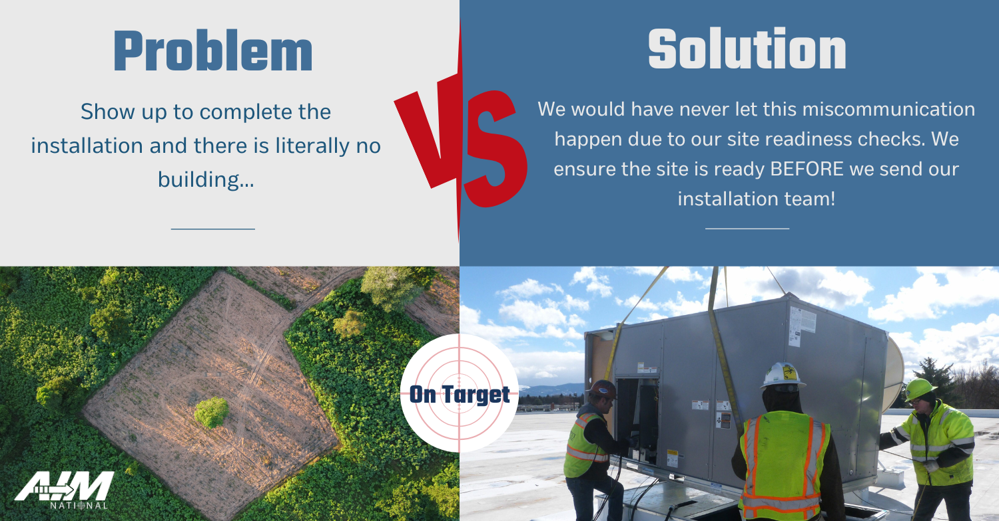
On Target with AIM
Problem / Solution
Problems Happen – We Solve Them
AIM National proactively addresses challenges before they become setbacks, ensuring smooth and efficient installations.
Real-World Examples of AIM on Target
Problem: We handle delivery logistics to ensure timely arrival
Solution: Skilled technicians install equipment efficiently
Problem: We handle delivery logistics to ensure timely arrival
Solution: Skilled technicians install equipment efficiently
Problem: We handle delivery logistics to ensure timely arrival
Solution: Skilled technicians install equipment efficiently

Slide 11
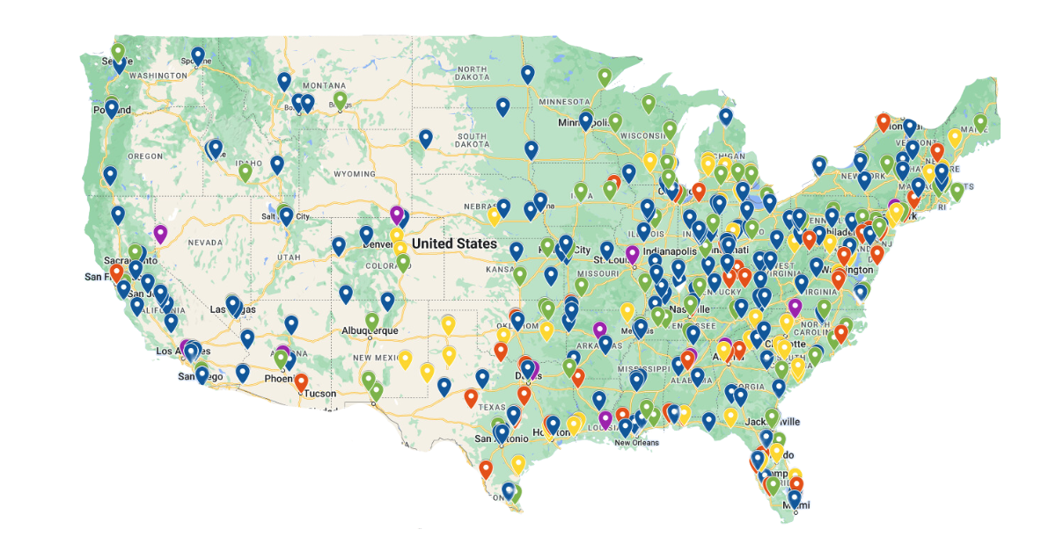
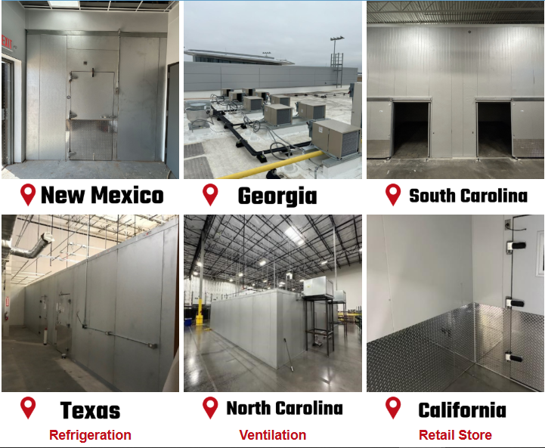
Out-of-State Installs?
AIM Has You Covered!
Why AIM?
✔ Experienced Installers – Located in major markets across North America.
✔ Industry Expertise – Specialized in commercial foodservice installations.
✔ Hassle-Free Coordination – We handle the logistics, so you don’t have to
Nationwide Installation Network
No Reliable Contacts? No Problem!
  AIM provides a vetted and trusted network of installers across the country
Same Quality, Anywhere
  Your clients receive top-tier service, no matter where the job takes them
Precision & Reliability
  AIM ensures seamless coordination and execution for out-of-state projects

Slide 12
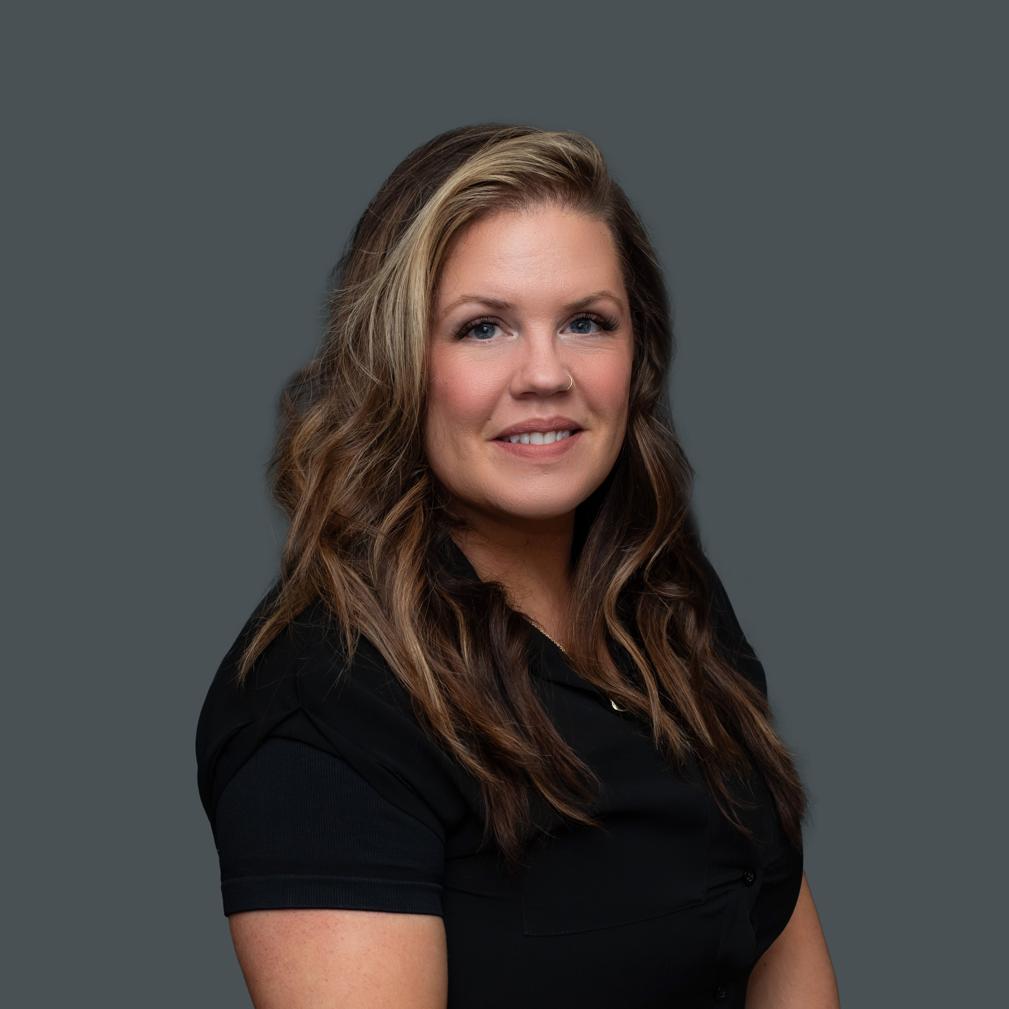
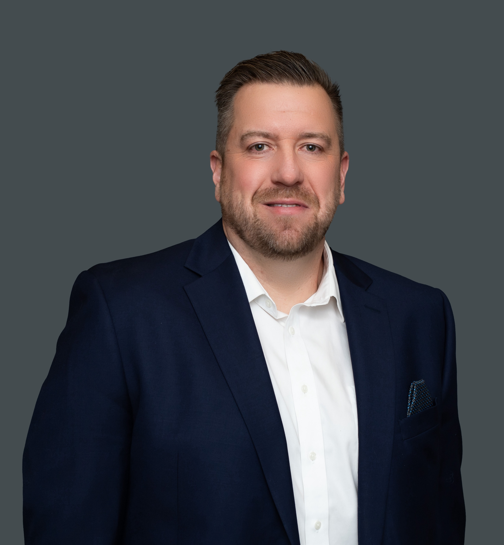
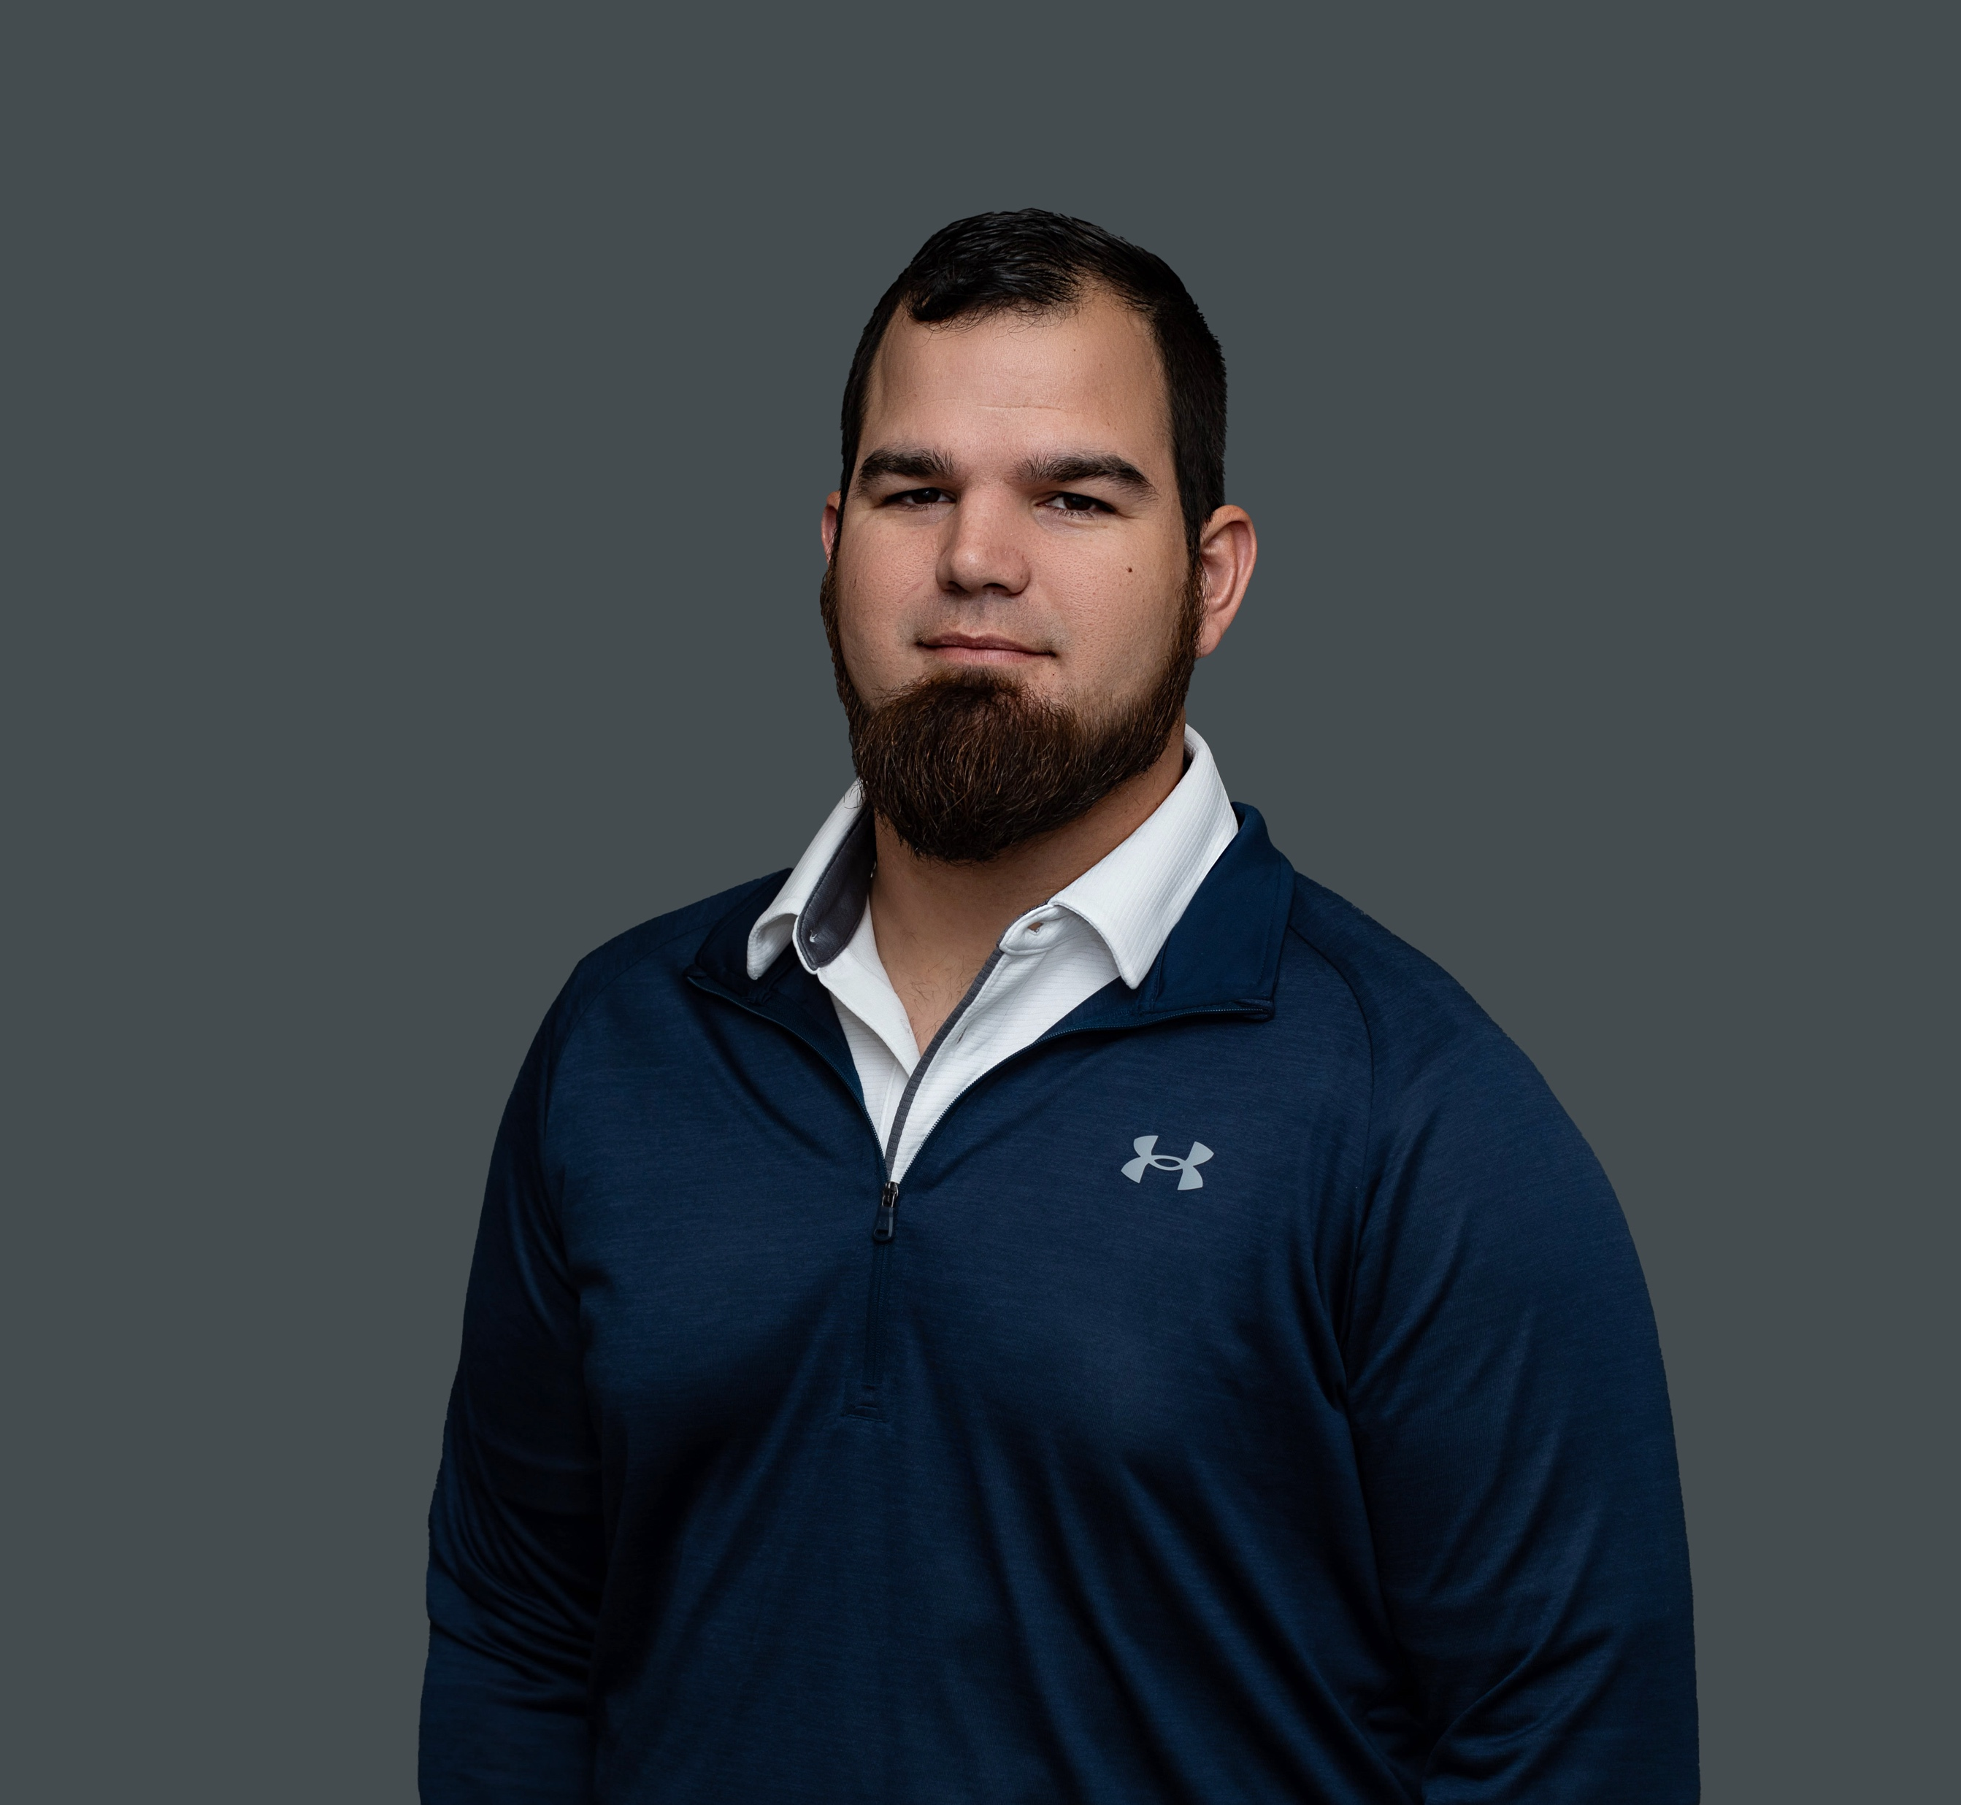
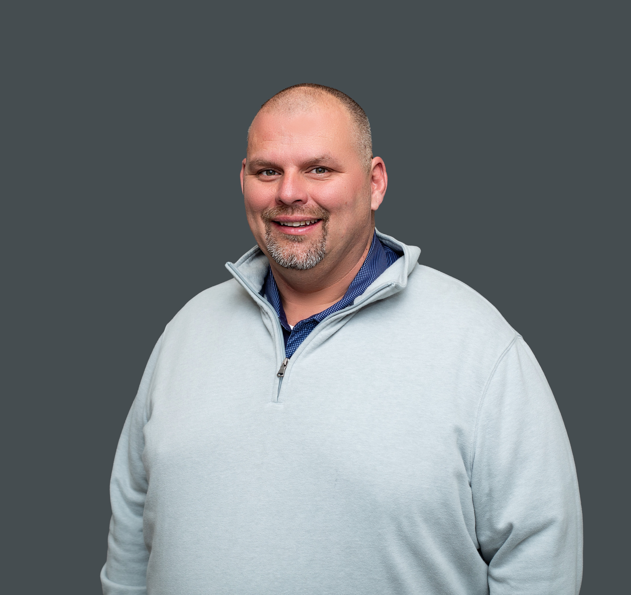
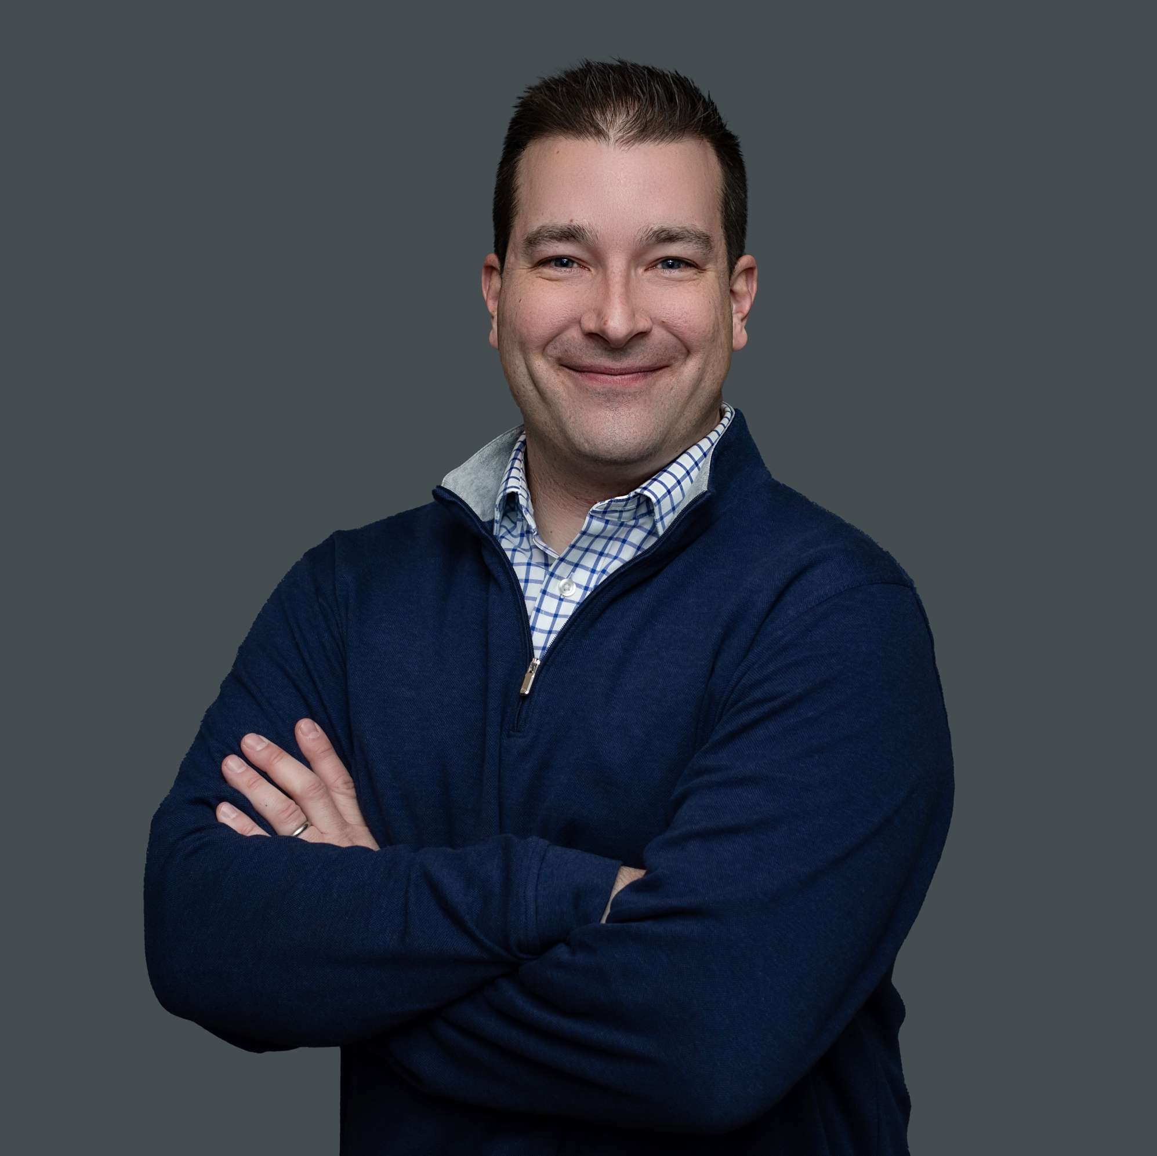
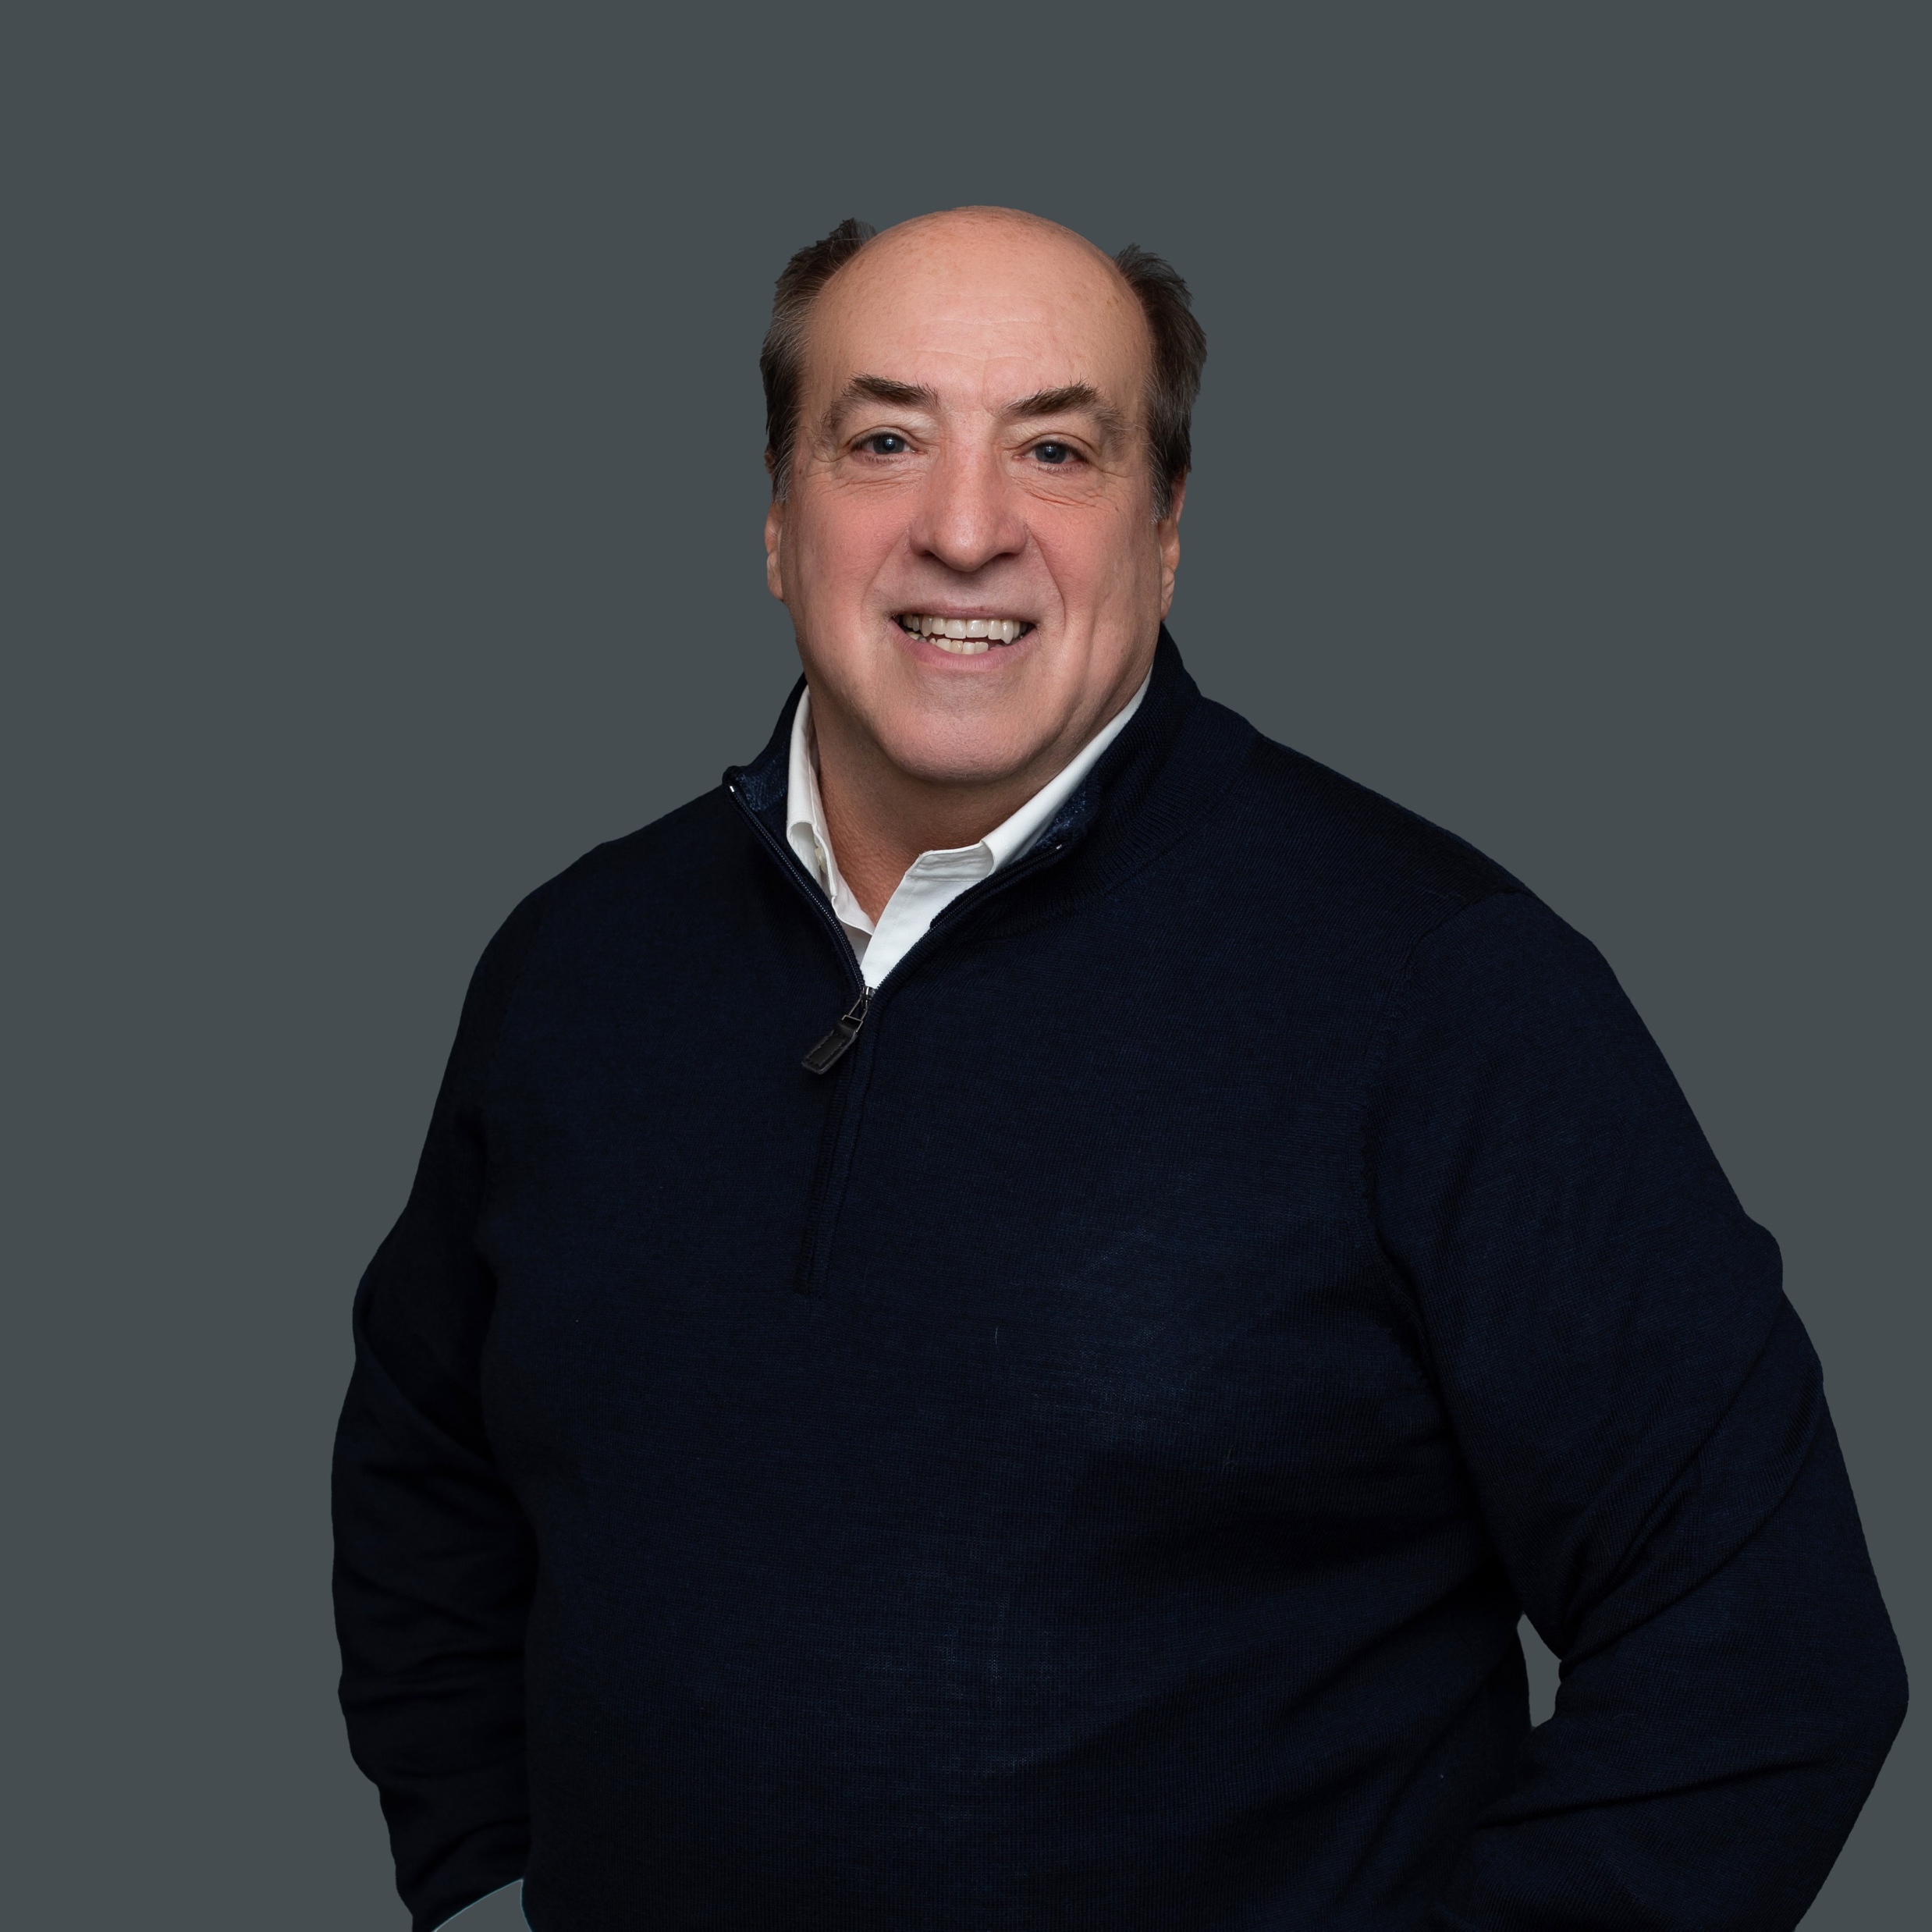
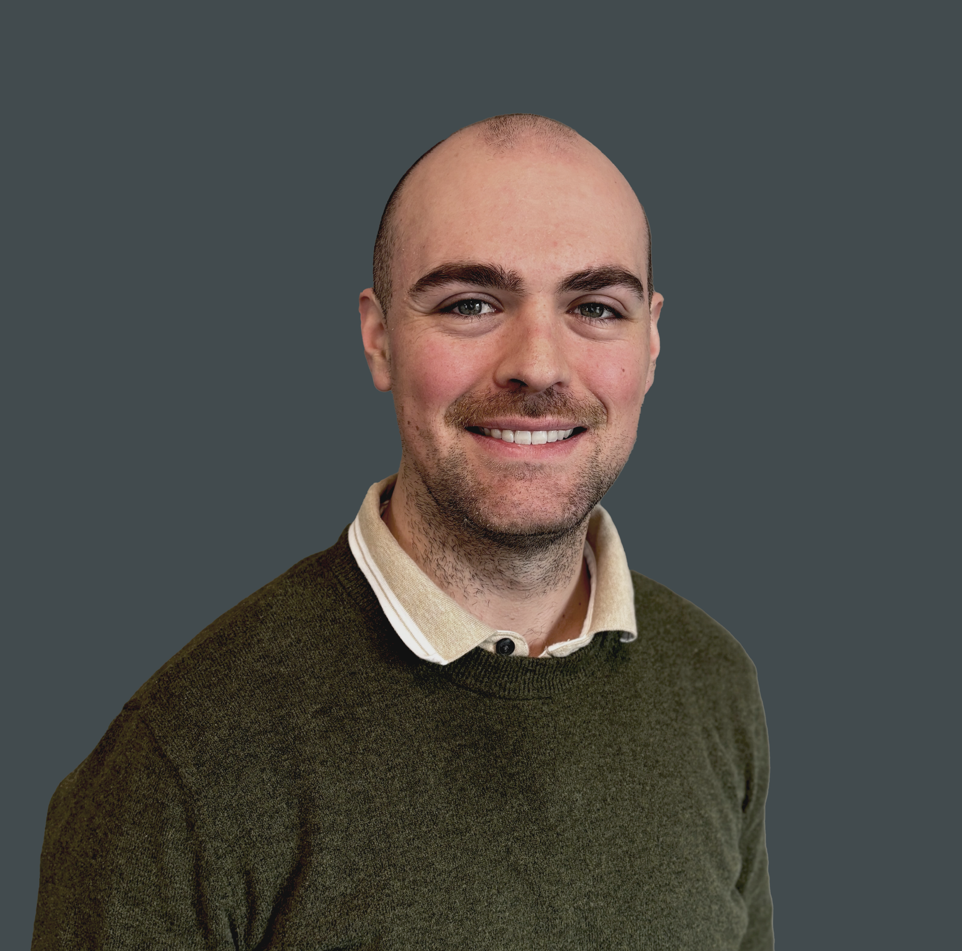
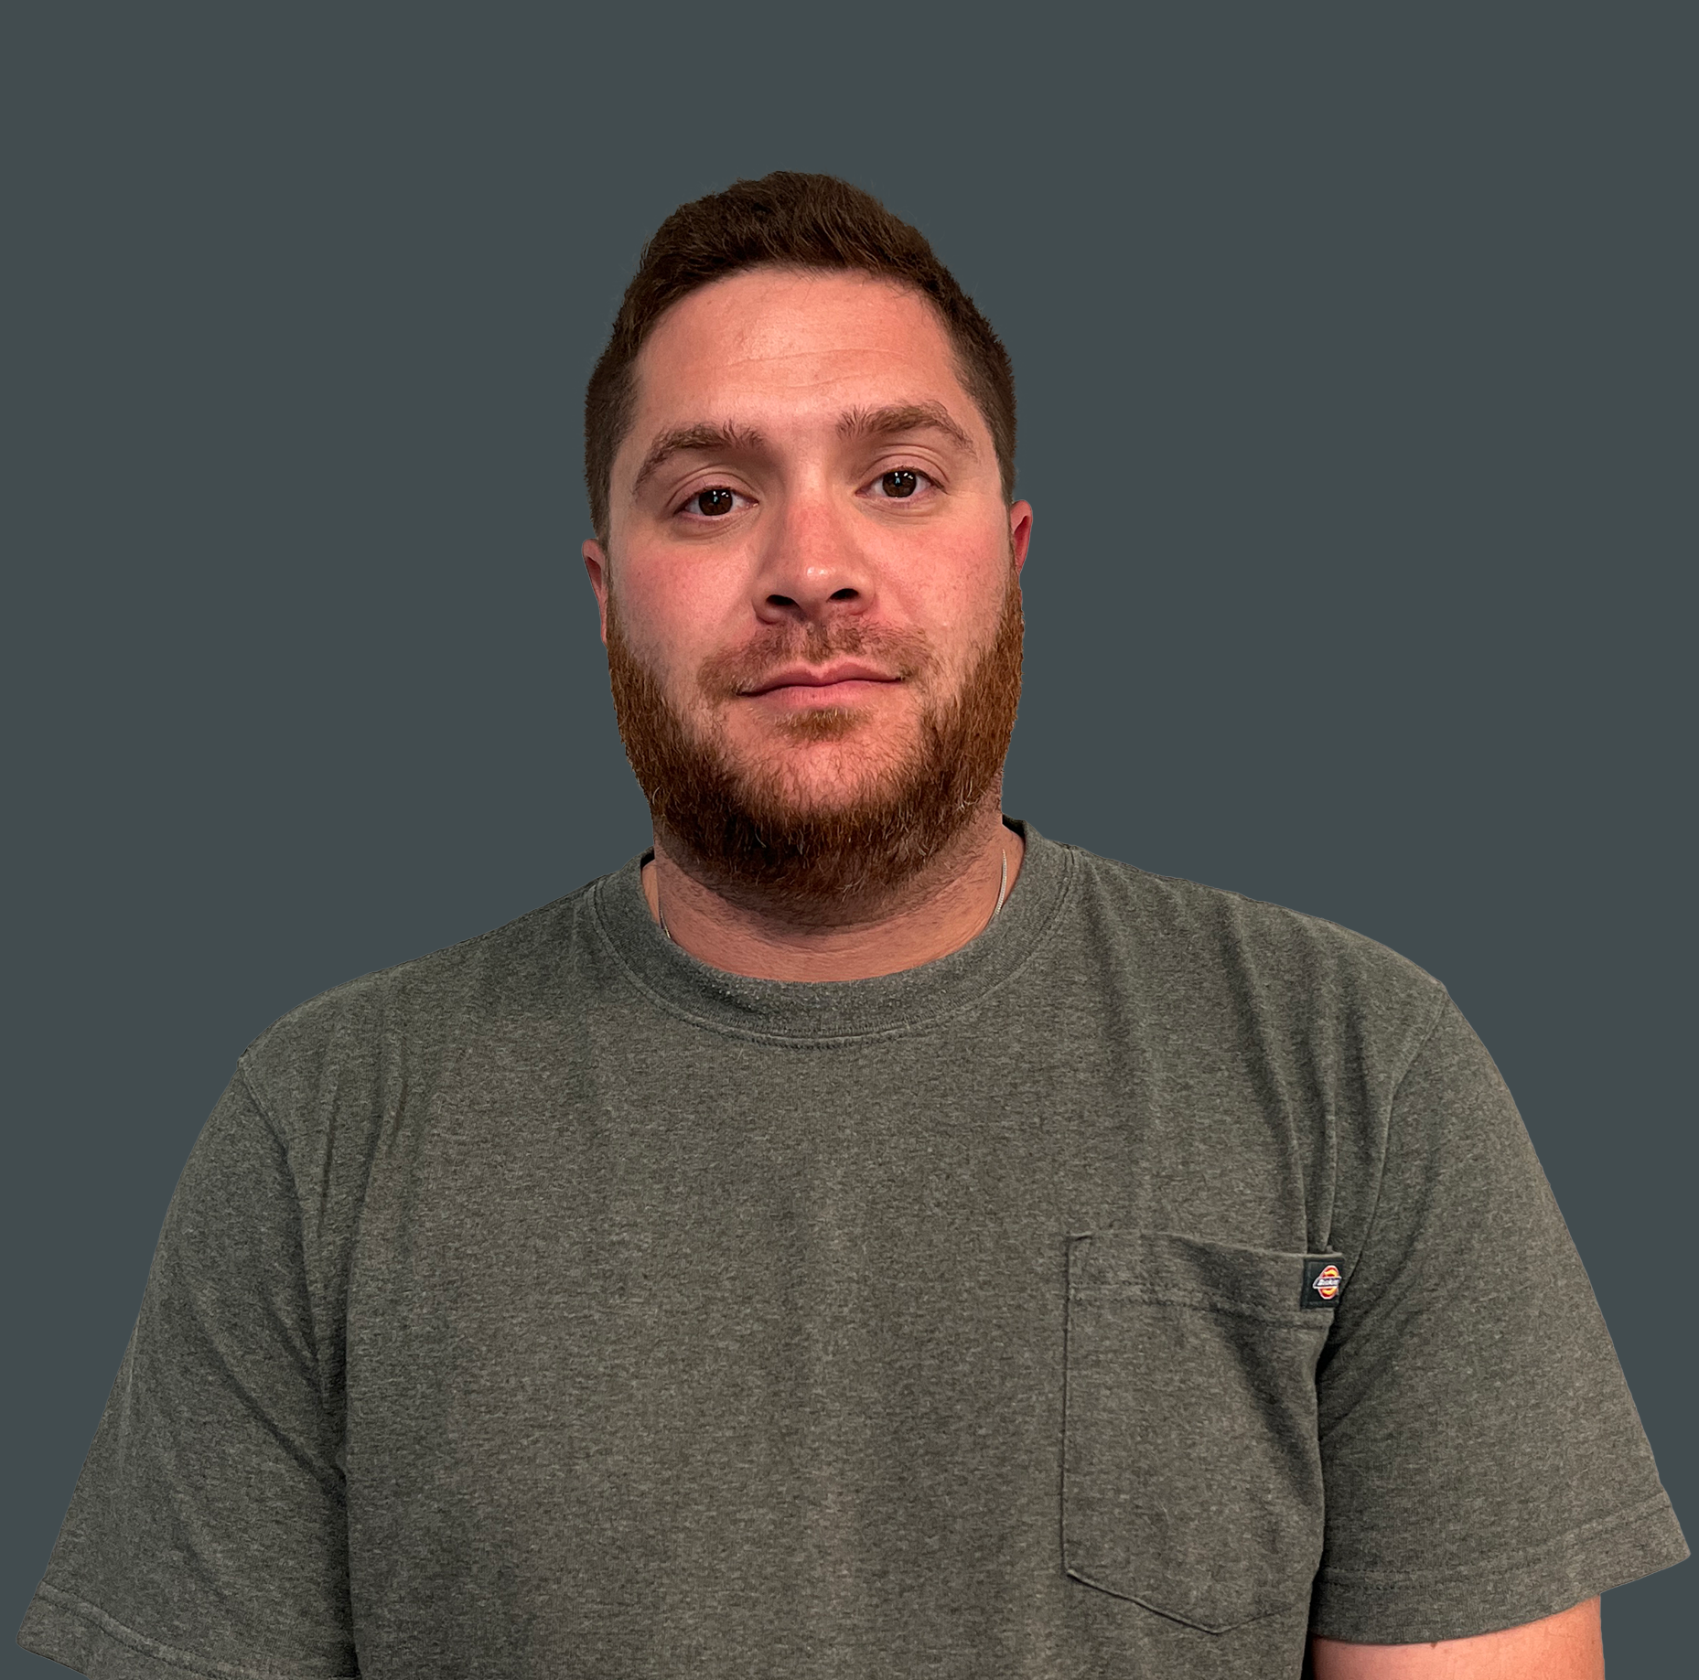
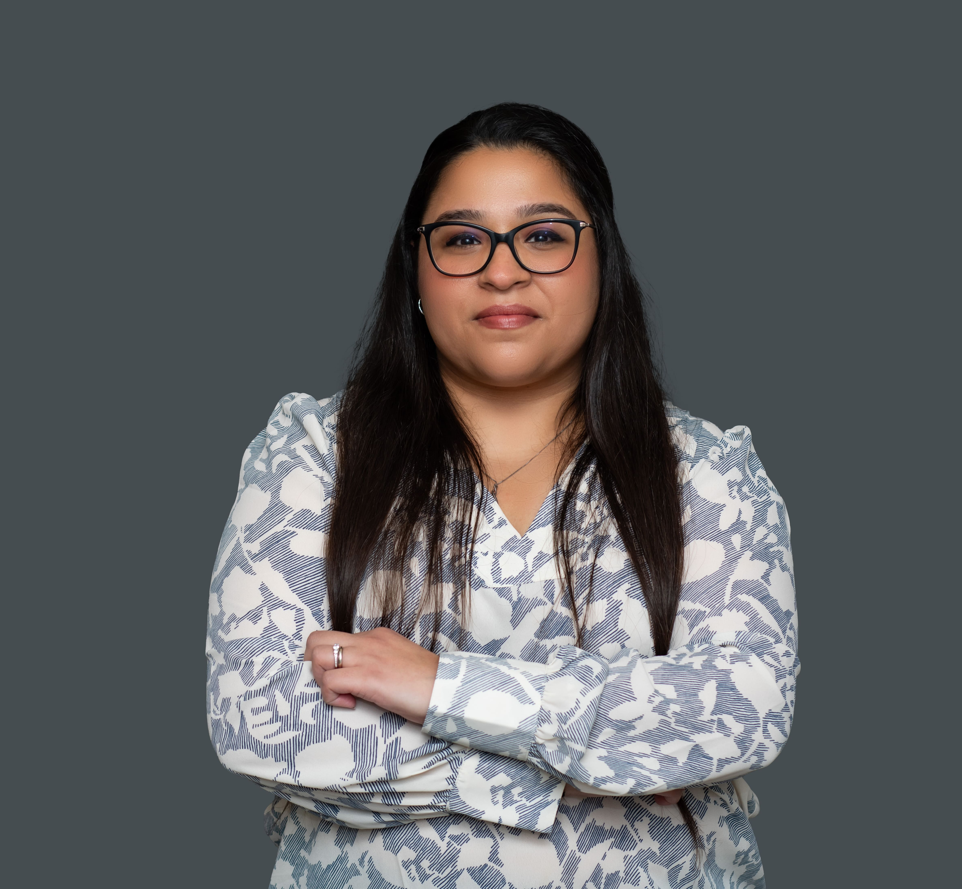
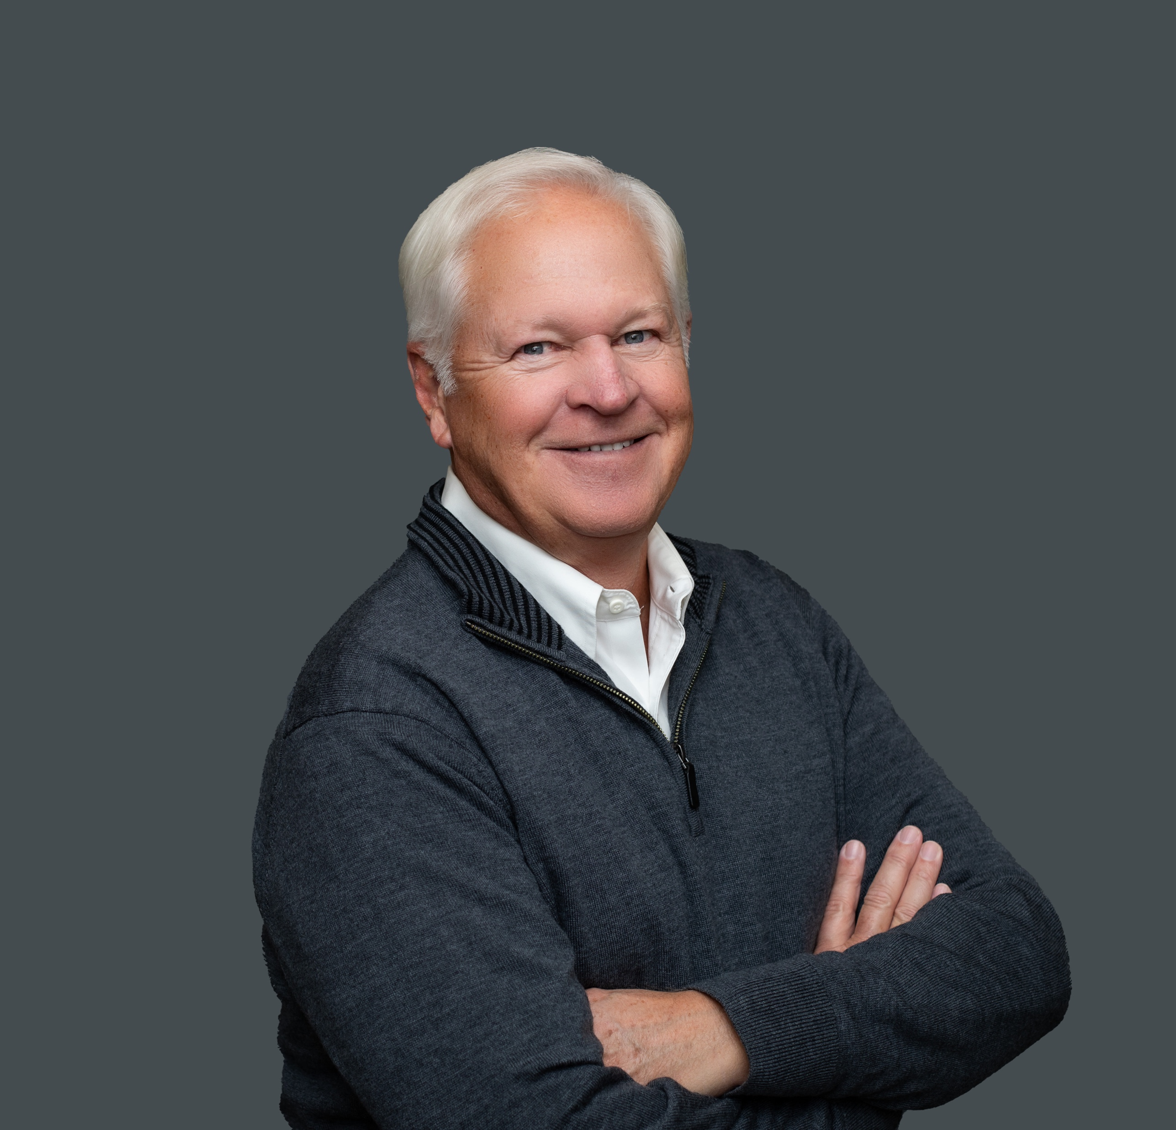



PROJECT MANAGEMENT TEAM
Stacy Shillcox
Installation Lead
sshillcox@aimnational.com
Brandon Ragsdale
Service Manager
bragsdale@aimnational.com
Steve Bosworth
VP / Operating Partner
steveb@aimnational.com
Jeremy Applegate
Installation Coordinator
japplegate@aimnational.com
Ron Trapper
Service Manager
rtrapper@aimnational.com
Matt Anctil
Installation Manager
matta@aimnational.com
Mason Olding
Installation Coordinator
jmccarty@aimnational.com
David Hoffman
Installation Manager - MI
dhoffman@aimnational.com
Meeta Bhatia
Installation Coordinator
mbhatia@aimnational.com
Jim Klamet
Installation Coordinator
jklamet@aimnational.com
Austin Zavodny
Installation Coordinator
azavodny@aimnational.com
Tara Haag
Installation Coordinator
thaag@aimnational.com
Ken Sparks
Installation Coordinator
ksparks@aimnational.com

Slide 13









































AIM CUSTOMERS
RESTAURANT
FOODSERVICE
MANAGEMENT
EDUCATION
TRAVEL & SPORTS
RETAIL
HEALTHCARE

Slide 14
HOW CAN WE WORK WITH ONE ANOTHER?

