Slide 1
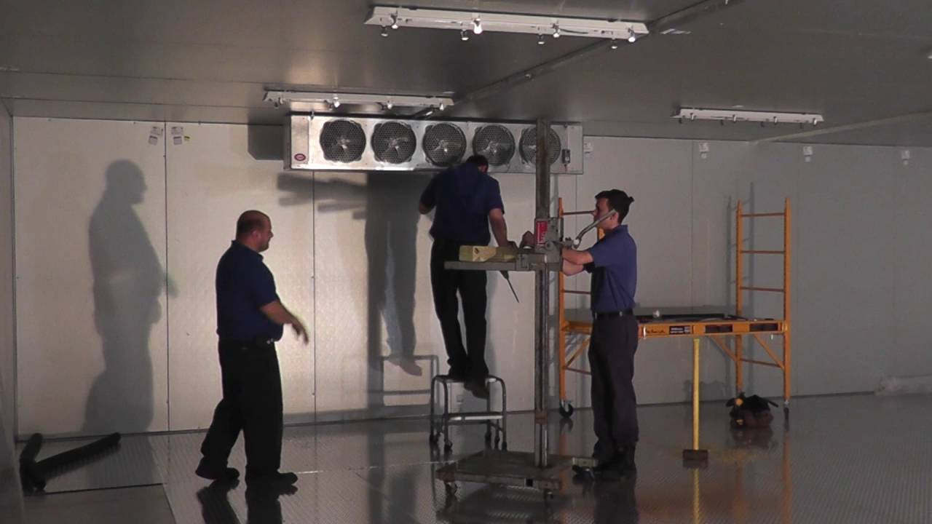

ON TARGET INSTALLS

Slide 2
The AIM Difference
SCALE
National installation network with 40+ years of experience managing specialty projects in the foodservice industry. Our dedicated teams of project managers and our own company field support technicians, utilize project management software, as well NetSuite (ERP / WMS) to finish projects on time and on budget. We are an EOS operating company.
SOLUTION PROVIDER
Single point of contact coordinating installations for multi-unit chains, new construction projects, and remodels. Specializing in Refrigeration, Ventilation and unique kitchen jobs, and providing creative solutions for any client need.
RISK MANAGEMENT
Our single focus is INSTALLATIONS – allowing AIM’s project teams to take complete ownership of our scope, and communicate job site conditions – up and down the channel. AIM protects margins for OEM Manufacturers, Factory Reps, Dealers and Operators.

Slide 3





AIM’S CORE VALUES
WE CARE
We Care for one another, our customers and our community. With respect and discipline, we are accountable, we “do the right thing” and we maintain high ethical standards.
EXCELLENCE
We strive for Excellence in everything we do. The integrity of our people and our best-in-class processes and facilities make us the first choice for representation.
RESULTS DRIVEN
We are a Results Driven team. We succeed by being creative, setting challenging goals and having a sense of urgency in all that we do, all with our customer’s success in mind.
CUSTOMER FIRST
We believe in delivering added value for our customers. Customer-First is the foundation of our business. We listen to our customers’ needs and we recognize that customer satisfaction is every employee’s responsibility.
FORWARD-FOCUSED
We are Forward-Focused and are always seeking education and training for personal and professional growth. We approach new challenges with resourcefulness, flexibility and innovation to develop effective solutions.

Slide 4
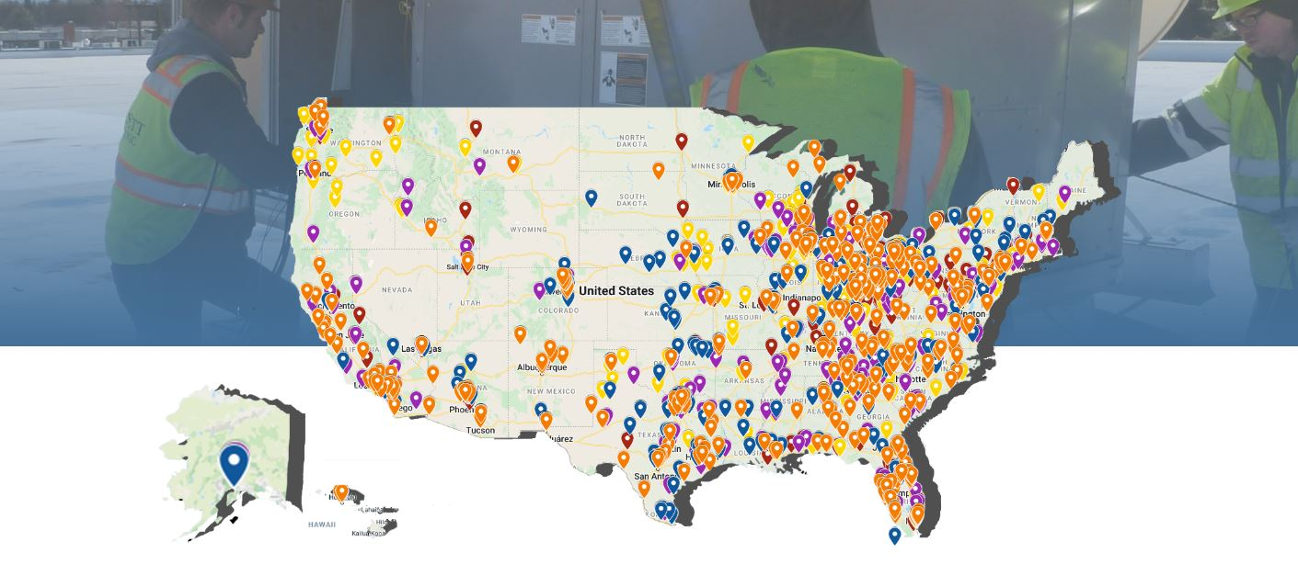
NATIONAL INSTALLATION NETWORK

Slide 5

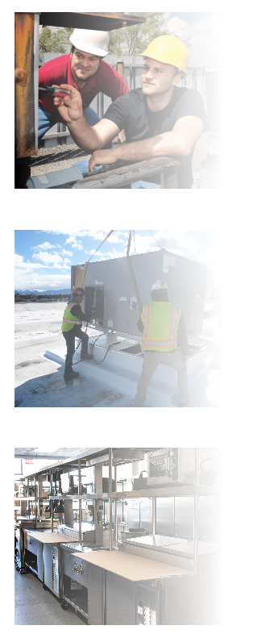
PROJECT ASSESSMENT
Request – Every project starts at the beginning.
The AIM team conducts a site survey if needed, validating any site details, and ensuring they are prepared for the road ahead. They use their vast project and knowledgeable team to put together a quote for the necessary scope of work.
EQUIPMENT INSTALLATION
AIM begins every project with all the permitting completed upfront. Every region and code is unique, just as every kitchen is. With a network across North America, be confident that all the necessary paperwork and certifications are in place before any work ensues.
From meeting the equipment on-site to handling all communication with the manufacturer, general contractor, and the dealer involved, AIM ensures that no one is left in the dark. The Advanced Installation team sets the communication standard, giving everyone complete confidence and peace of mind that the job will be done, and done correctly.
PROJECT COMPLETION
As soon as all the equipment is set in place and hooked up, everything is started up and guaranteed to be in full working order. They will make hood adjustments, start up the cooking line, and get the walk in down to temp before leaving the site.

Slide 6
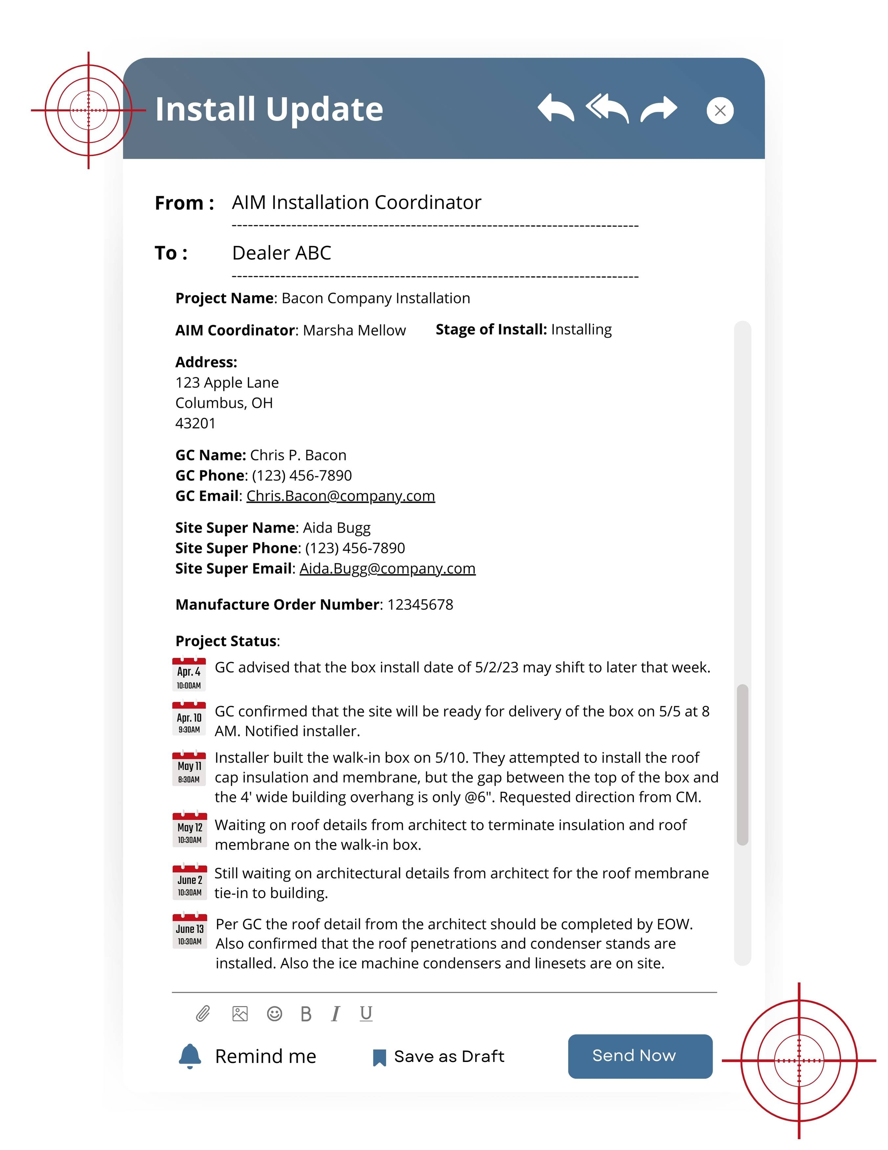
PROJECT UPDATES
Project Assignment – Making introductions with site supers and dealers
Arranging site visits and verifying site readiness
Going over questions and setting schedule date
Coordinating logistics and obtaining permits
Day of Installation – Ensuring a smooth process
Startup – Setting the stage for success
Project Completion – The final touches

Slide 7






INSTALLATION SERVICES
Refrigeration
Ventilation
Retail
Warewashing
Cooking
Automation

Slide 8
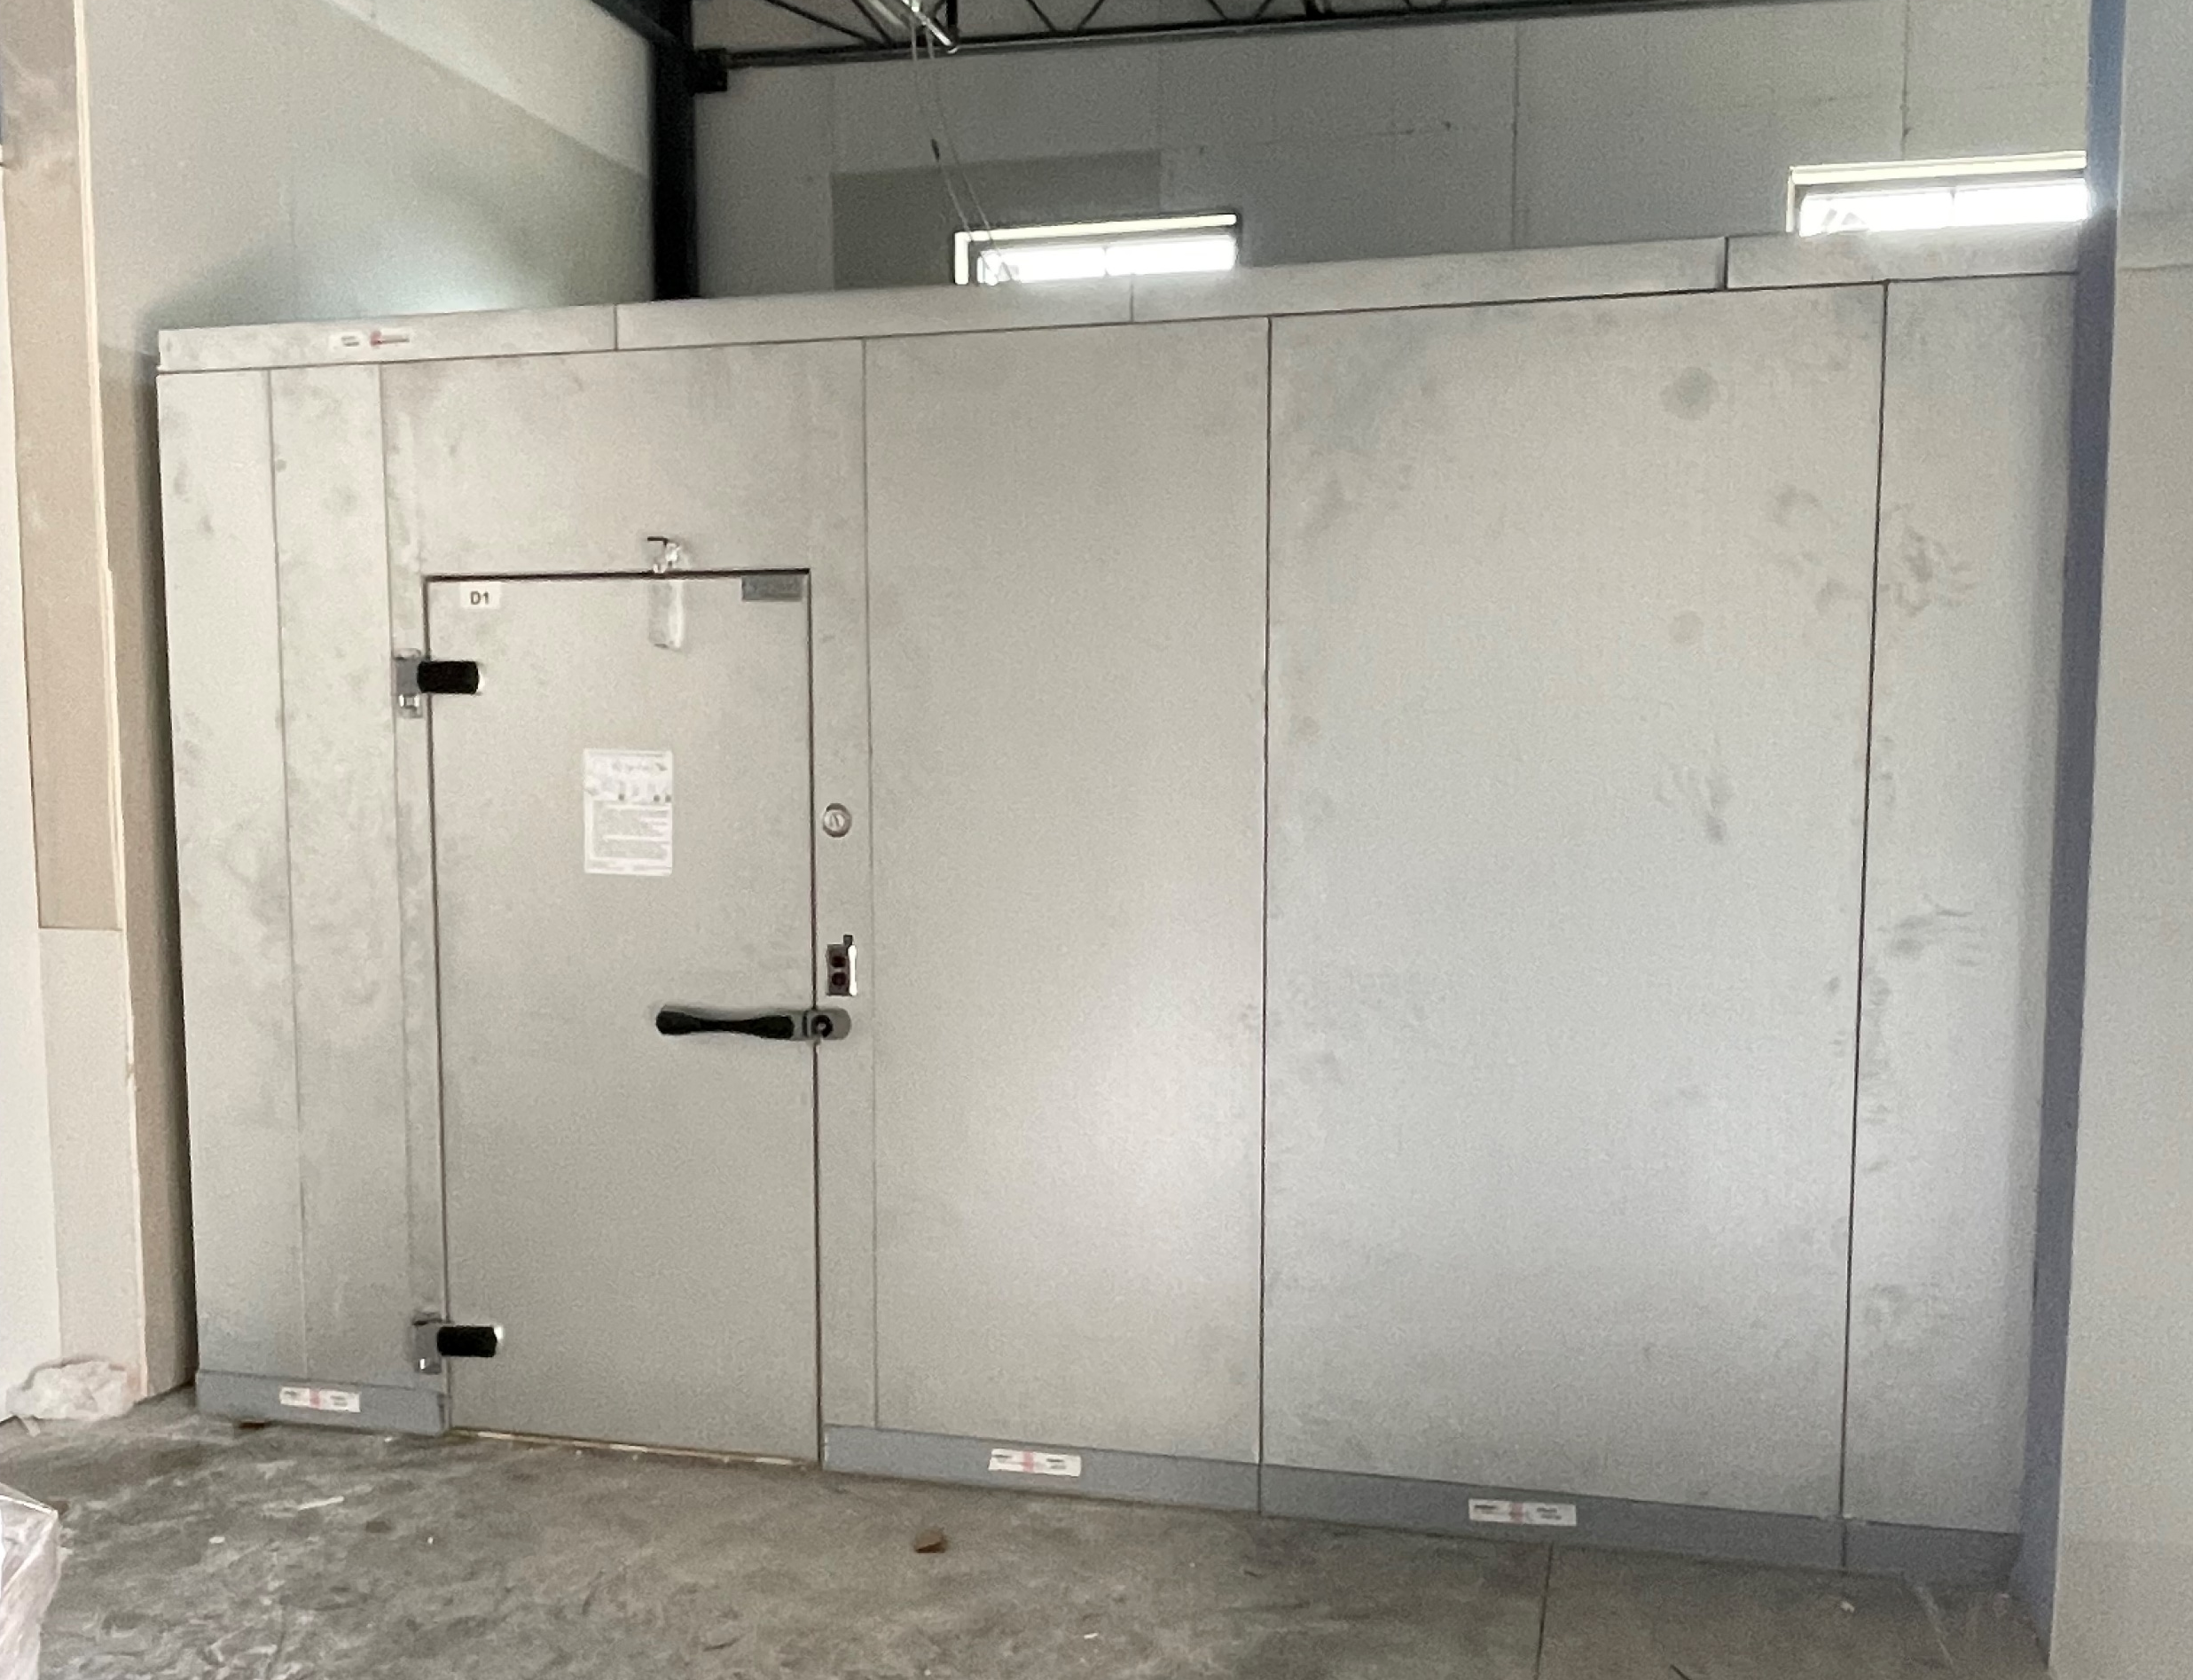
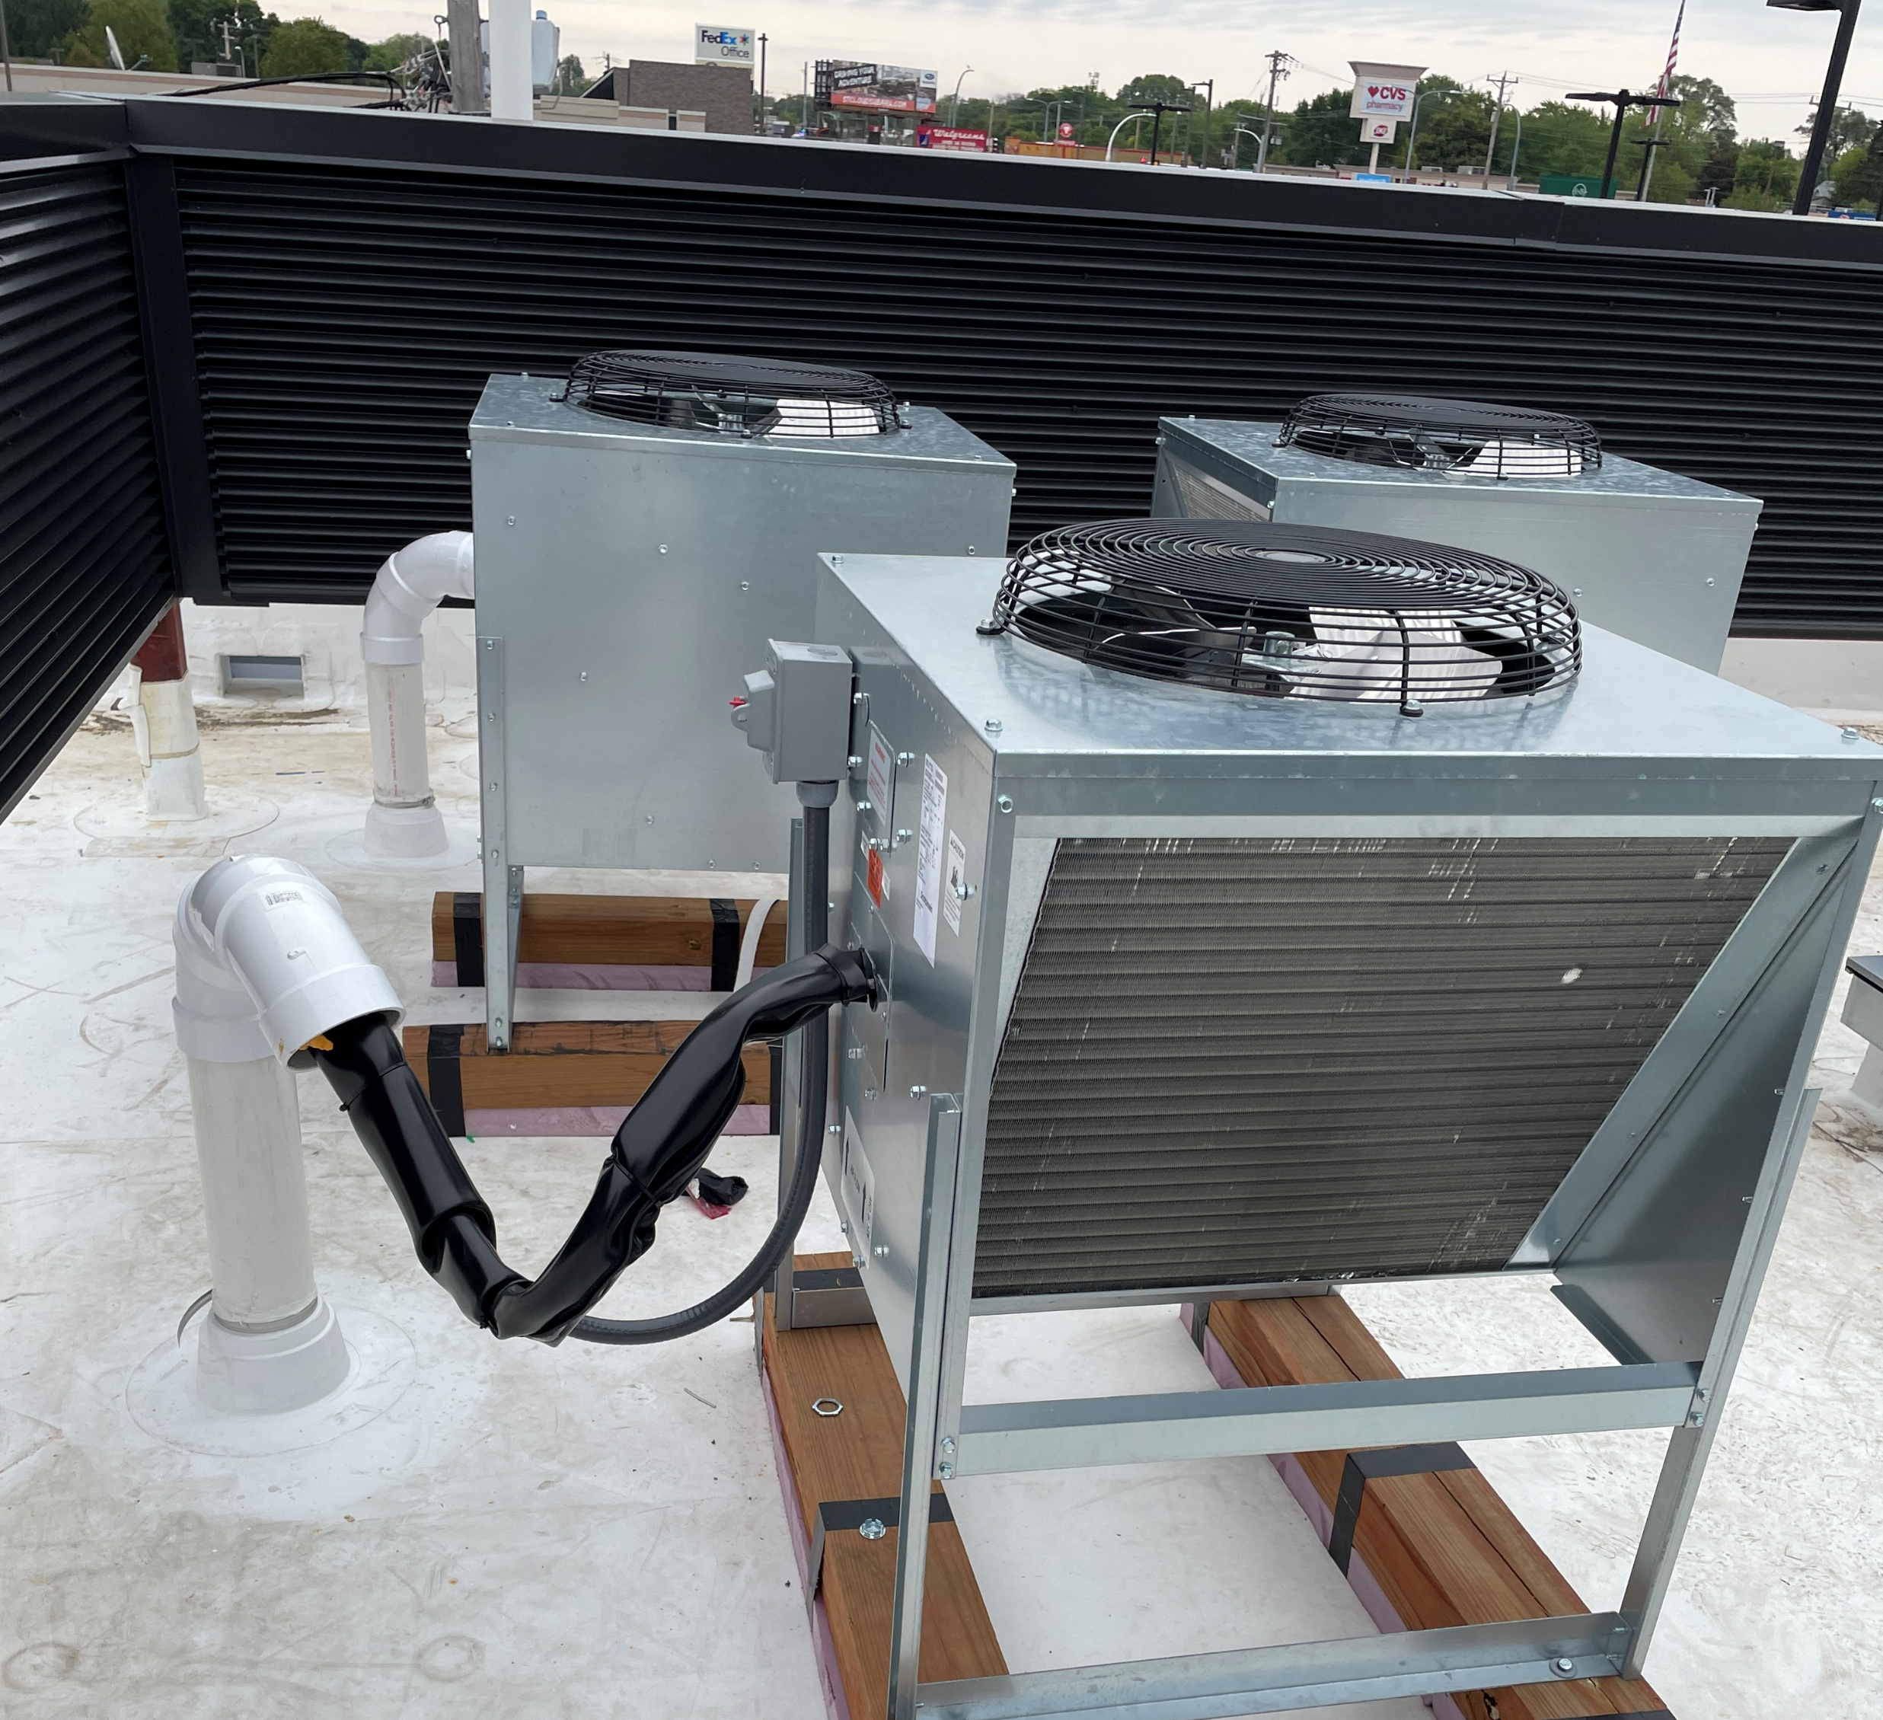




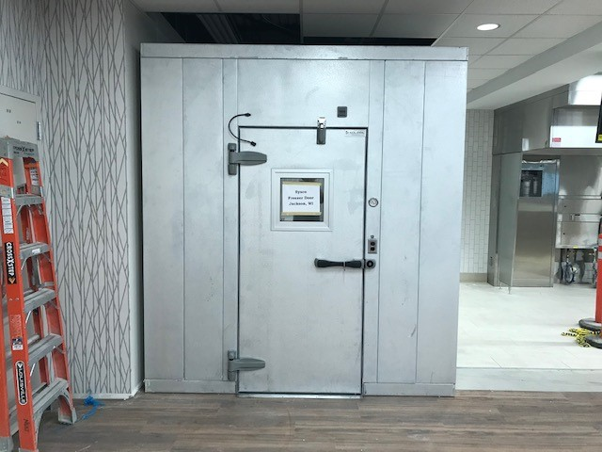
REFRIGERATION
AIM National Installs Walk-in cooler panels, Self contained, precharged, remove, rack system refrigeration, reach in refrigerators, beer chiller systems, bar back coolers, and more.
Walk-in
Rack System
Reach-In
Ice Machine

Slide 9
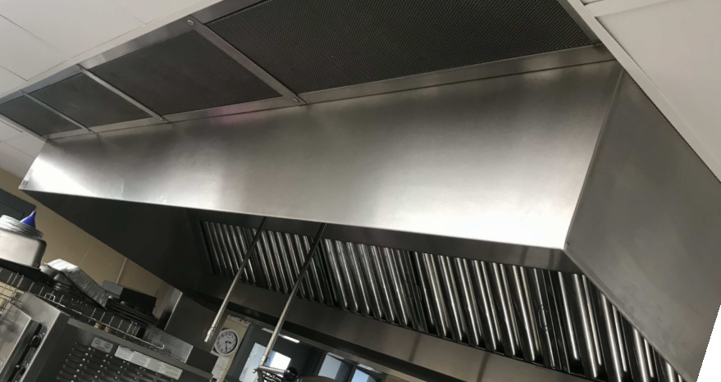
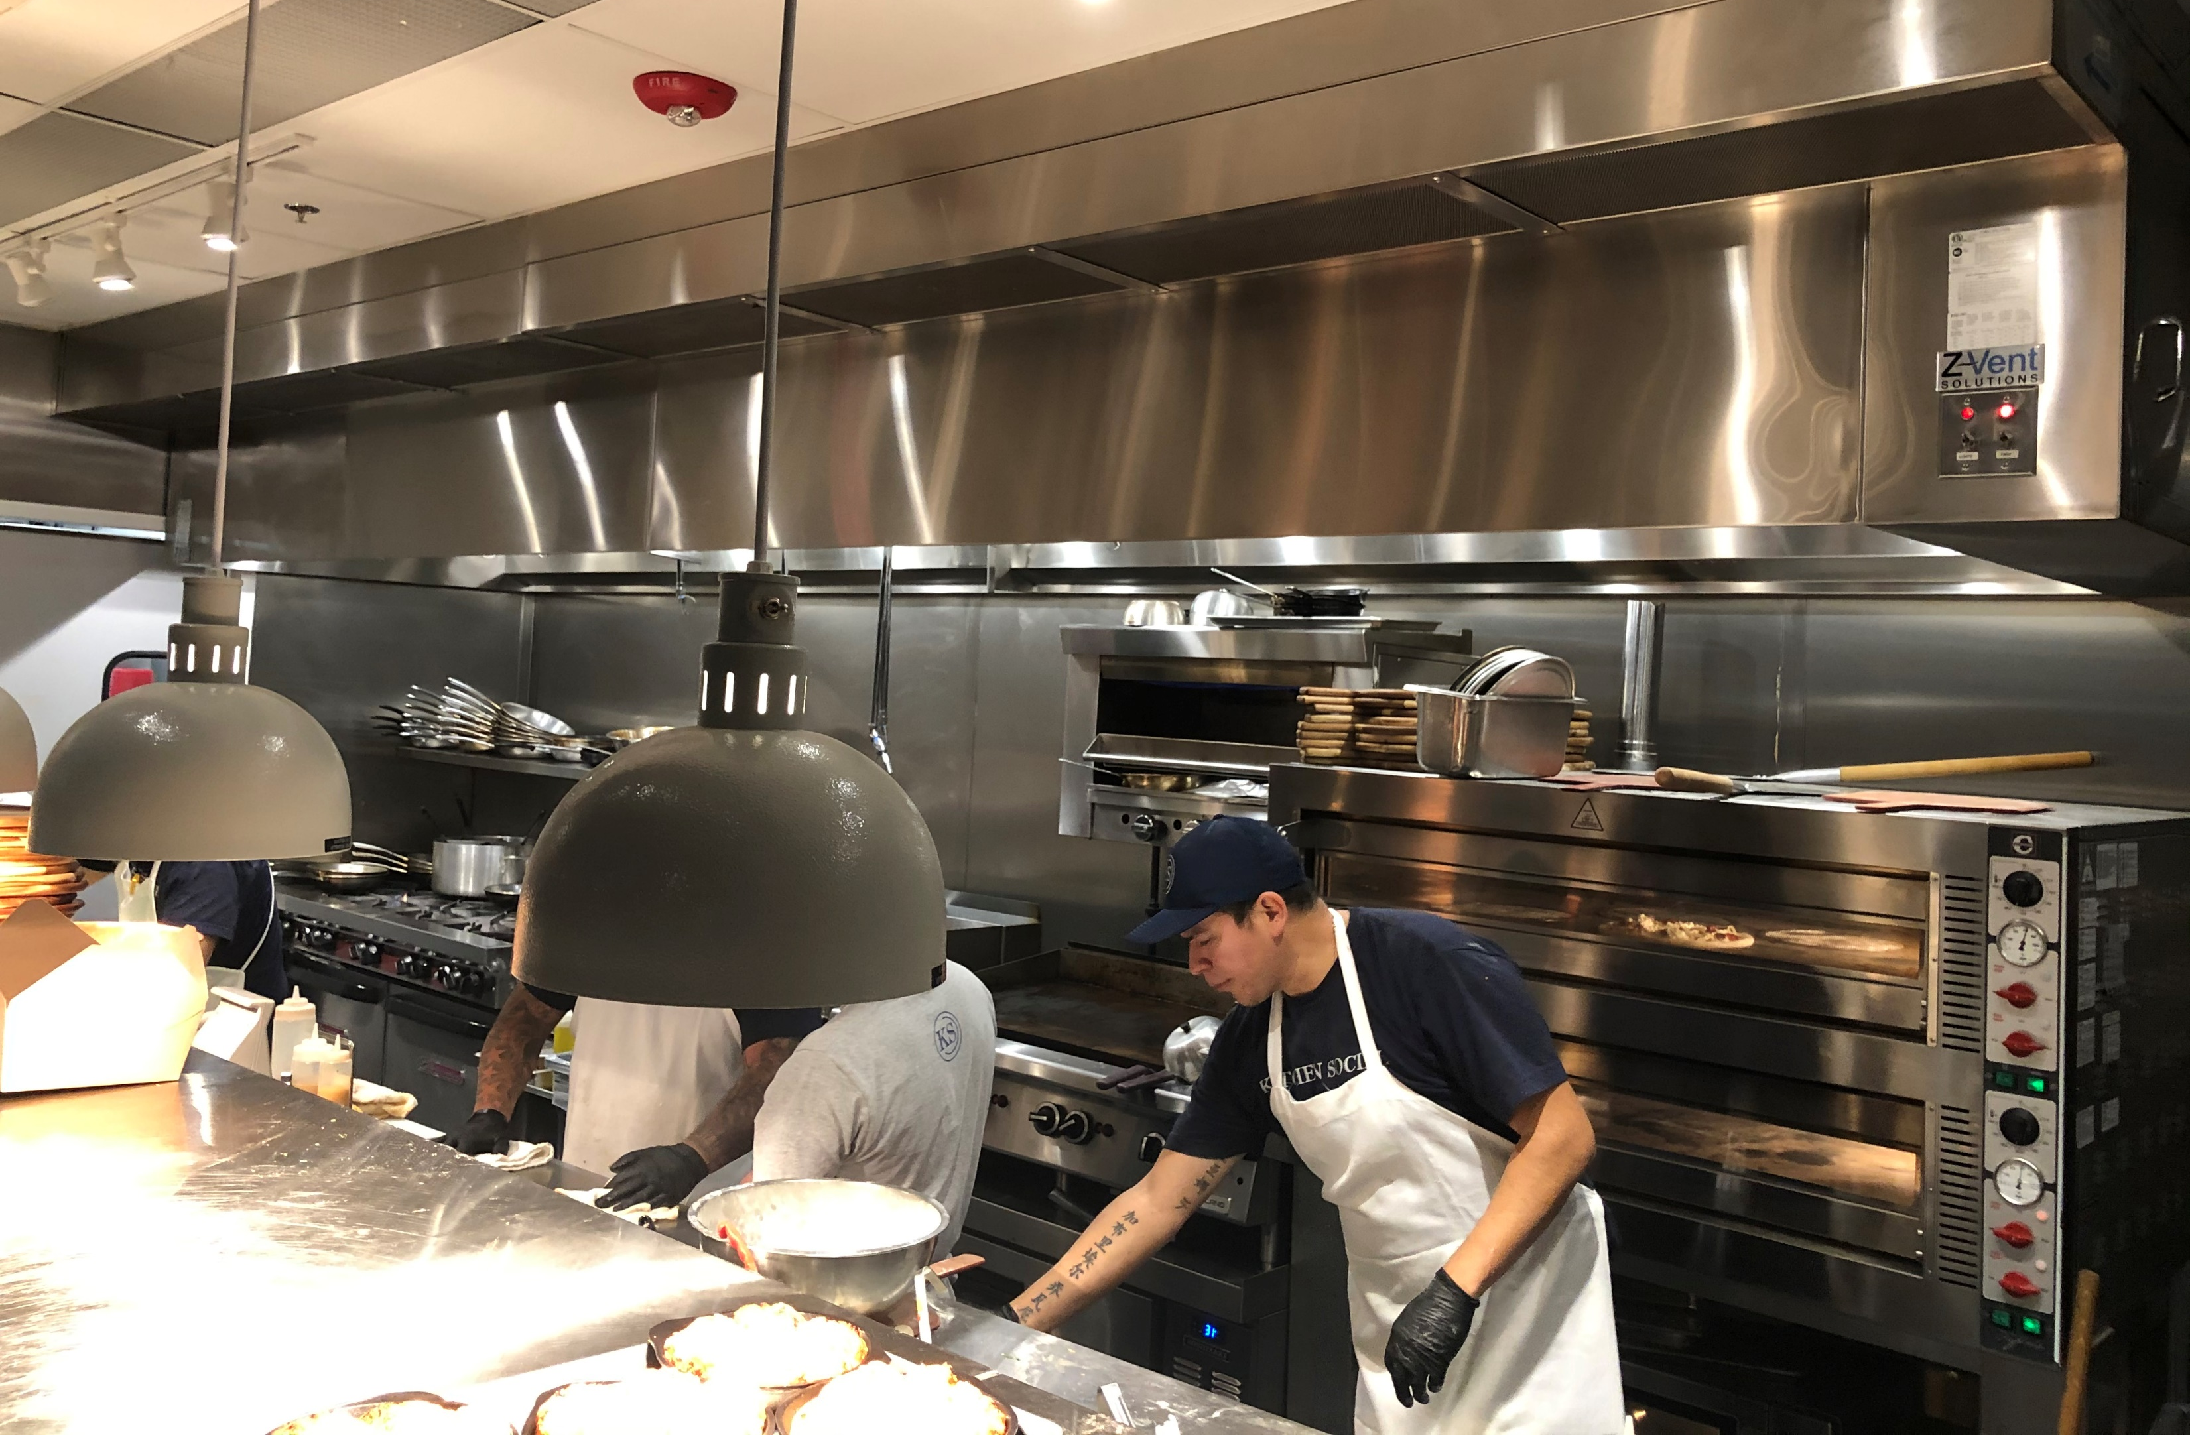



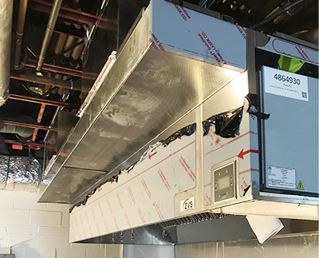

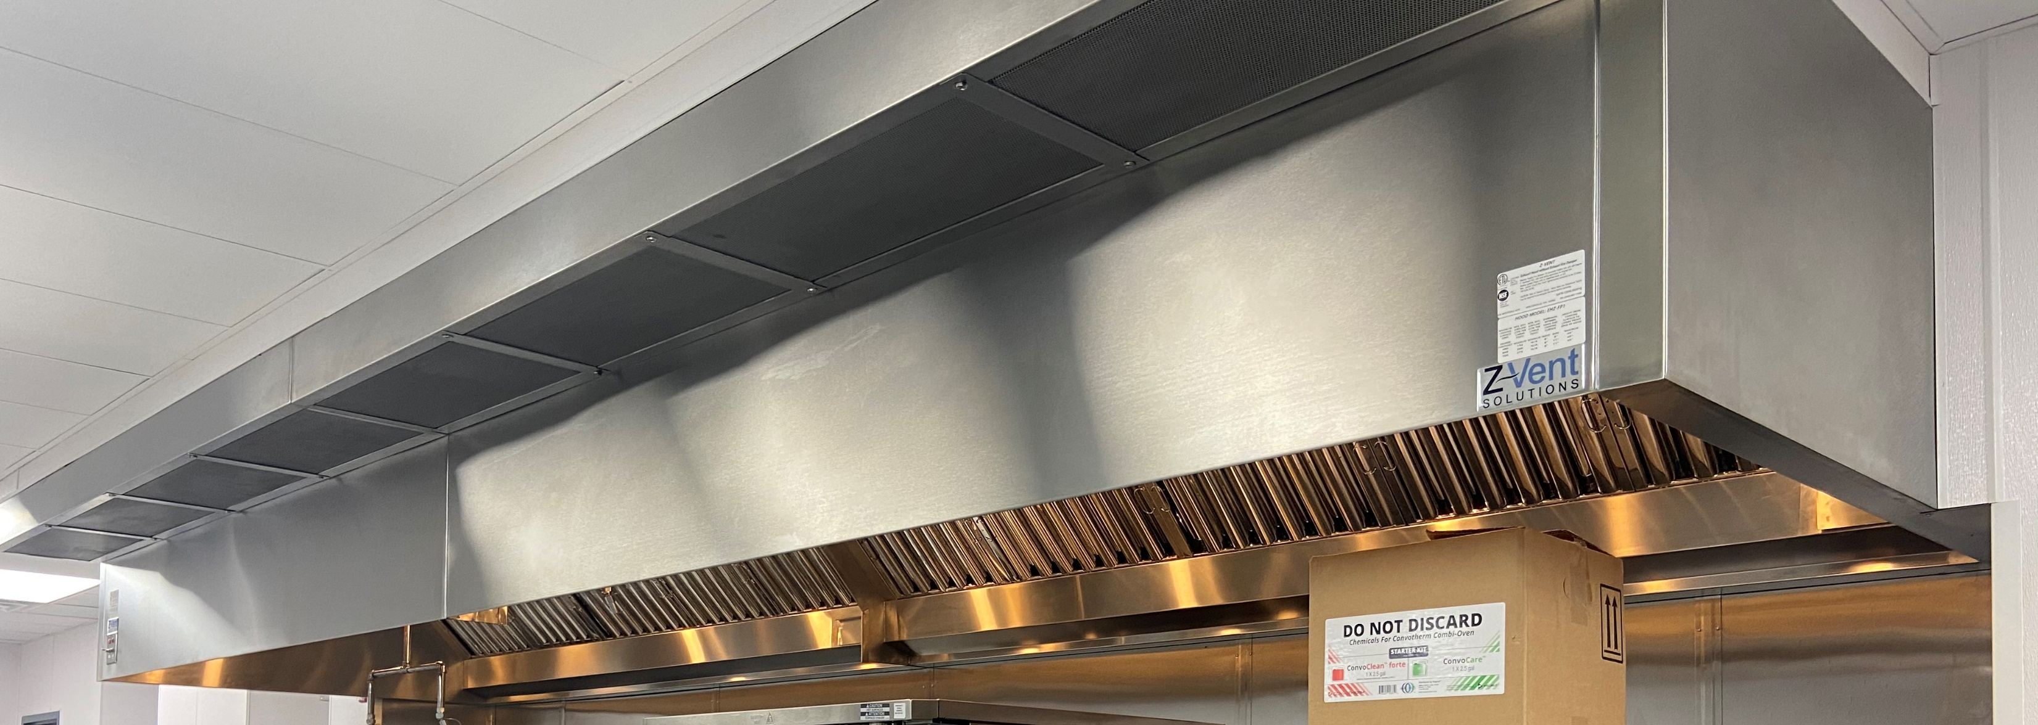
COMMERCIAL HOODS
From major chains and restaurants, to hospitals and schools, AIM team can aid in hanging the hoods, installing the exhaust fans MUA systems, and ductwork, and putting in place a fire suppression system.
Ventilation Hoods
Exhaust Fans
MUA Systems
Ductwork
Prefabricated
Fire Suppression
Performance
Verification Checks

Slide 10
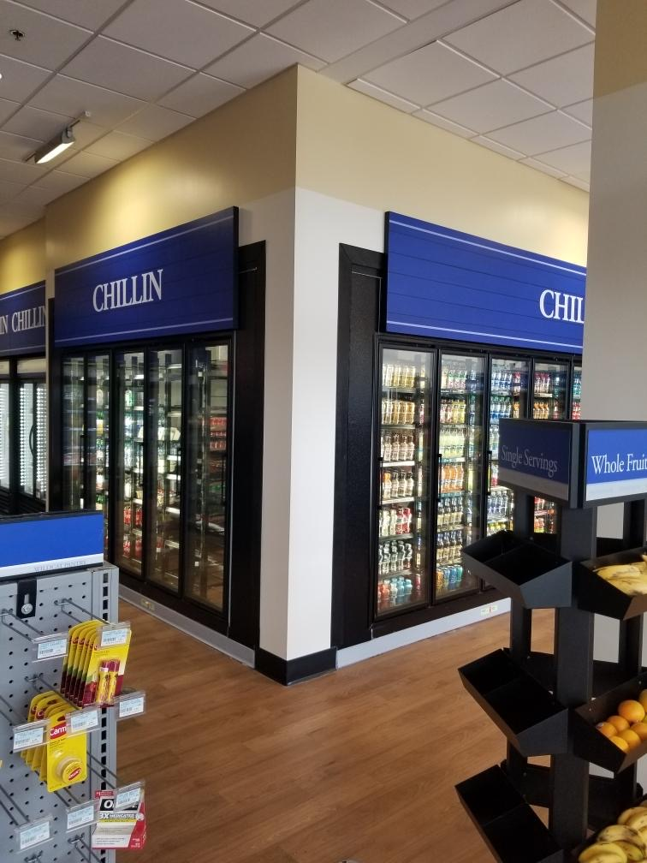
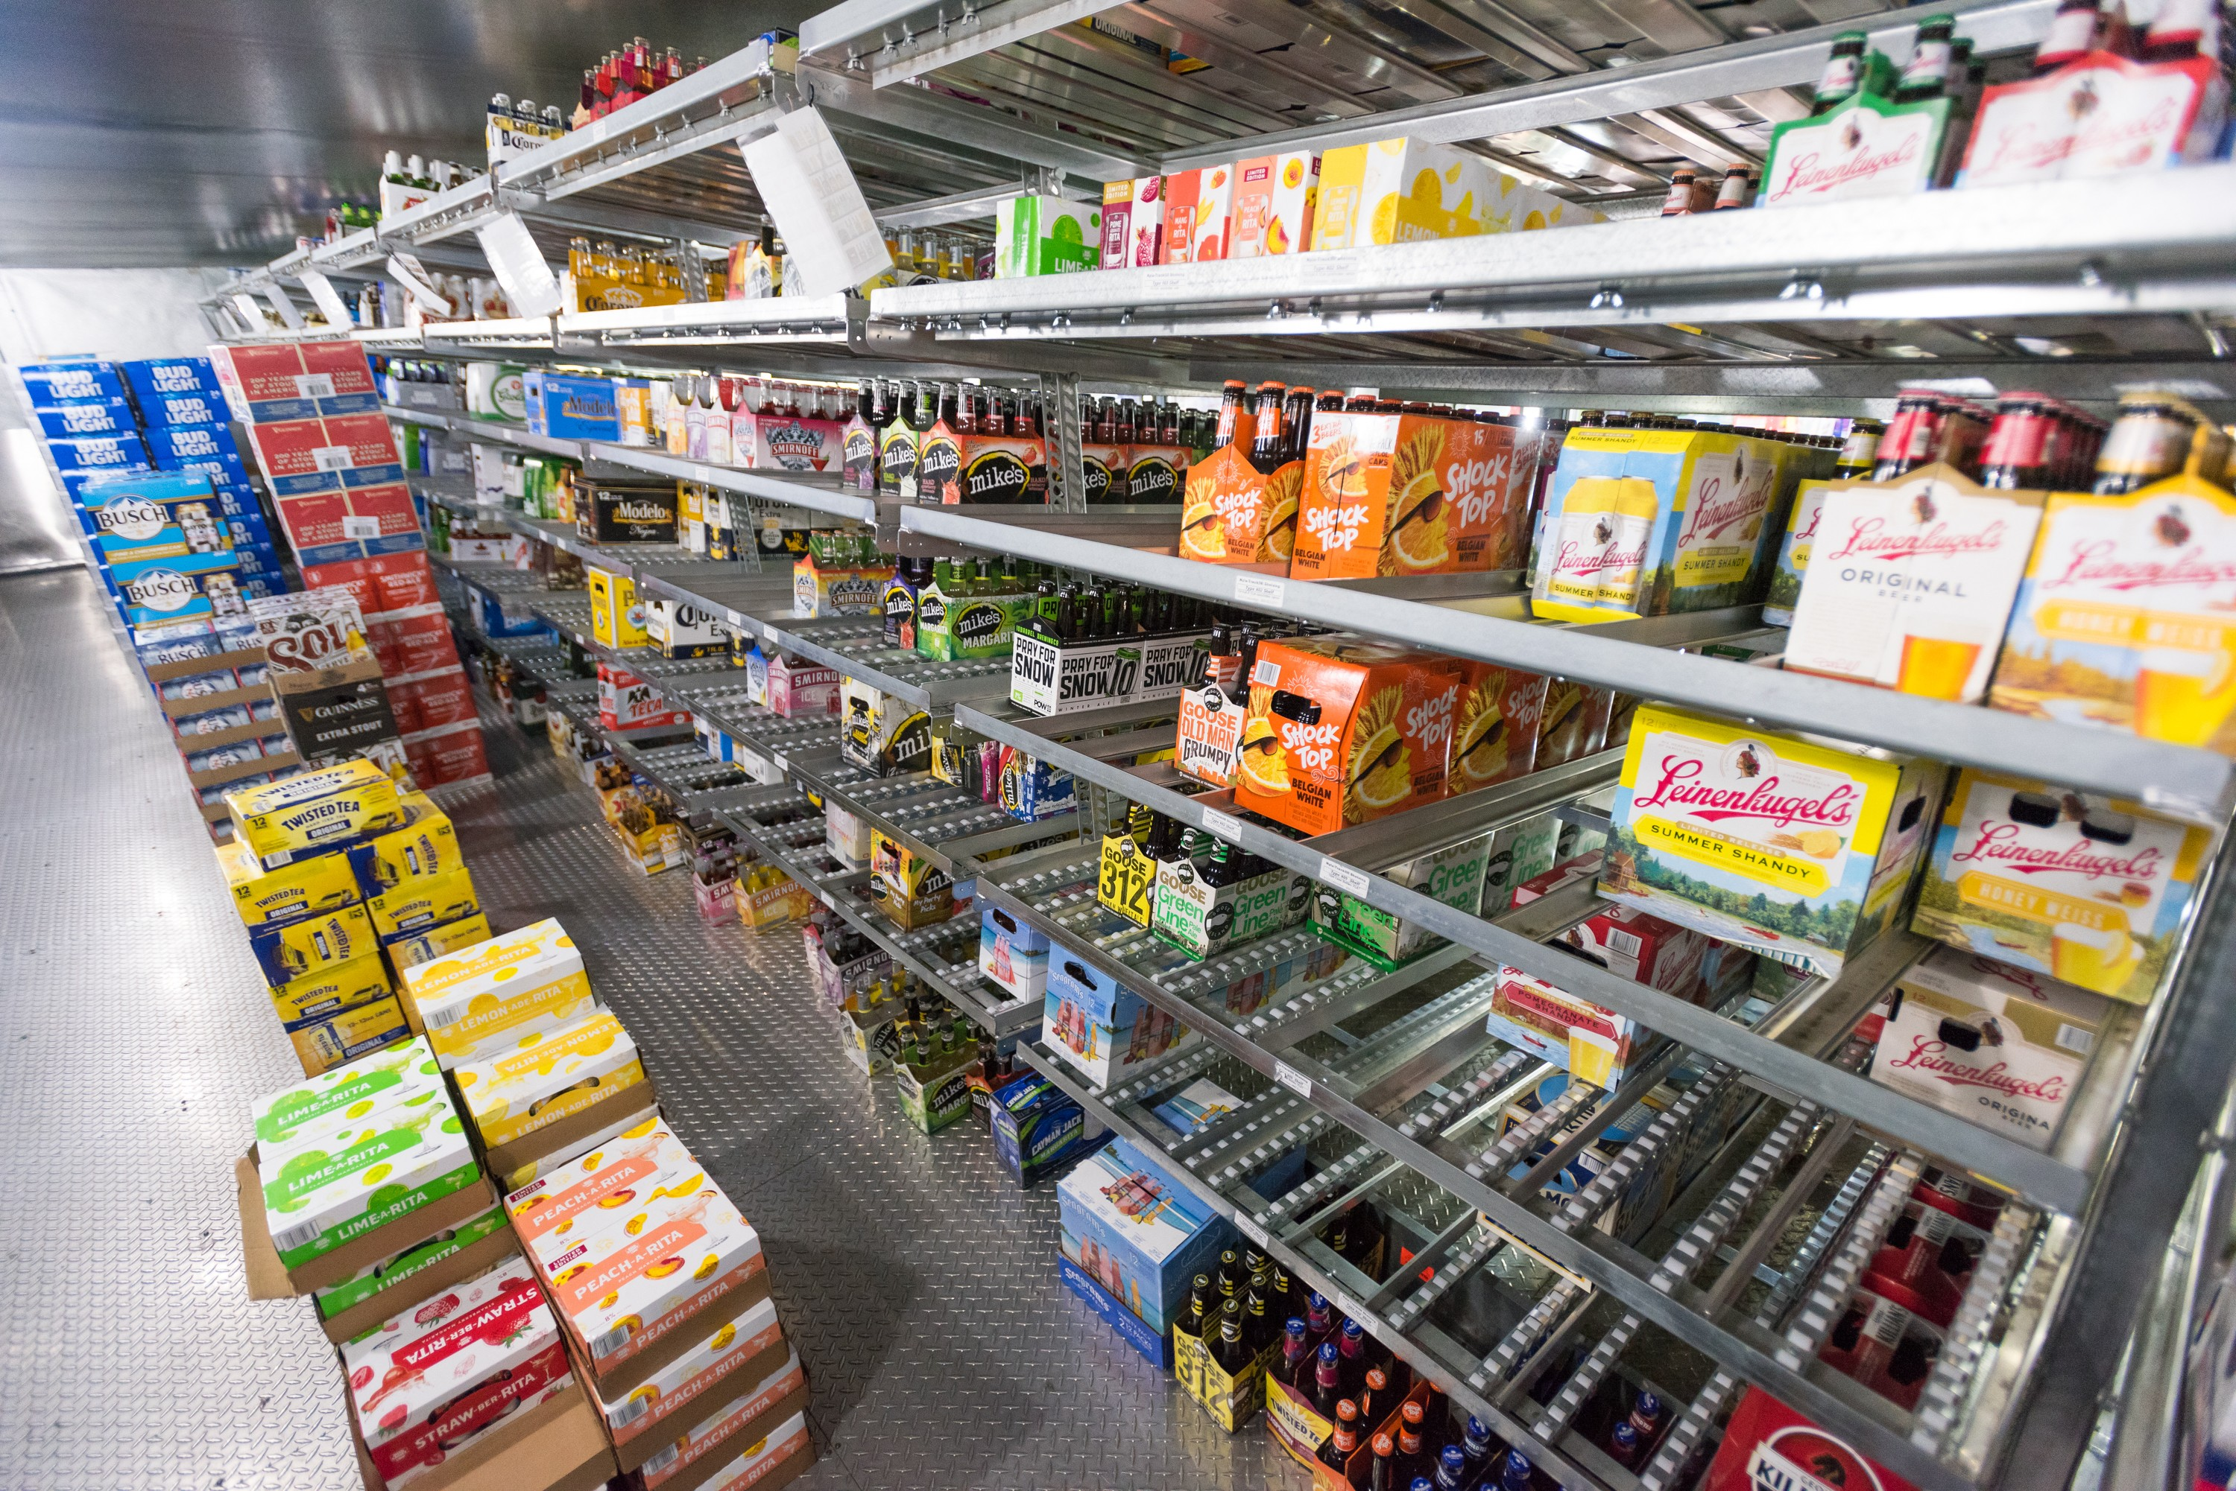




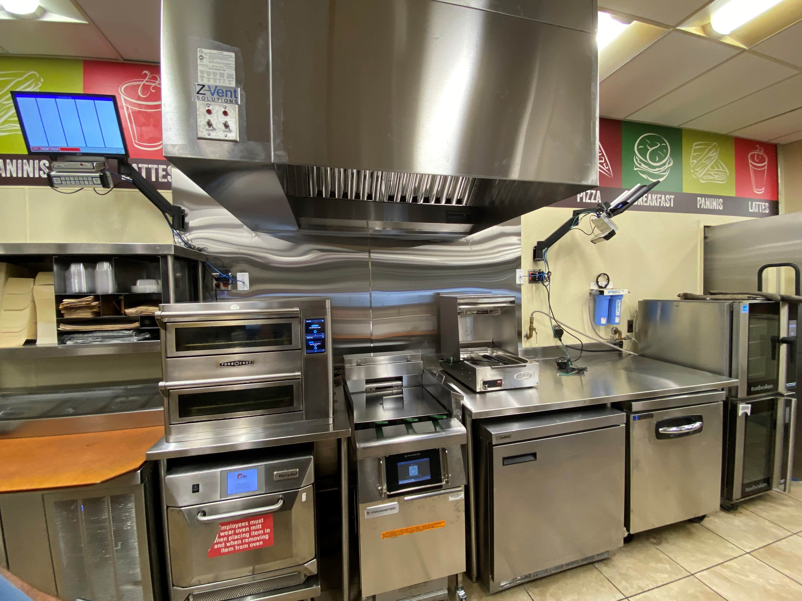
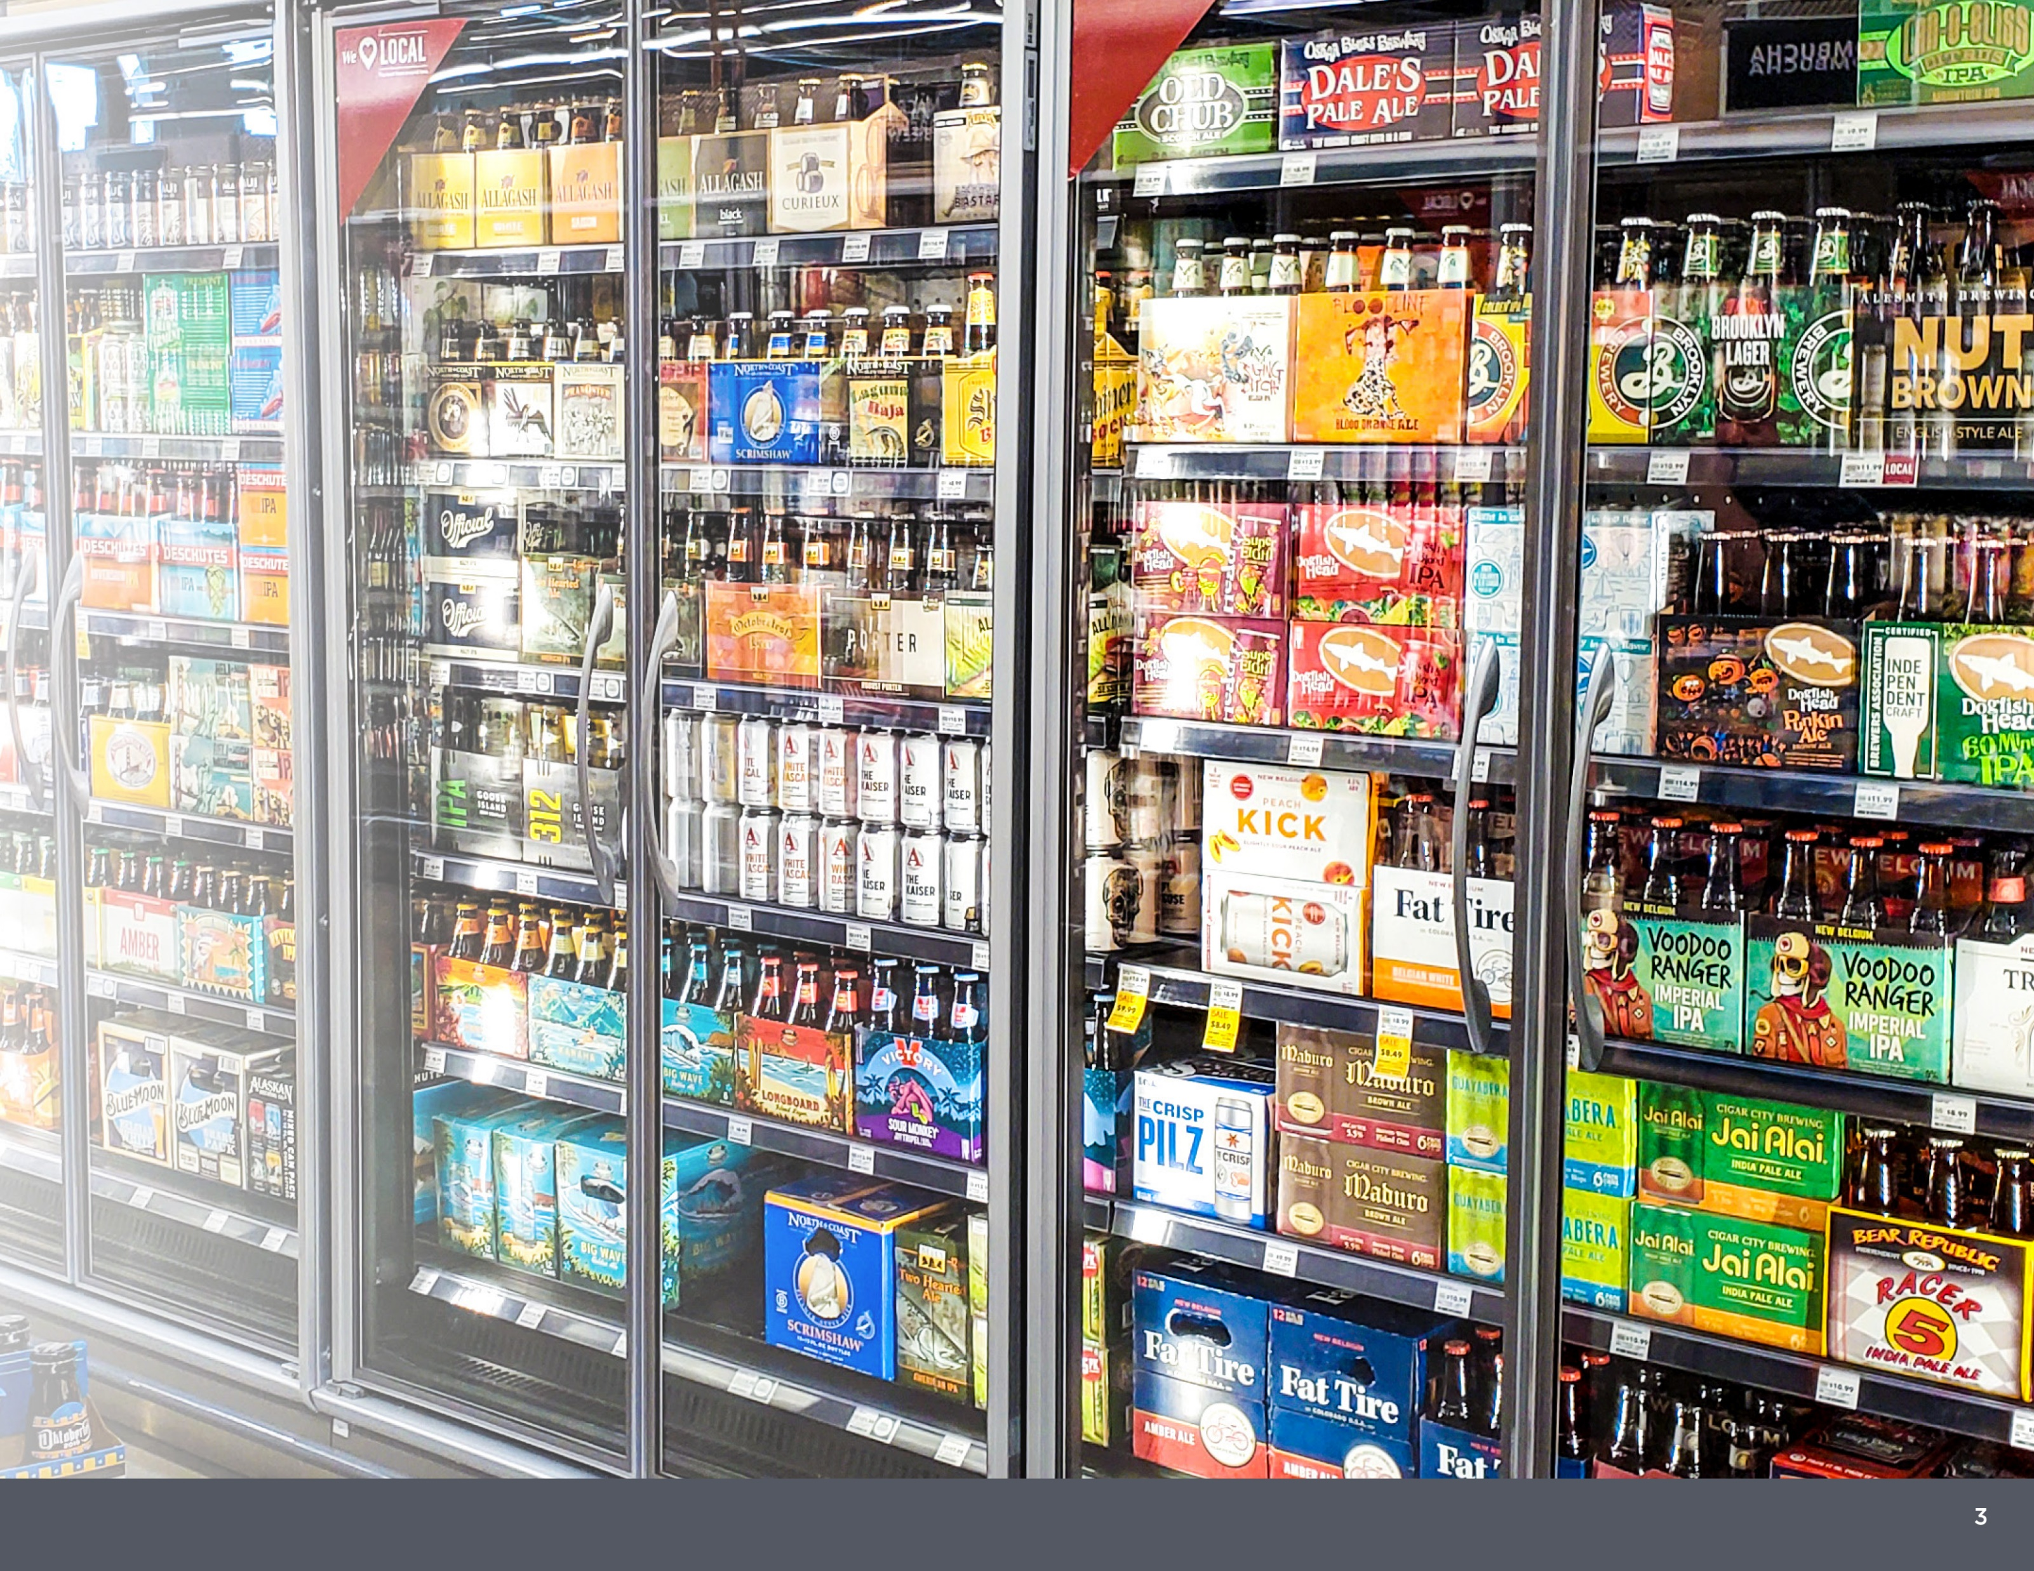
RETAIL
Retail and convenience stores are true to their name – they make it a business to craft fast service solutions for their customers to get in and get out as conveniently as possible. They use glass doors, specialty shelving and product display solutions, merchandisers, display cases, and more to create a seamless process for their average consumer.
Glass Door
Installation
Walk-In
Shelving
Display Cases
Box Design
And Build
LED Lighting
Systems

Slide 11
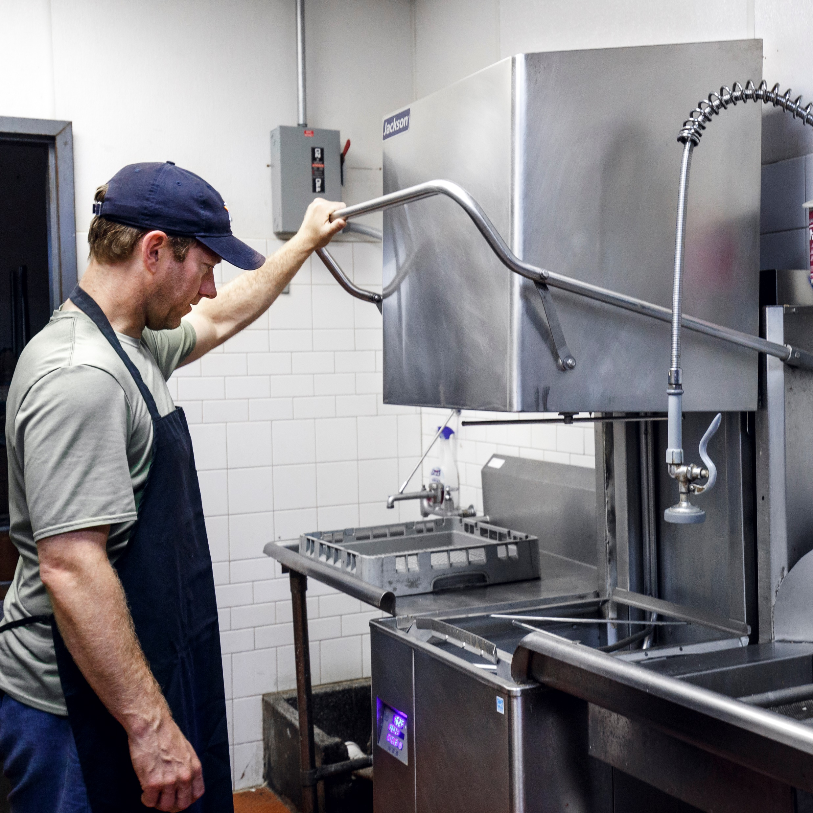
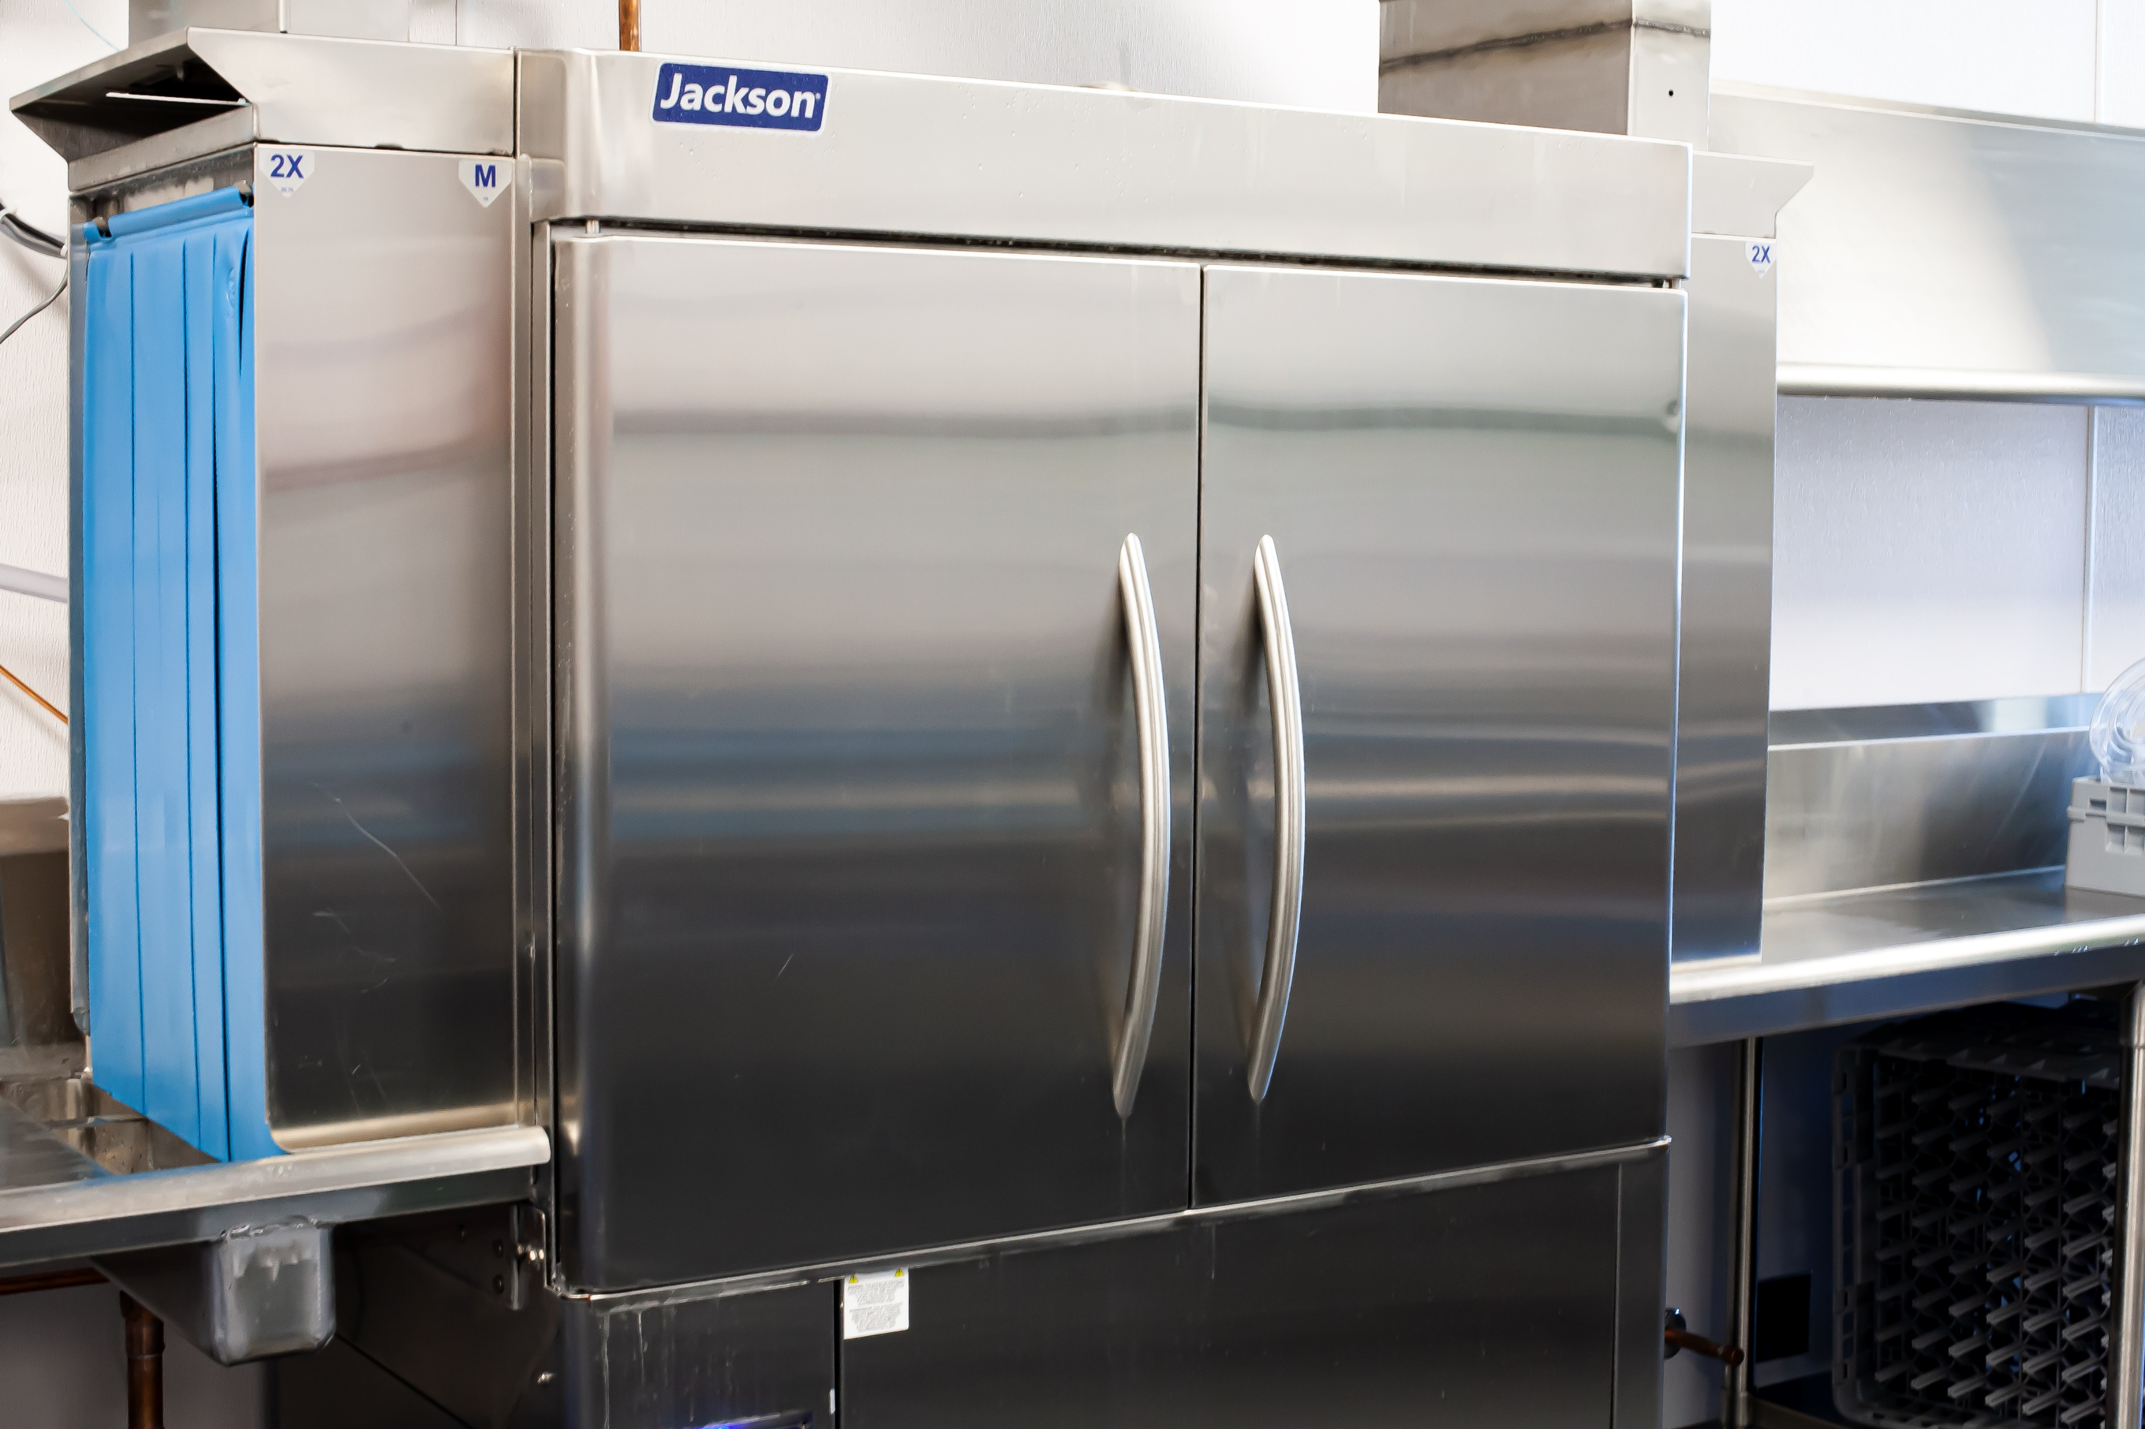




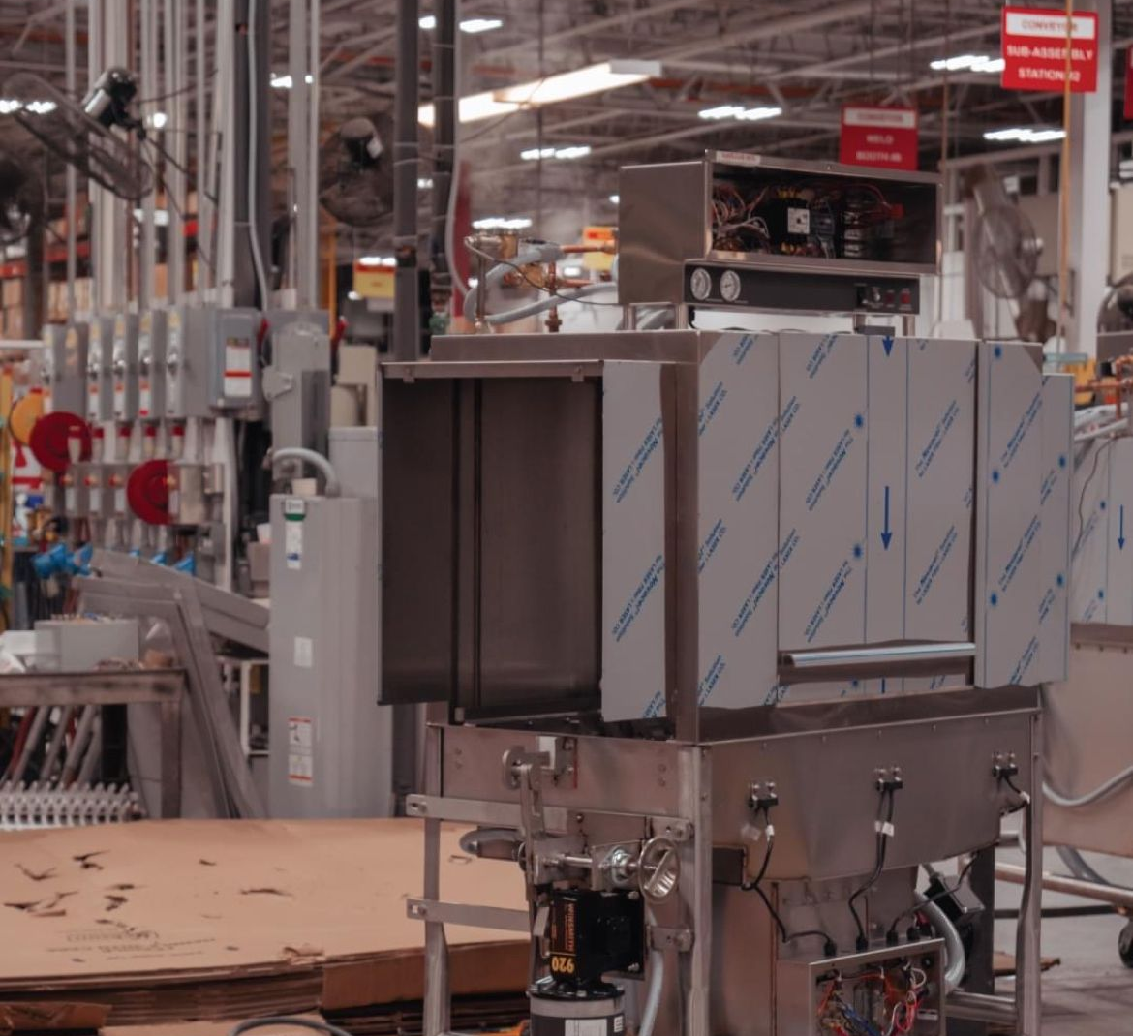
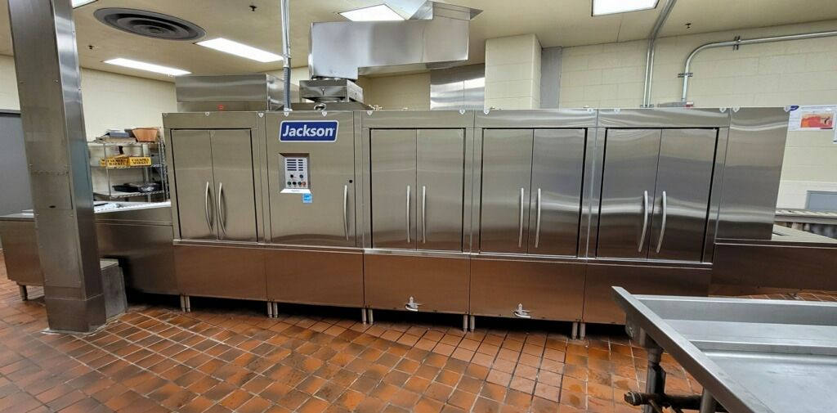
DISHMACHINES
The AIM team has extensive experience in all avenues of dish machine installation, from undercounters and door-type machines, to a full flight system.
Undercounter
Door Type
Conveyors
Flight Systems

Slide 12
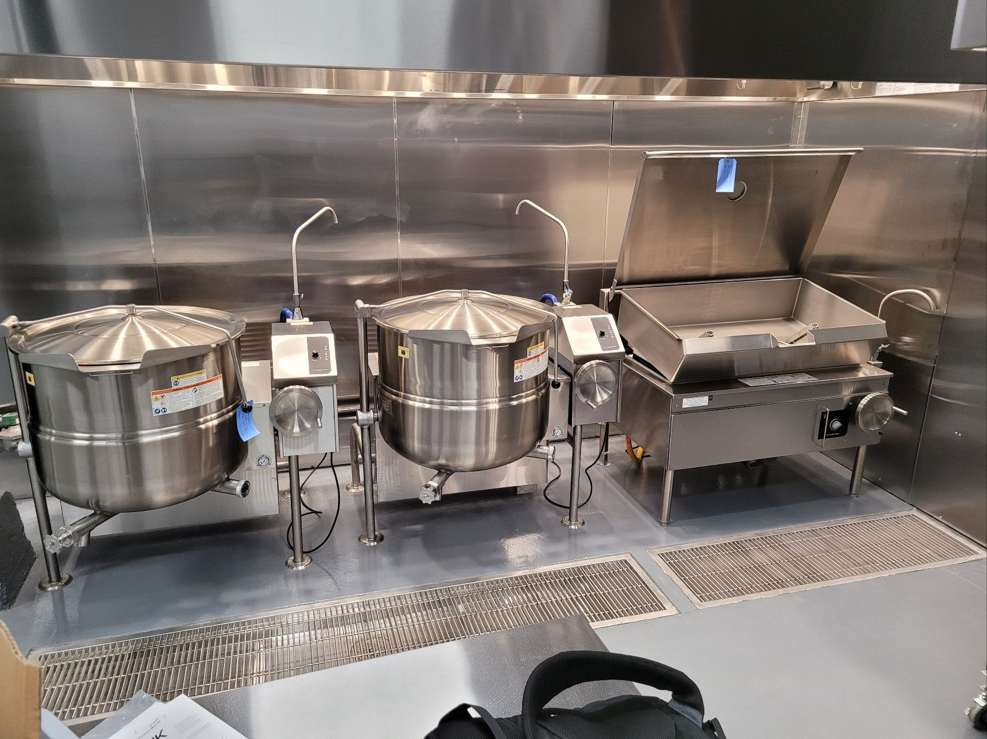
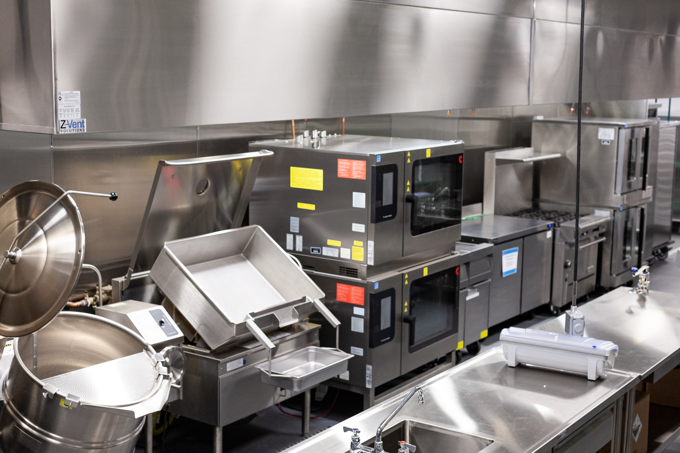





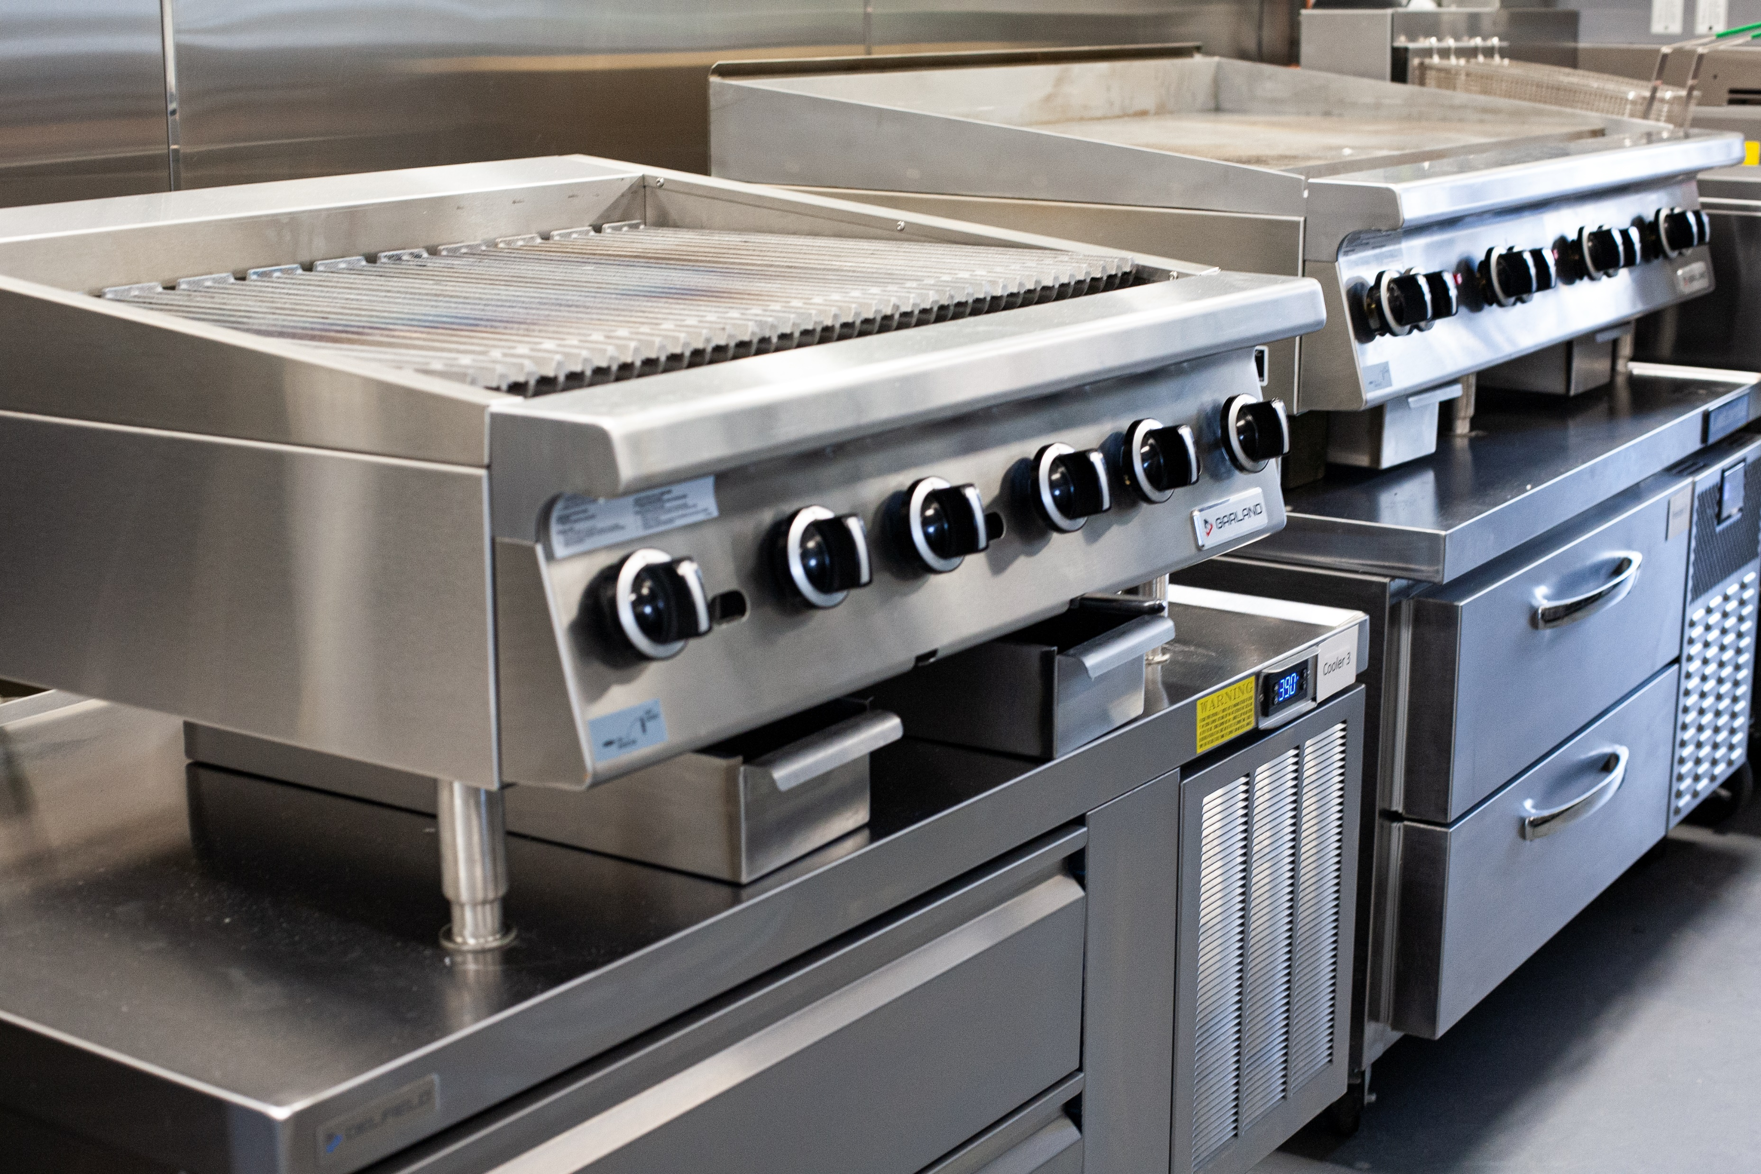
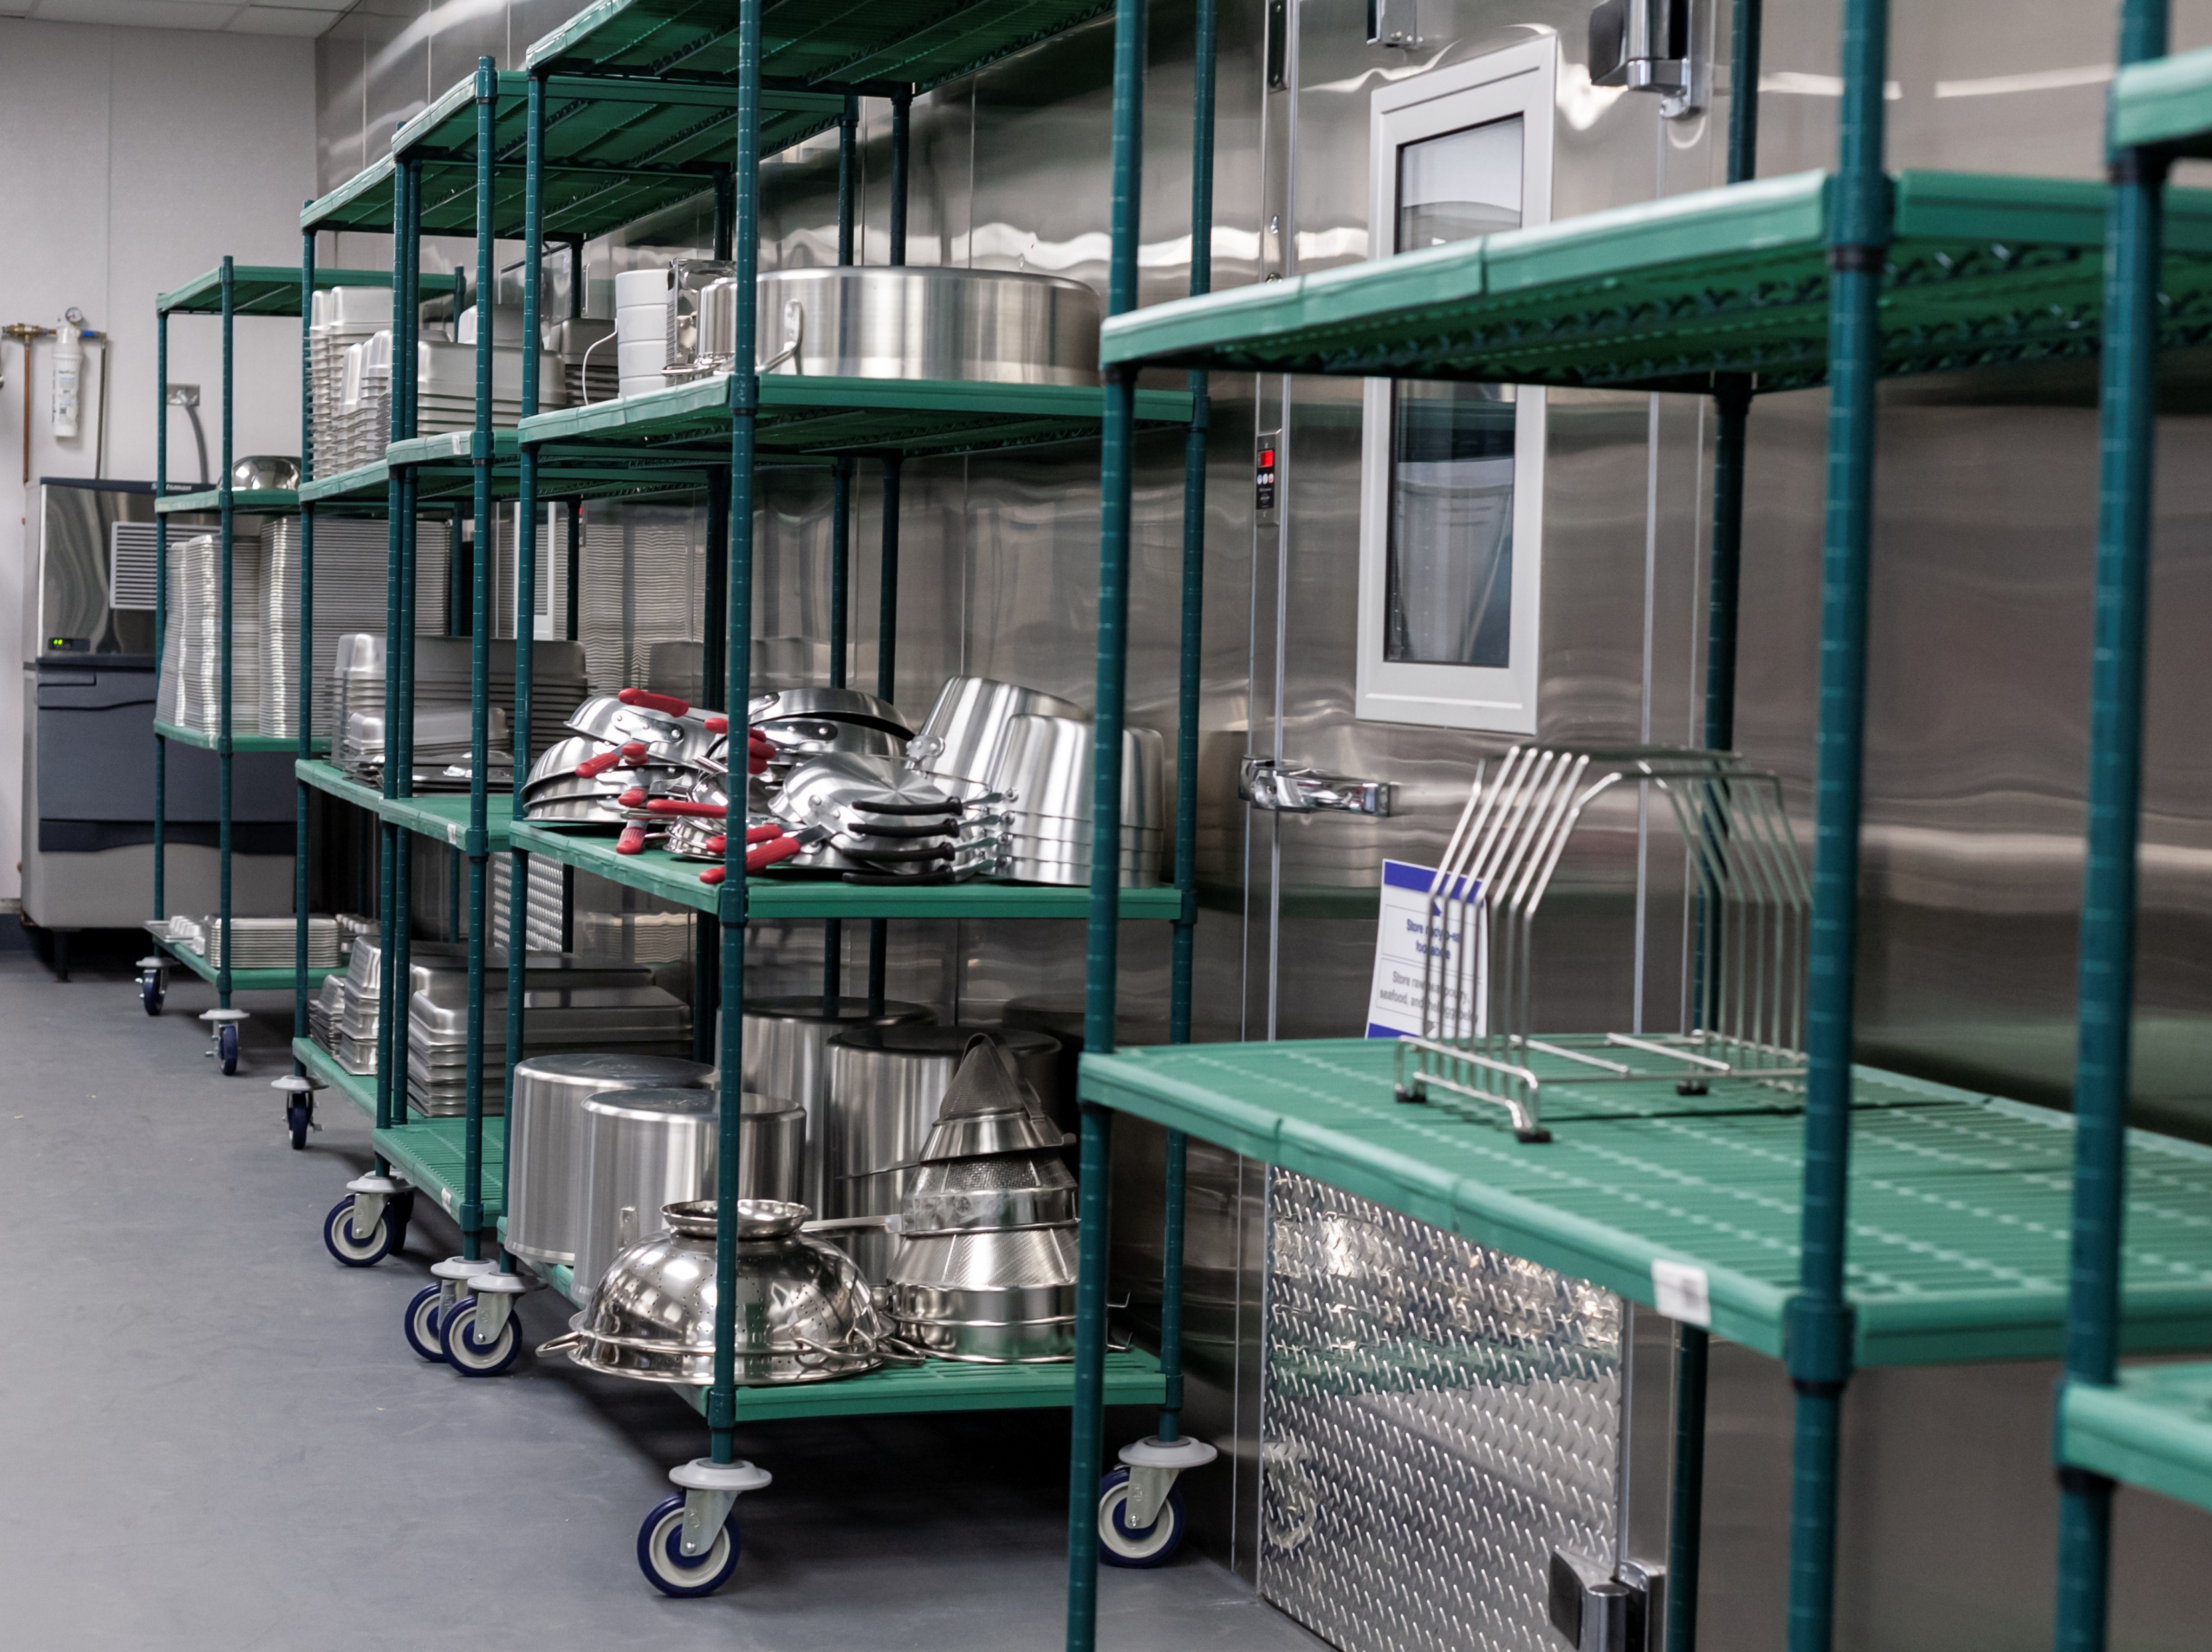
HOT SIDE EQUIPMENT
AIM National installs Ranges, conveyor ovens, fryers, convection ovens, fryers, grills and charbroilers, and steamers.
Ranges
Conveyor
Ovens
Fryers
Convection Ovens
Grills and
Char broilers
Steamers

Slide 13
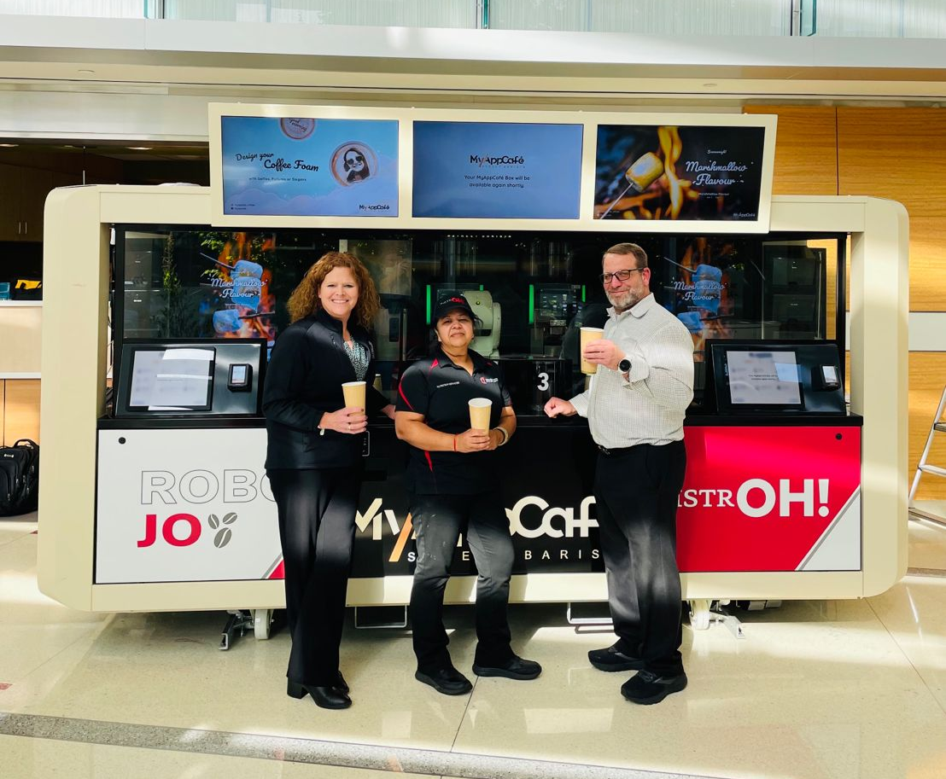
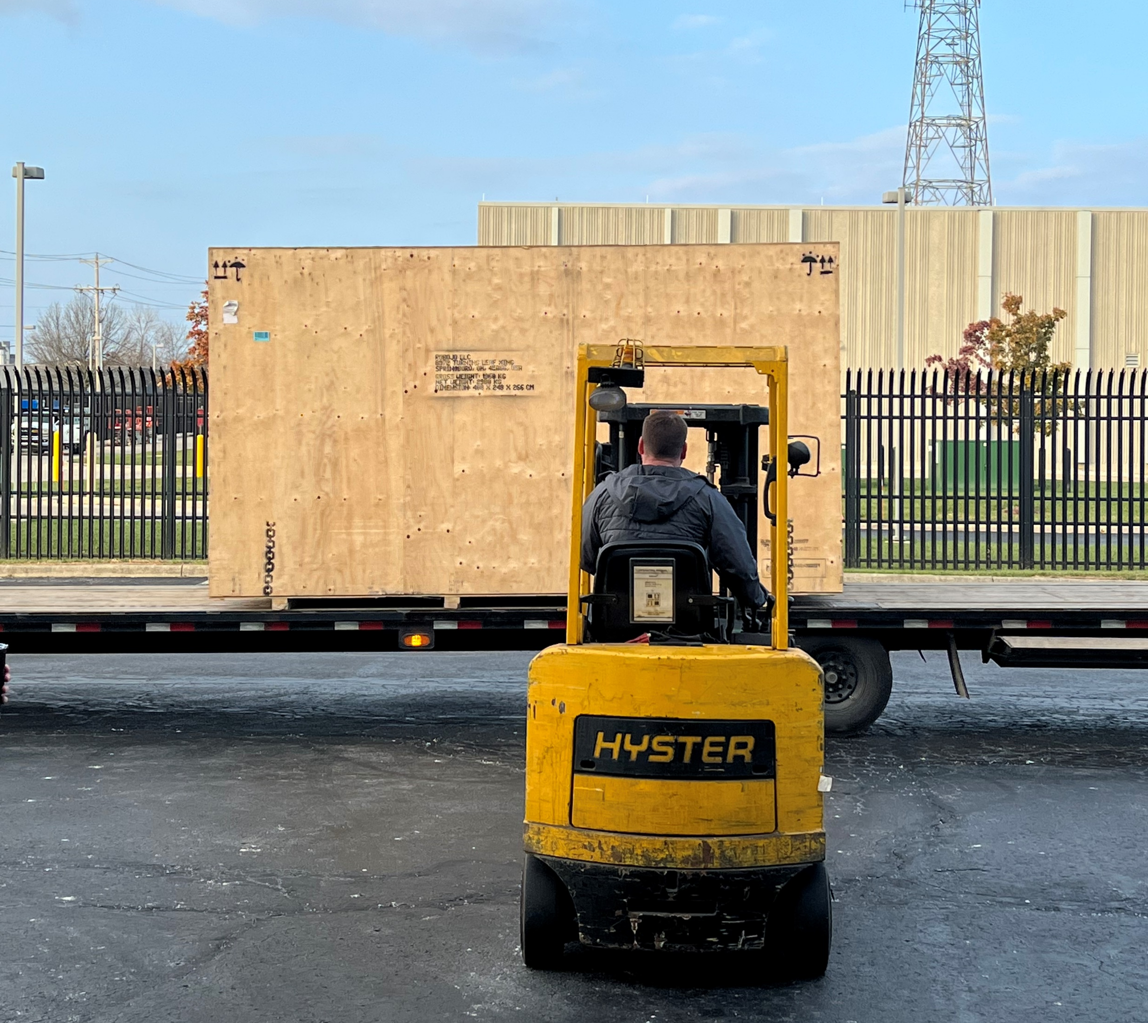
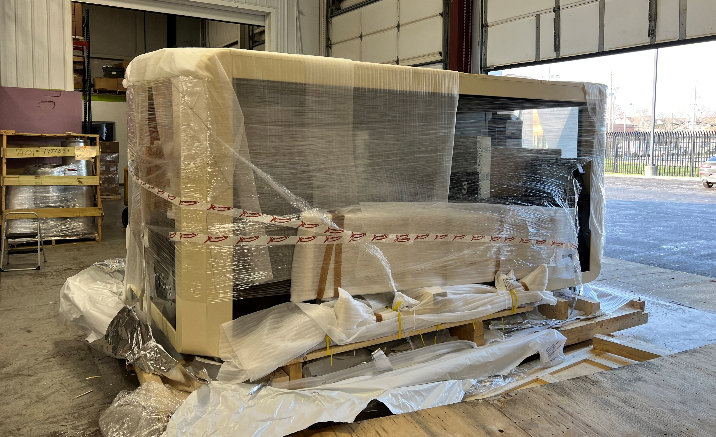
AUTOMATION
Automation is a newly tapped avenue in the foodservice industry. As labor demands grow, and costs continue to increase, it has become brought more possibilities to the forefront, from fully robotic coffee kiosks to automations in prep lines. AIM is offers reliability in this evolving field.
Autonomous
Kiosk
Performance Verification
Checks

Slide 14
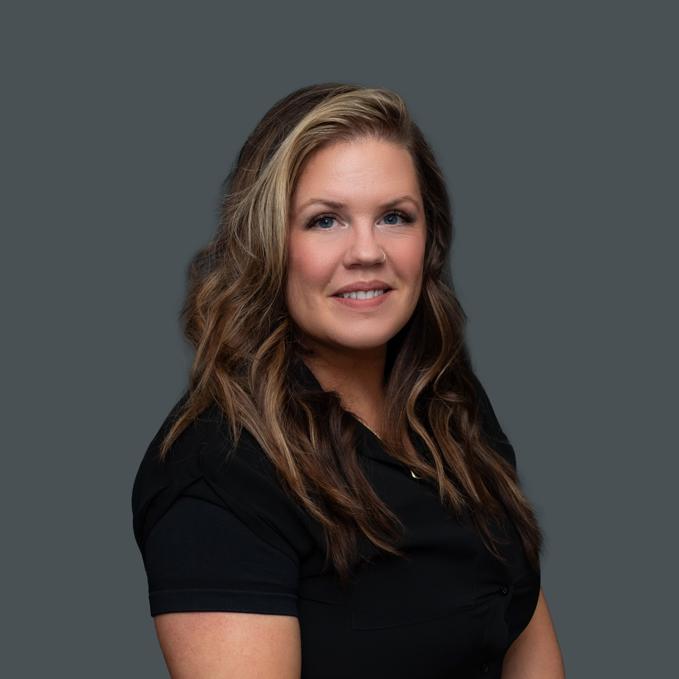
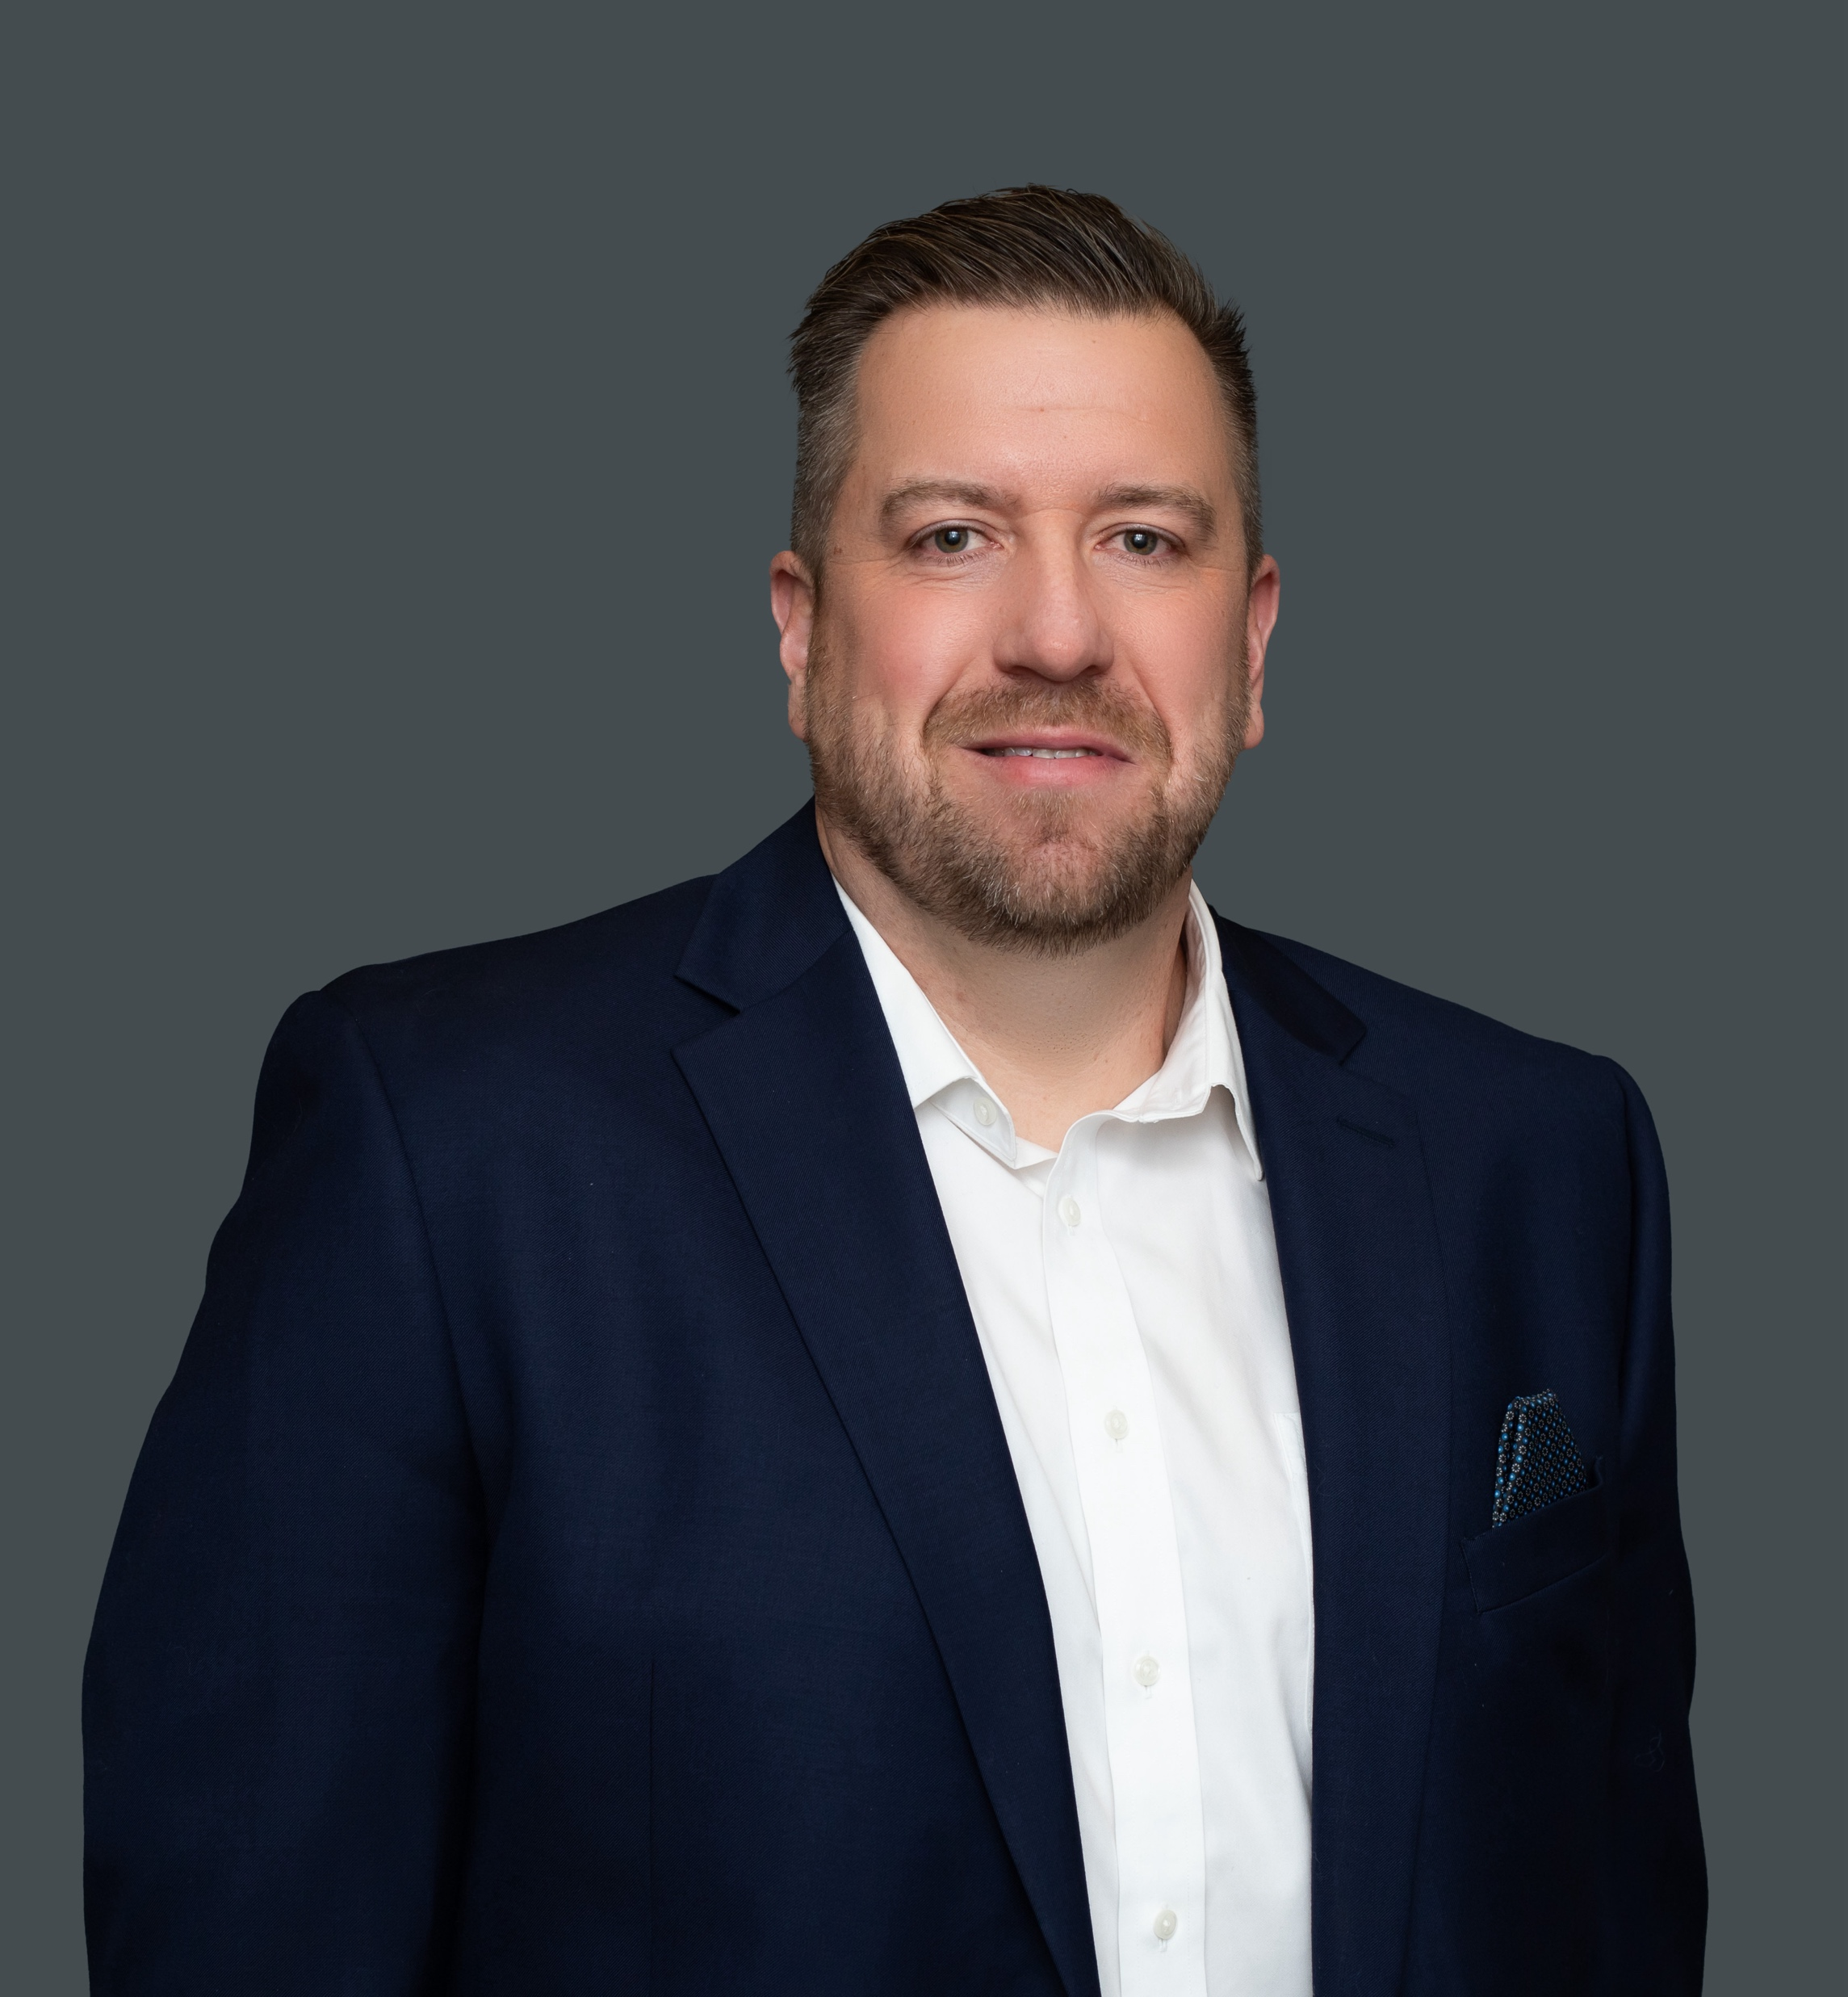
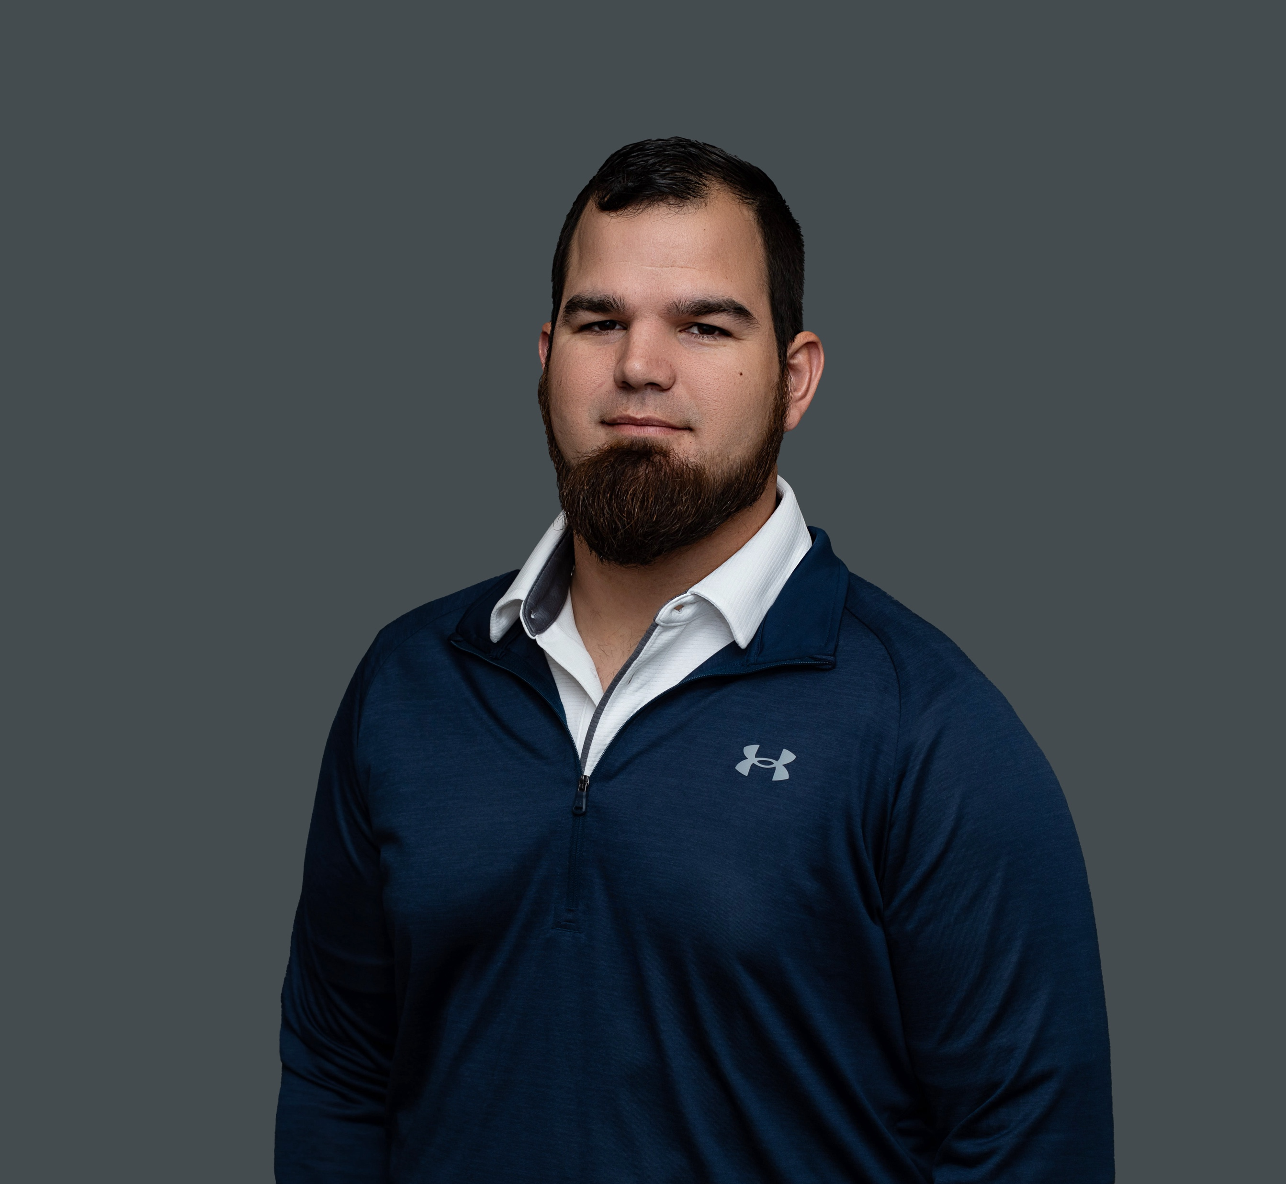
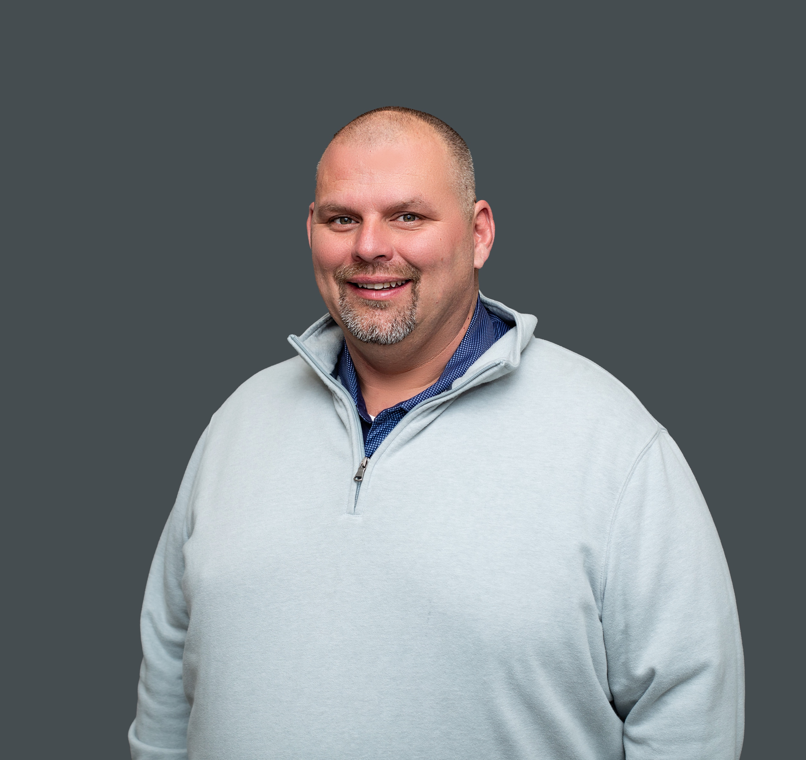
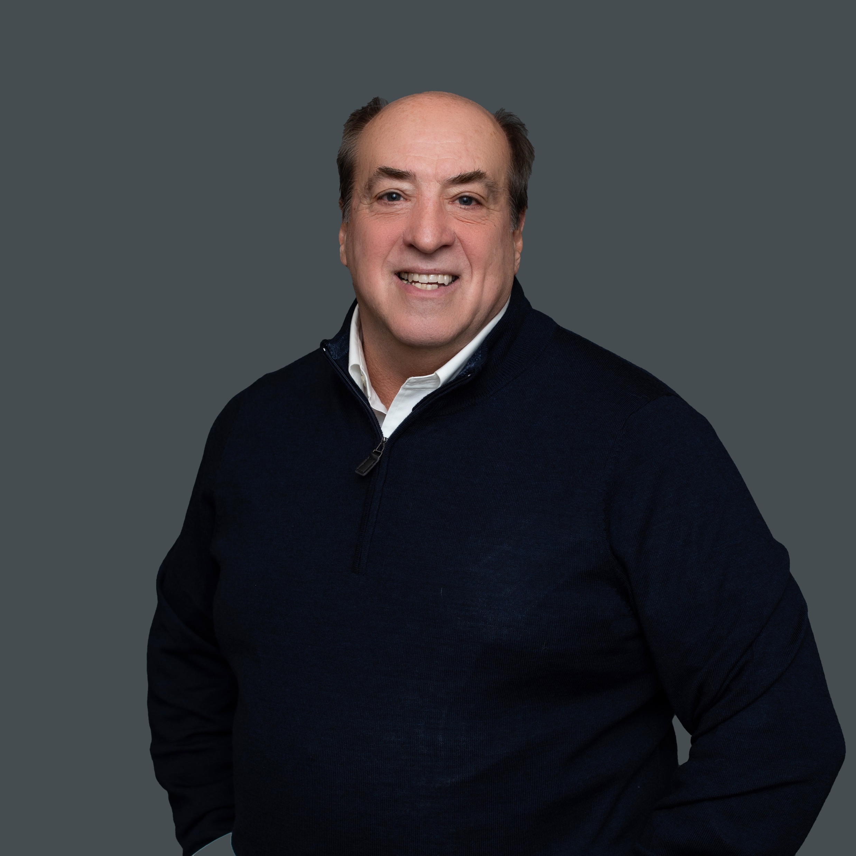

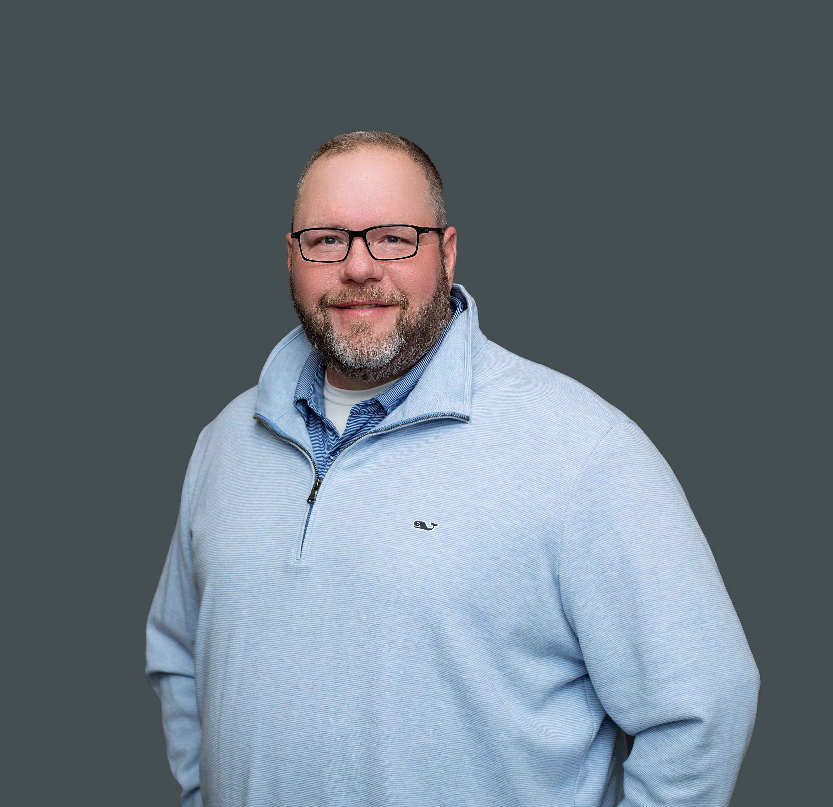
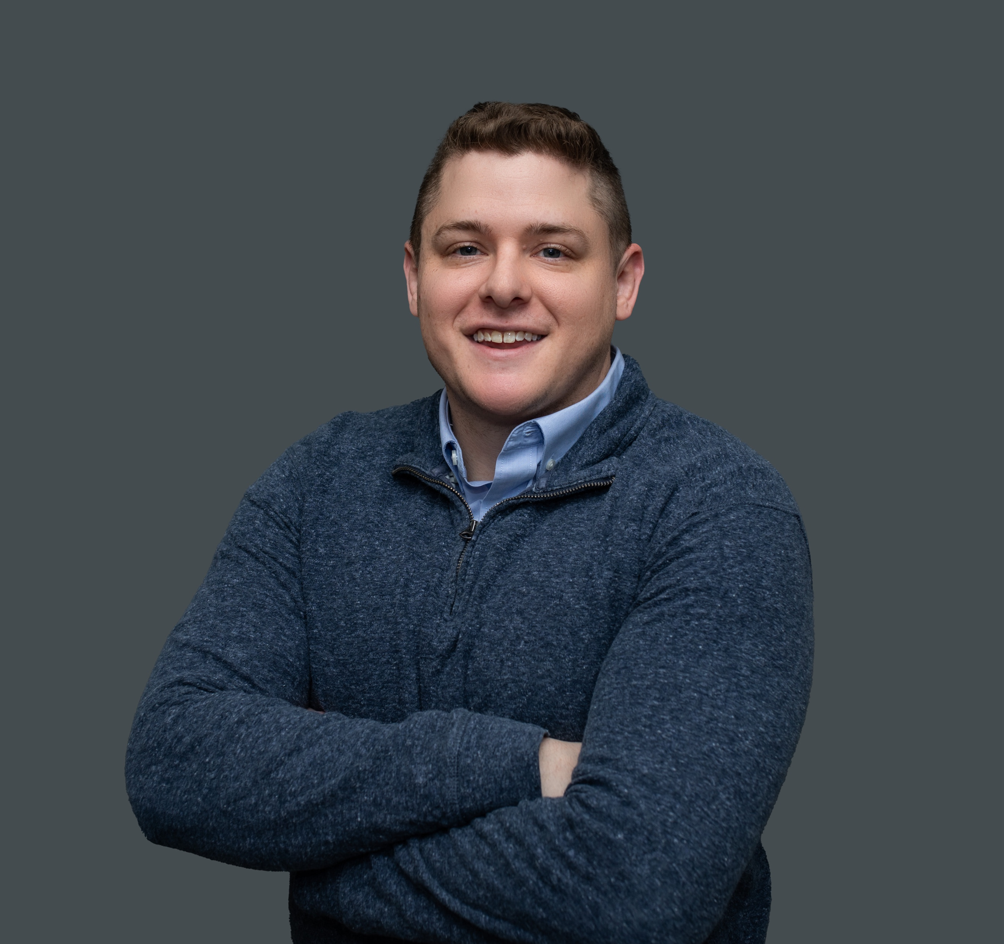
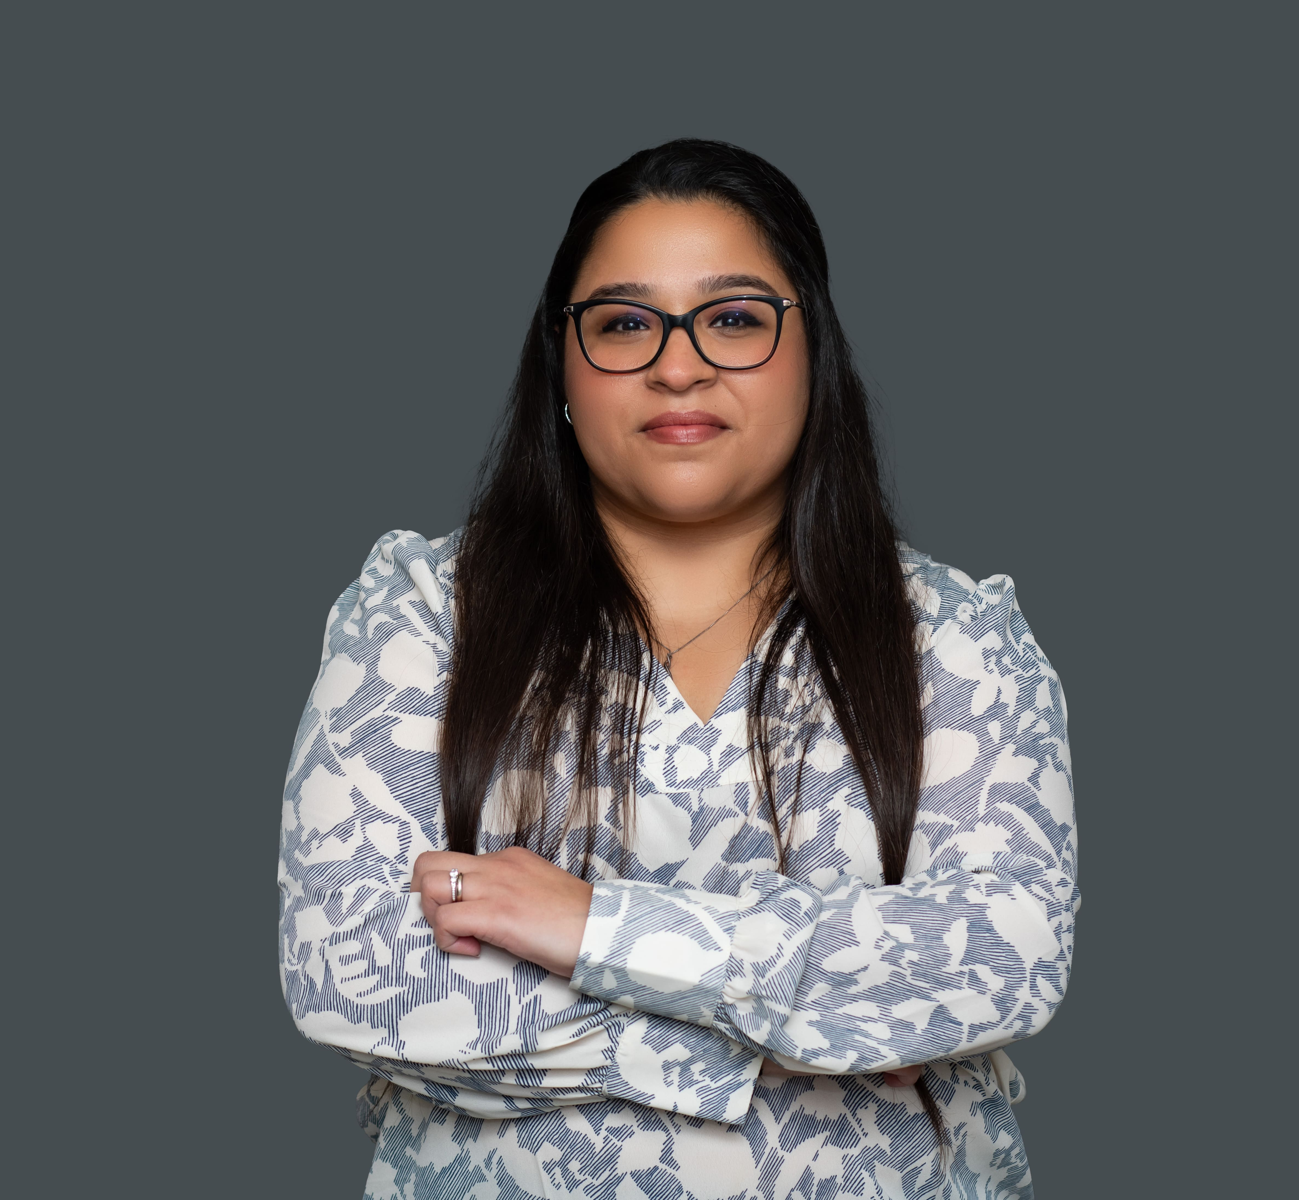
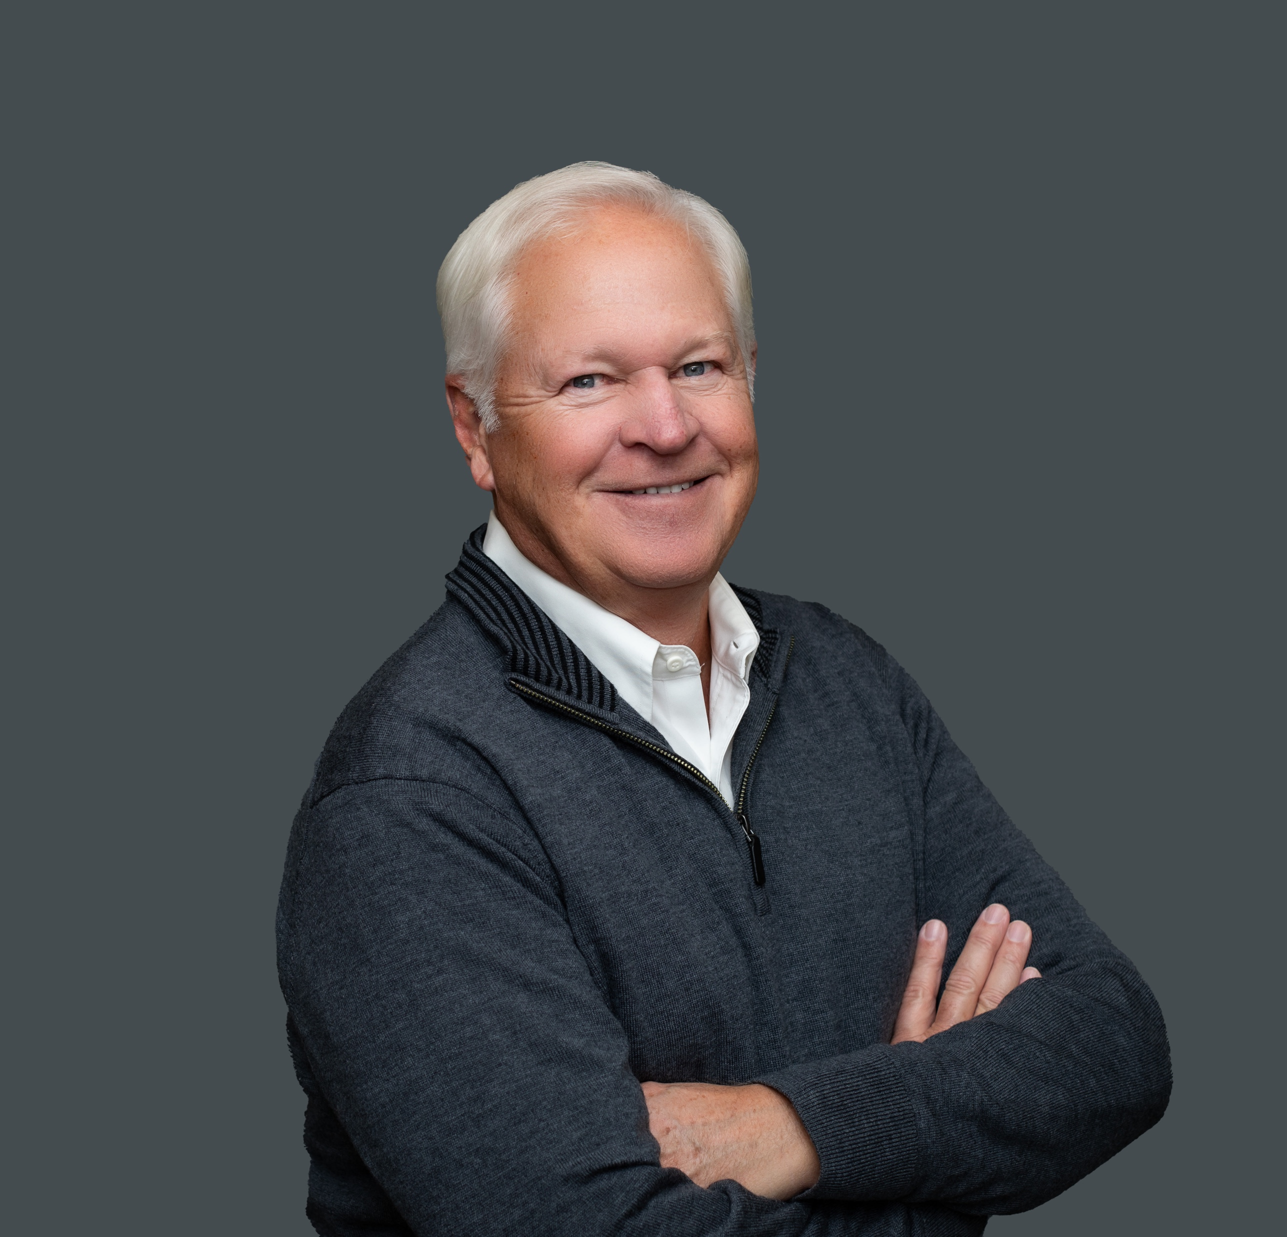
PROJECT MANAGEMENT TEAM
Stacy Shillcox
Installation Lead
sshillcox@aimnational.com
Brandon Ragsdale
Service Manager
bragsdale@aimnational.com
Steve Bosworth
Division Manager
steveb@aimnational.com
Jeremy Applegate
Installation Coordinator
japplegate@aimnational.com
Ron Trapper
Service Manager
rtrapper@aimnational.com
Matt Anctil
Installation Manager
matta@aimnational.com
Jody McCarty
Installation Coordinator
jmccarty@aimnational.com
Meeta Bhatia
Installation Coordinator
mbhatia@aimnational.com
Austin Zavodny
Installation Coordinator
azavodny@aimnational.com
Jim Klamet
Installation Coordinator
jklamet@aimnational.com

Slide 15
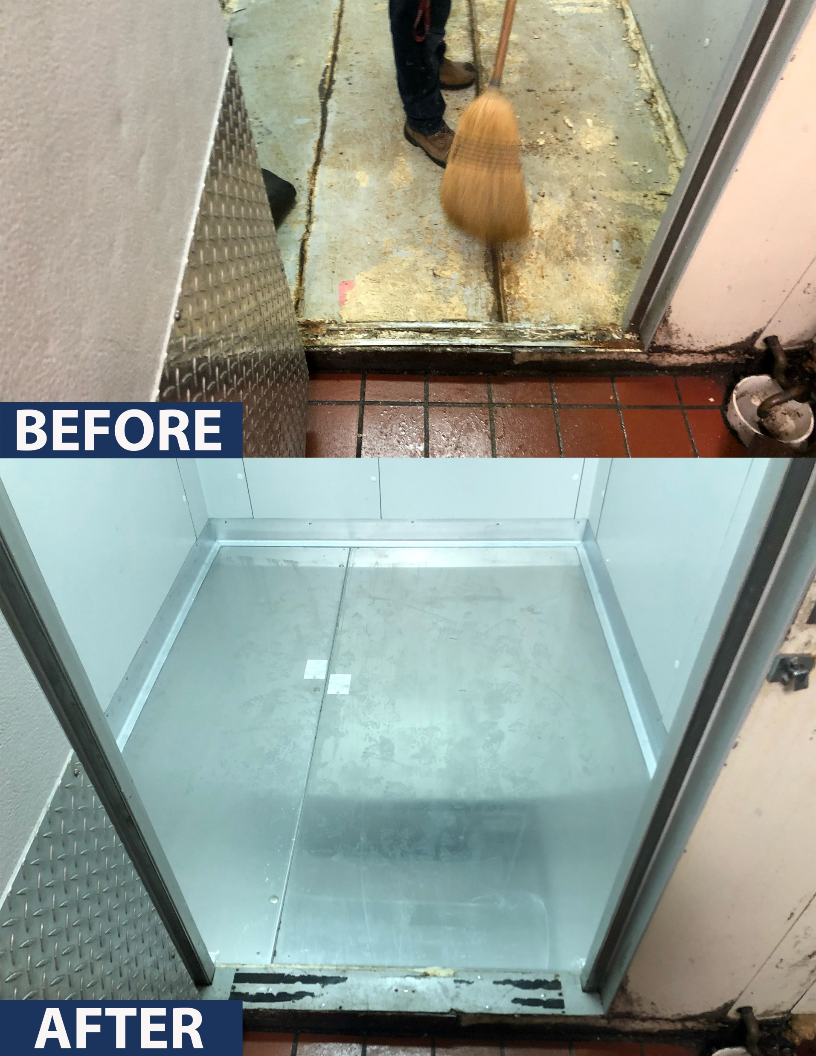









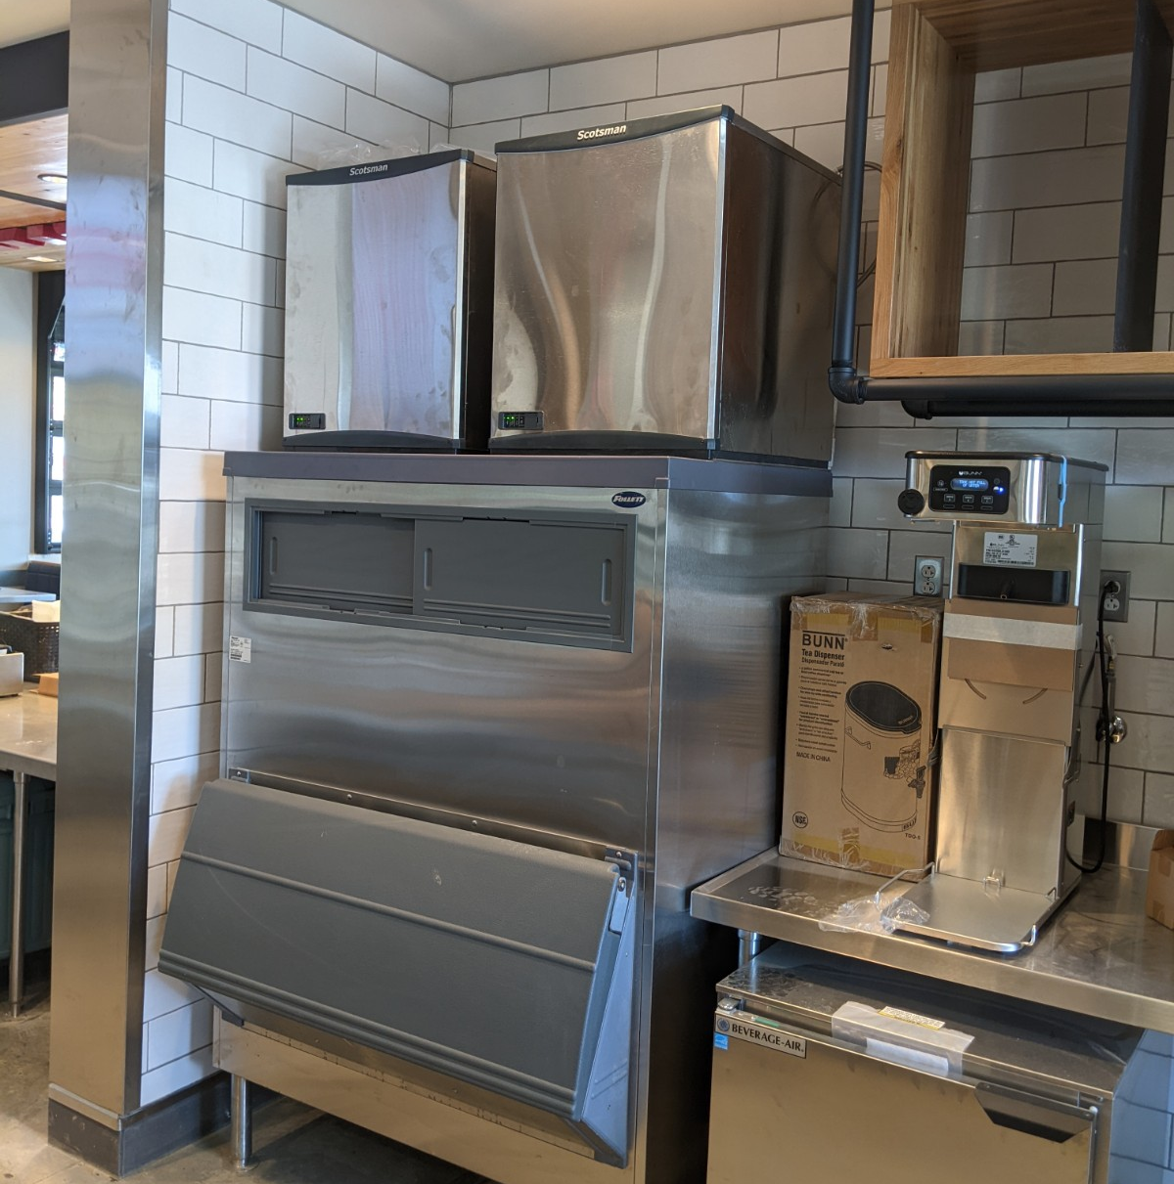











RESTAURANTS

Slide 16
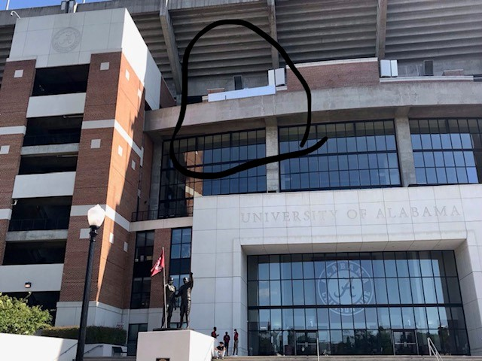



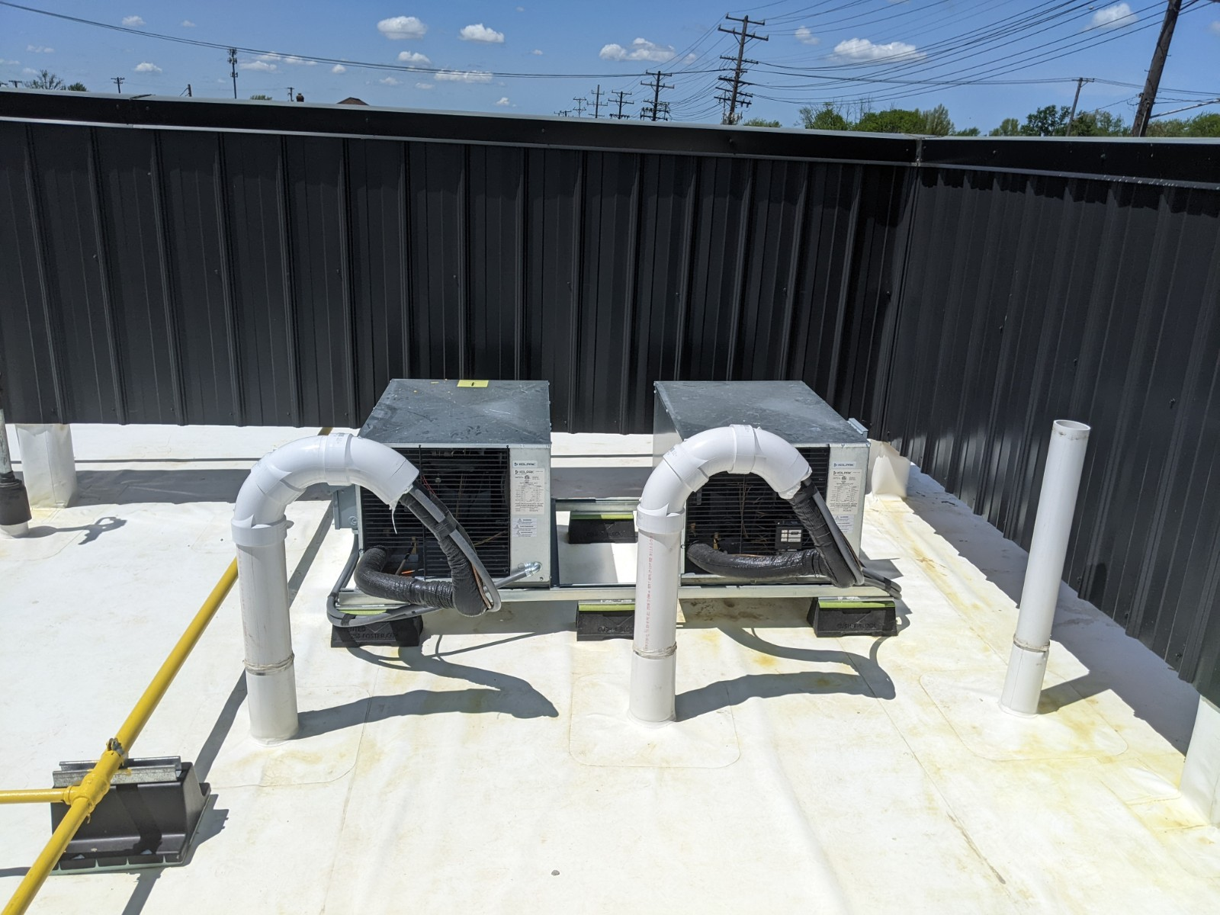




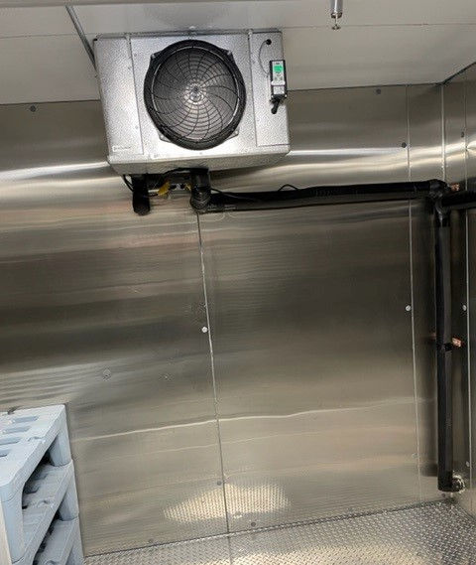





EDUCATION

Slide 17


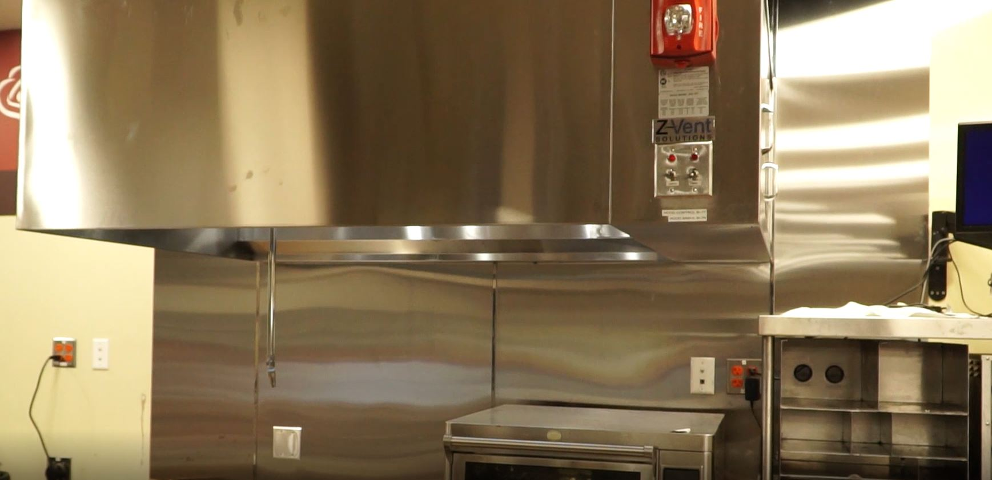

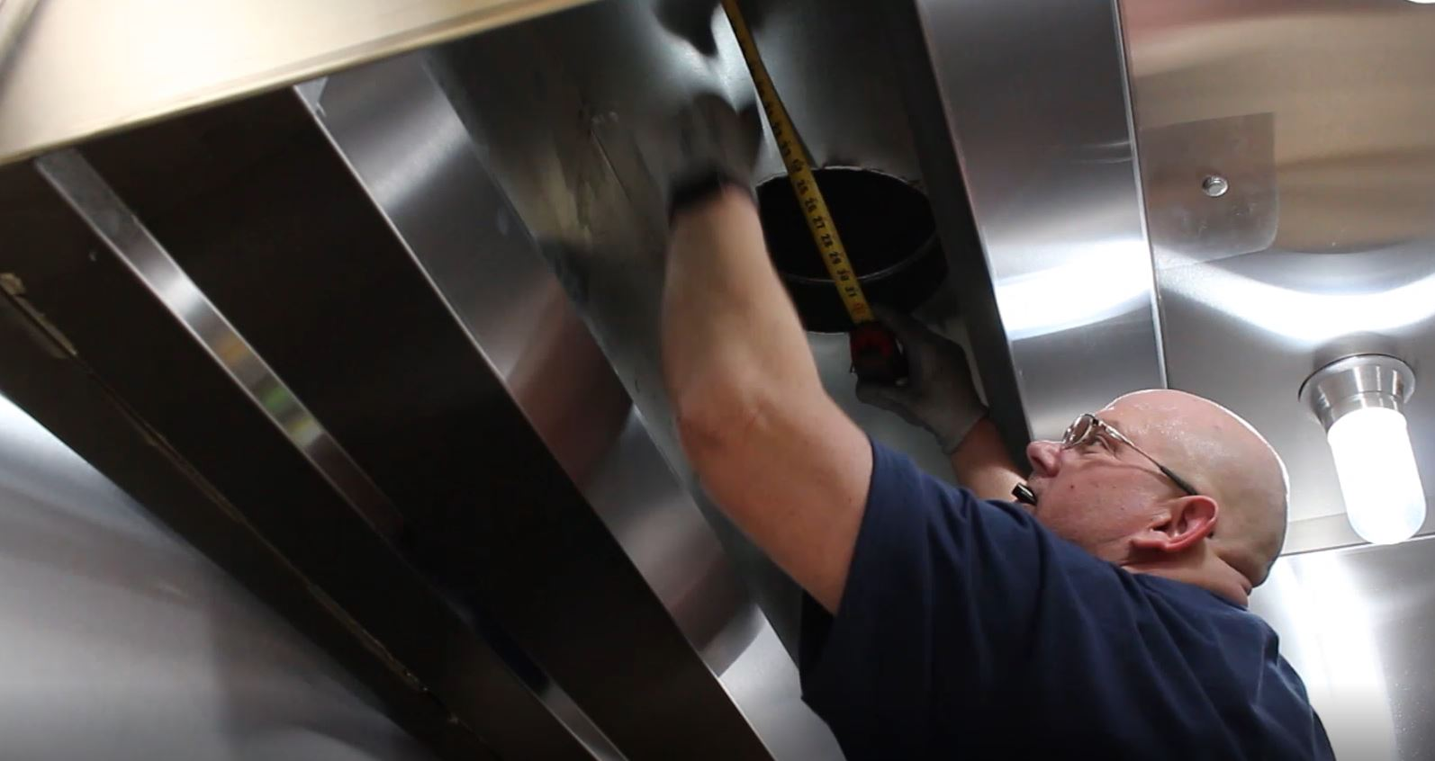


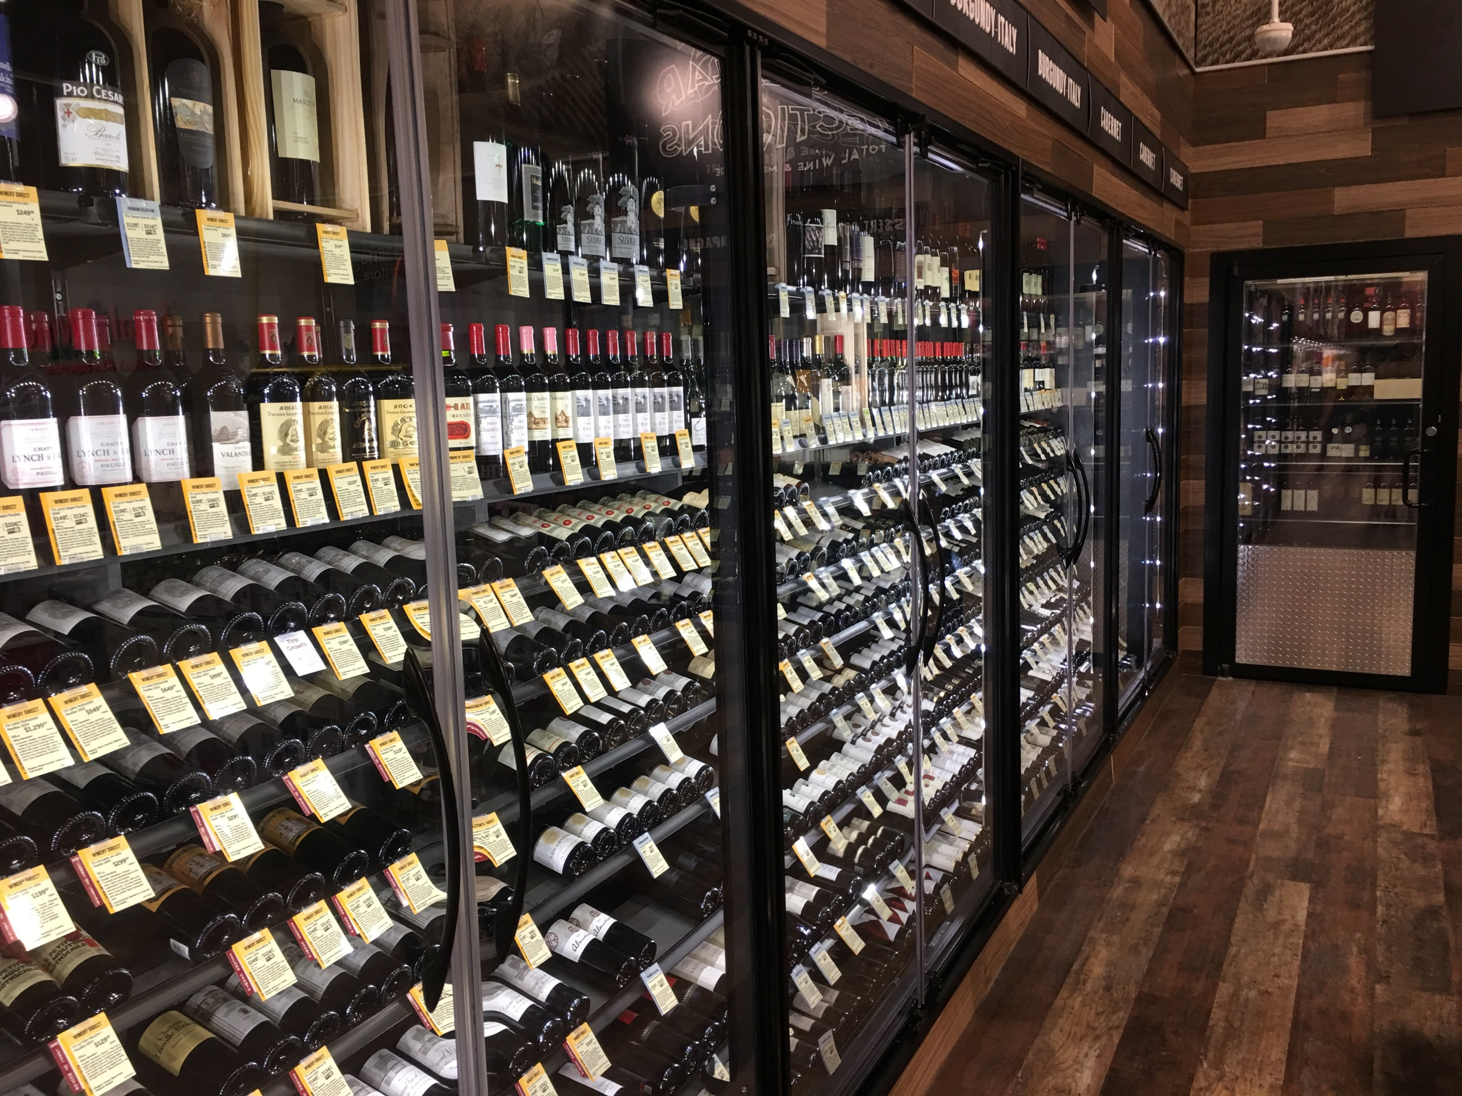
RETAIL

Slide 18
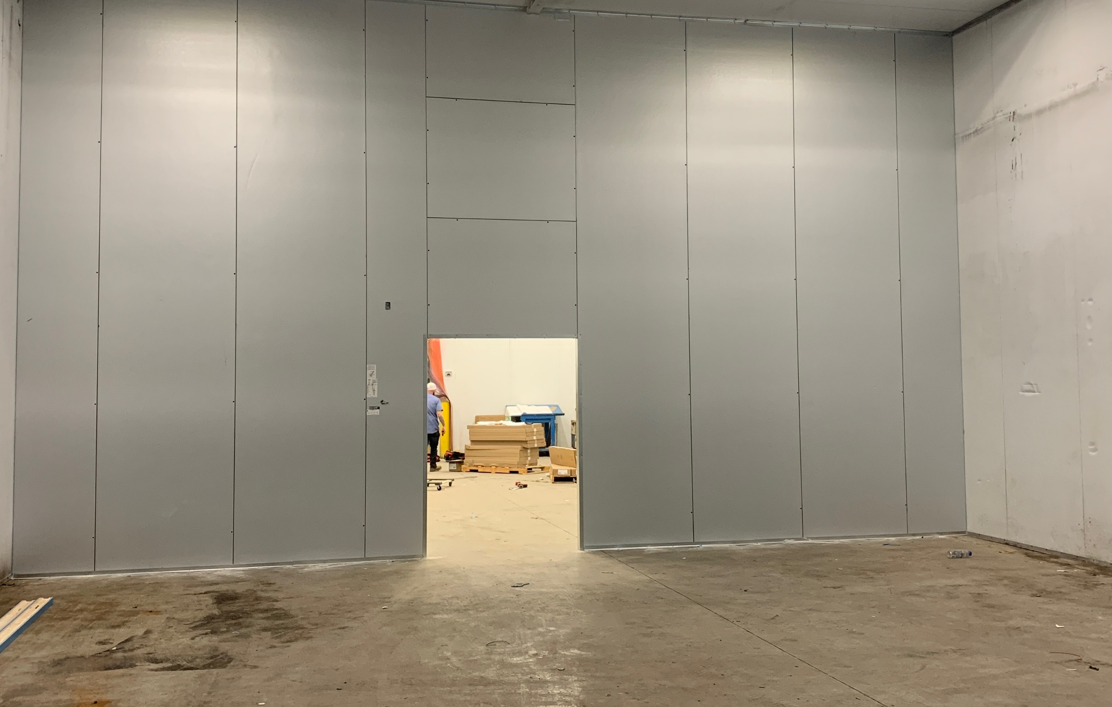


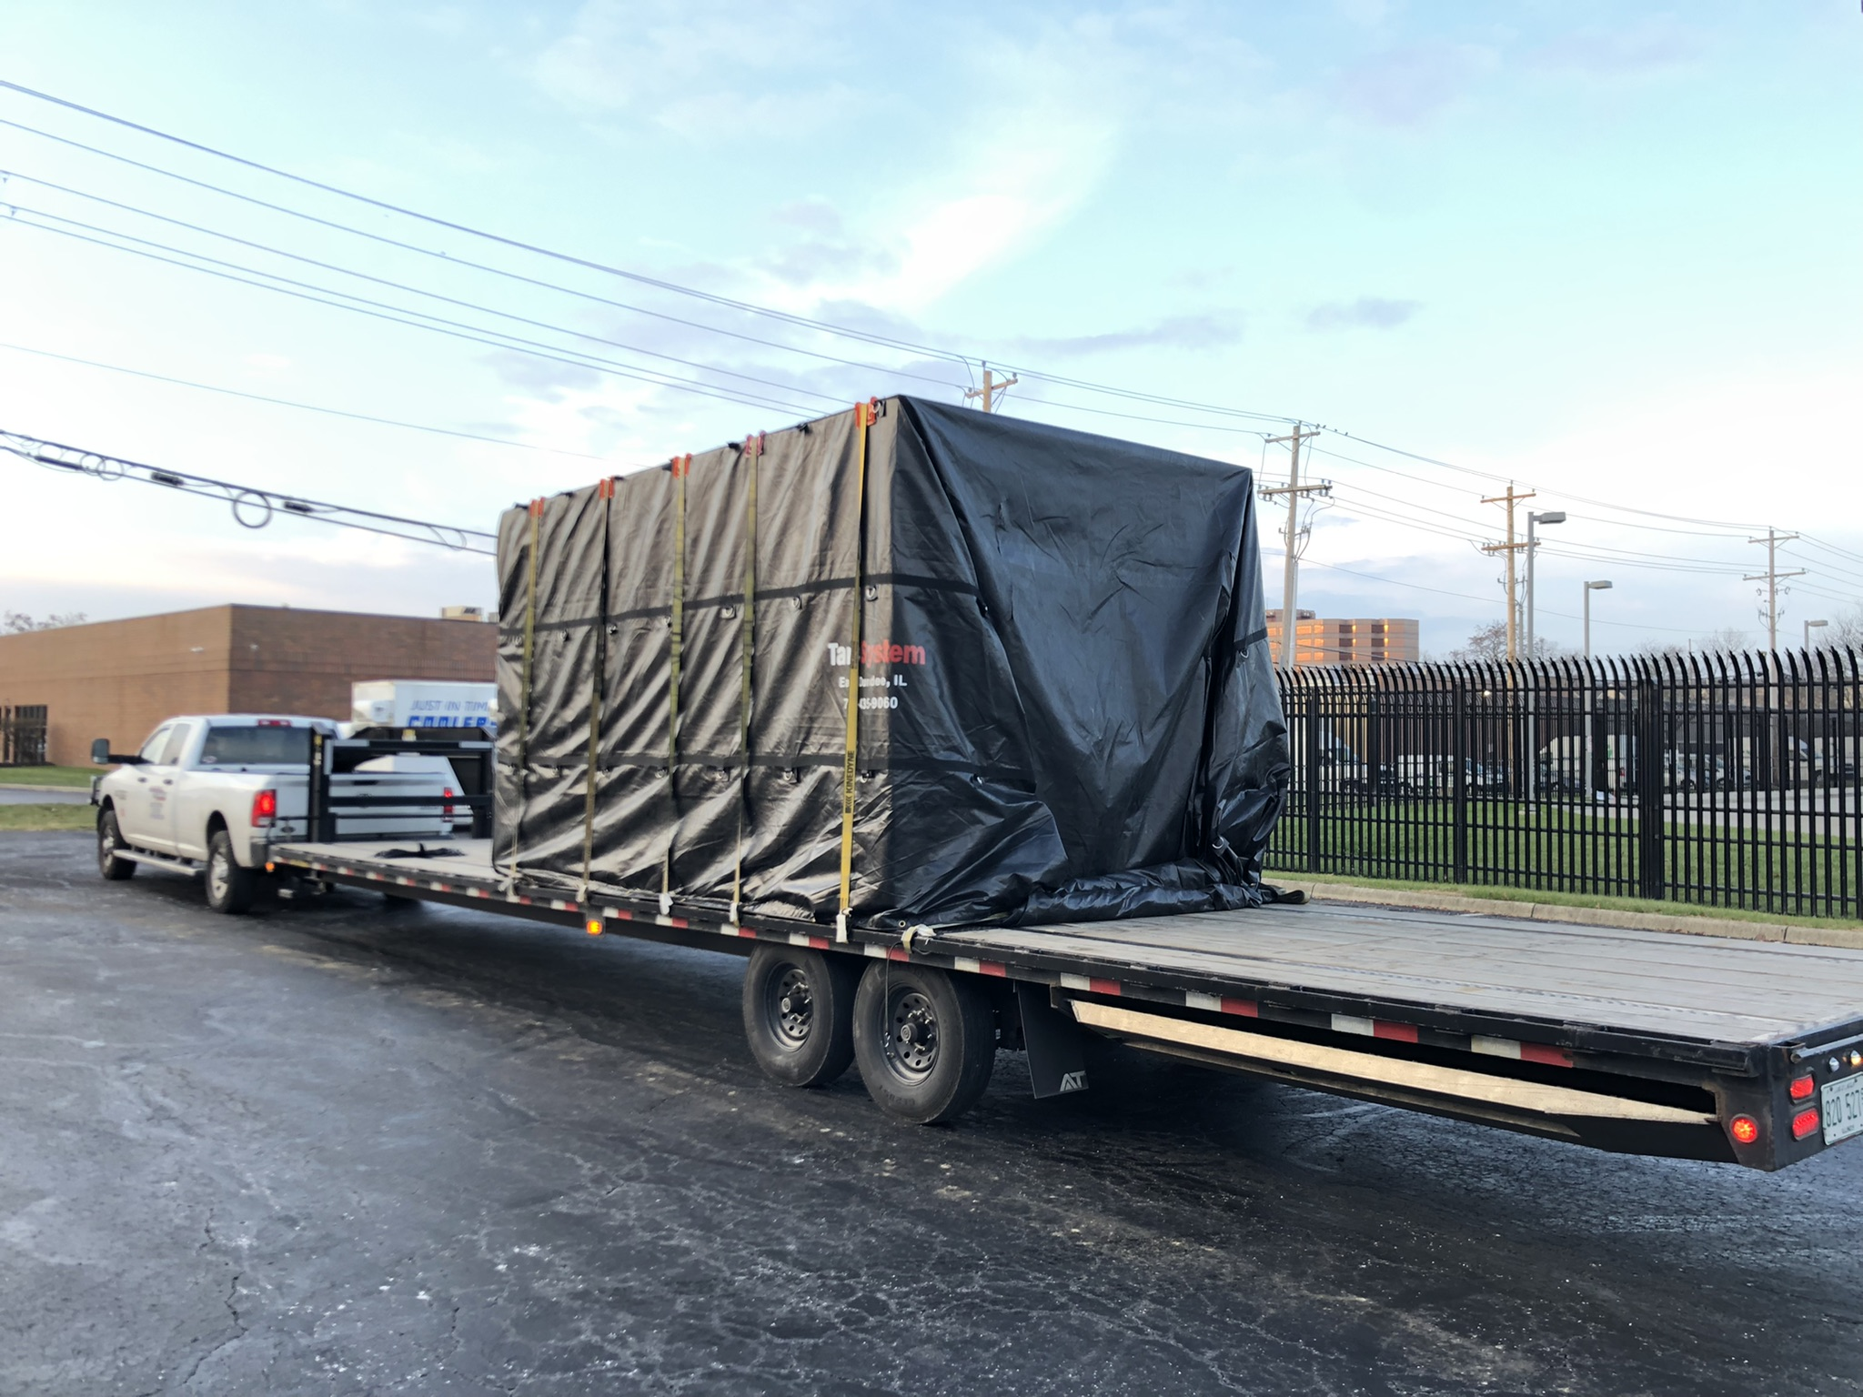

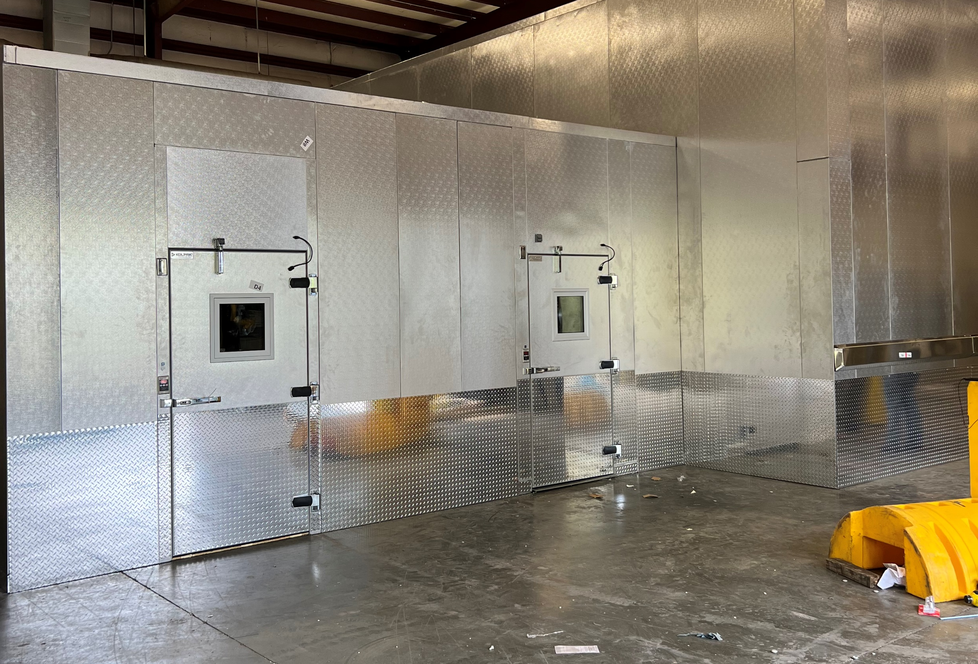





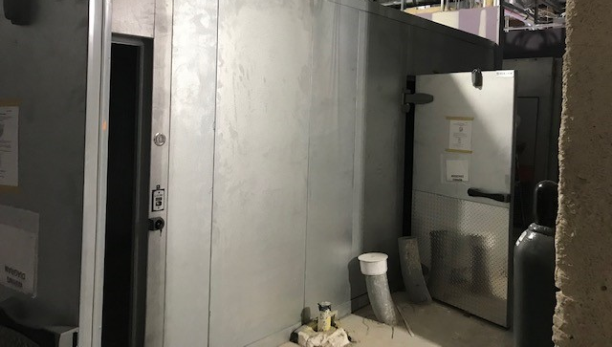
HEALTHCARE

Slide 19






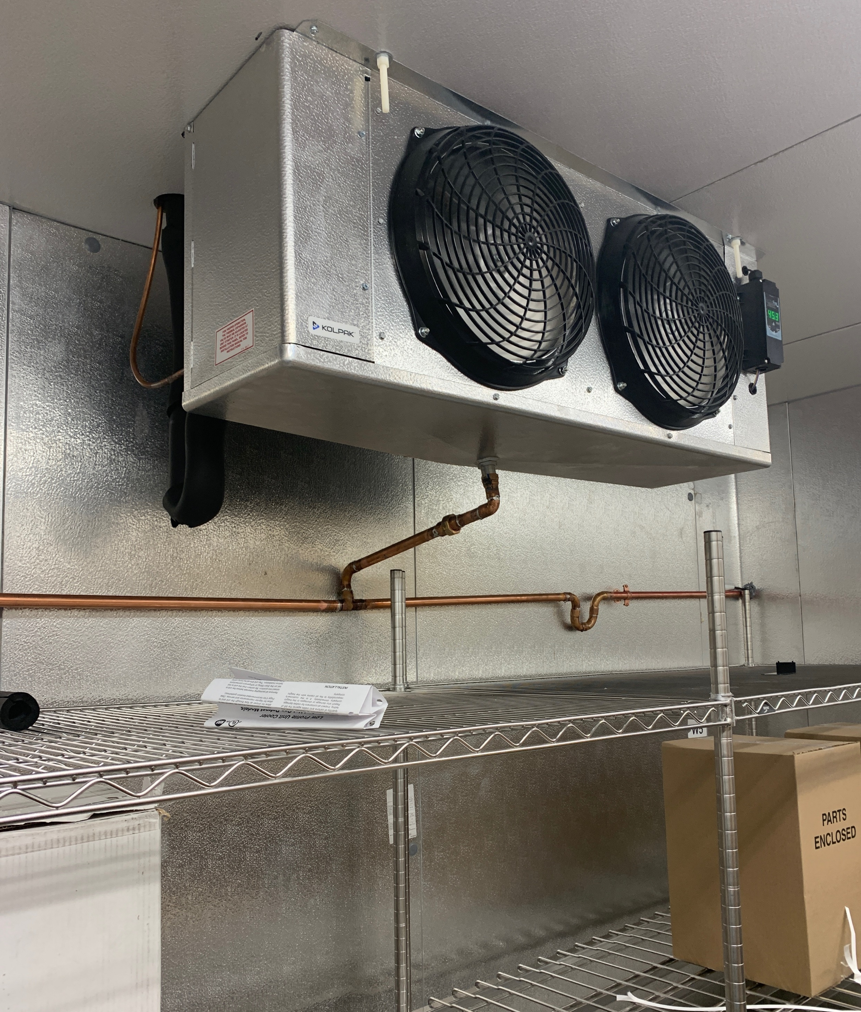

TRAVEL

Slide 20
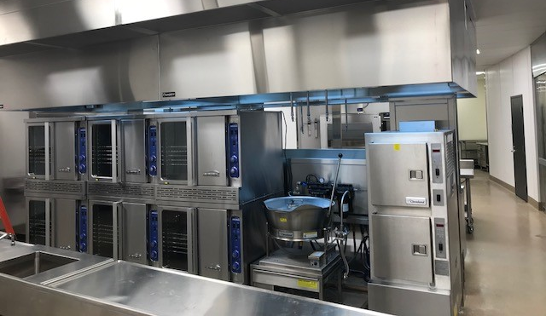



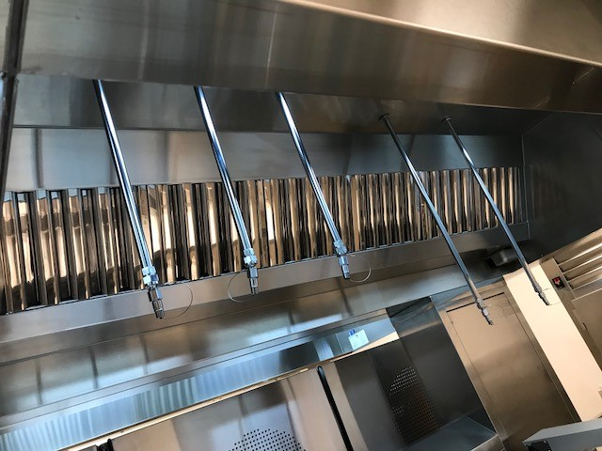






SPORTS VENUES

